Slide 1
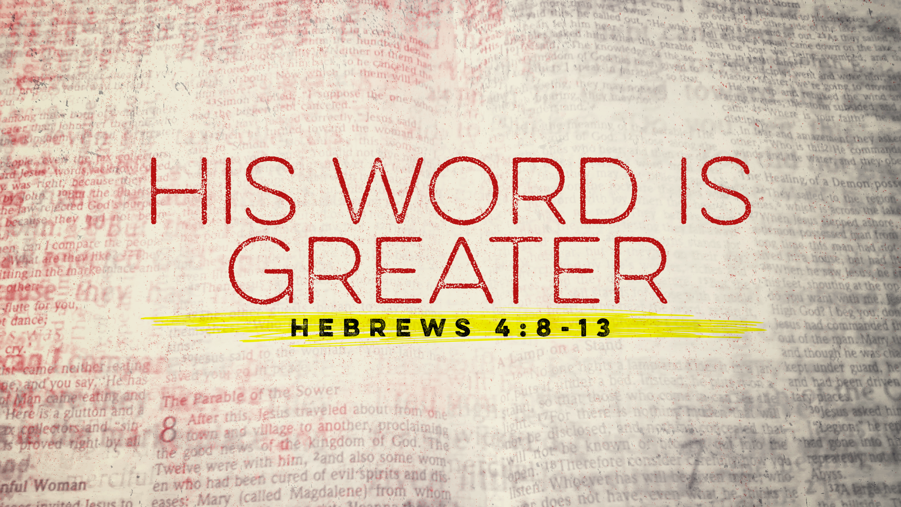

Slide 2
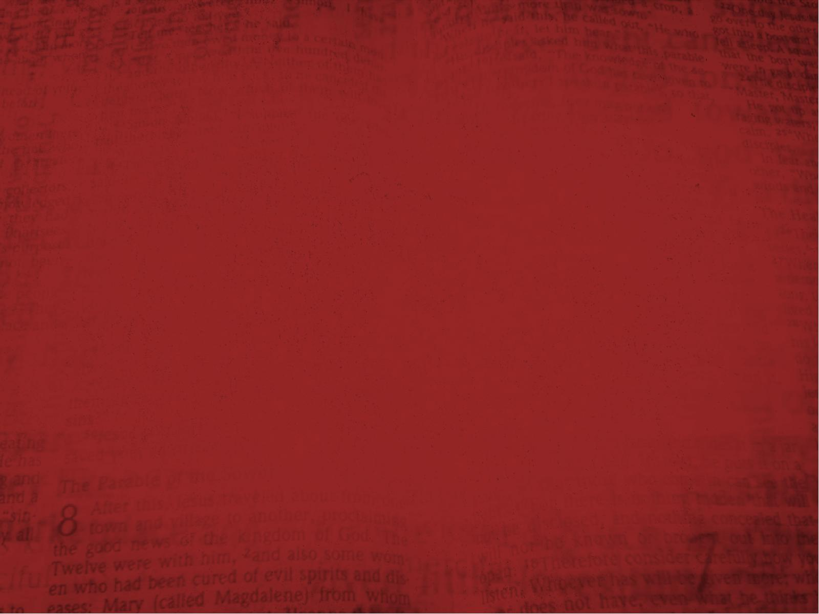
Hebrews 4:8
For if Joshua had given them rest, then He would not afterward have spoken of another day.

Slide 3
Hebrews 4:9
There remains therefore a rest for
the people of God.

Slide 4
Hebrews 4:10
For he who has entered His rest has himself also ceased from his works as God did from His.

Slide 5
Hebrews 4:11
Let us therefore be diligent to
enter that rest, lest anyone fall according to the same example of disobedience.

Slide 6
Hebrews 4:12
For the word of God is living and powerful, and sharper than any
two-edged sword, piercing even to the division of soul and spirit, and of joints and marrow, and is a discerner of the thoughts and intents of the heart.

Slide 7
Hebrews 4:13
And there is no creature hidden from His sight, but all things are naked and open to the eyes of Him
to whom we must give account.

Slide 8
Hebrews 4:8
For if Joshua had given them rest, then He would not afterward have spoken of another day.

Slide 9
Hebrews 4:9
There remains therefore a rest for
the people of God.

Slide 10
Hebrews 4:10
For he who has entered His rest has himself also ceased from his works as God did from His.

Slide 11
Hebrews 4:11
Let us therefore be diligent to
enter that rest, lest anyone fall according to the same example of disobedience.

Slide 12
Hebrews 4:12
For the word of God is living and powerful, and sharper than any
two-edged sword, piercing even to the division of soul and spirit, and of joints and marrow, and is a discerner of the thoughts and intents of the heart.

Slide 13
Hebrews 4:13
And there is no creature hidden from His sight, but all things are naked and open to the eyes of Him
to whom we must give account.

