Slide 1
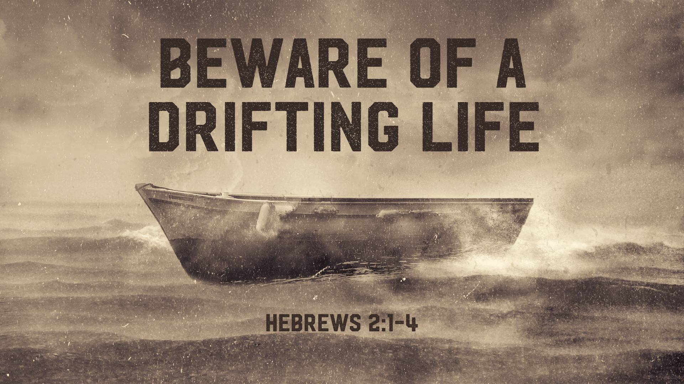

Slide 2

Hebrews 2:1
Therefore we must give the more earnest heed to the things we have heard, lest we drift away.

Slide 3
Hebrews 2:2
For if the word spoken through angels proved steadfast, and every transgression and disobedience received a just reward,

Slide 4
Hebrews 2:3
how shall we escape if we neglect so great a salvation, which at the first began to be spoken by the Lord, and was confirmed to us by those who heard Him,

Slide 5
Hebrews 2:4
God also bearing witness both with signs and wonders,
with various miracles, and gifts of the Holy Spirit, according to His own will?

Slide 6
Do not DRIFT from the Word of God.

Slide 7
Do not DOUBT the
Word of God.

Slide 8
Do not lose ZEAL for the Word of God.

Slide 9
Do not DESPISE the
Word of God.

Slide 10
Do not DISOBEY the
Word of God.

Slide 11
Jeremiah 15:6
You have forsaken Me,” says the Lord, “You have gone backward. Therefore I will stretch out My hand against you and destroy you; I am weary of relenting!

Slide 12
Joshua 1:8
This Book of the Law shall not depart from your mouth, but you shall meditate in it day and night, that you may observe to do according to all that is written in it. For then you will make your way prosperous, and then you will have good success.

