Slide 1
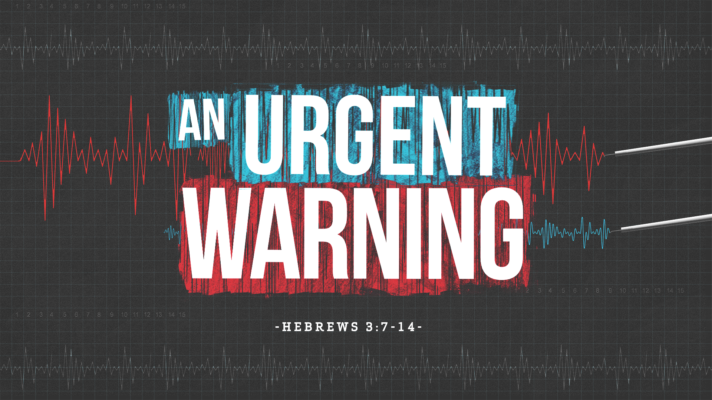

Slide 2

Hebrews 3:7
Therefore, as the Holy Spirit says: “Today, if you will hear His voice,

Slide 3
Hebrews 3:8
Do not harden your hearts as in the rebellion, in the day of trial in the wilderness,

Slide 4
Hebrews 3:9
Where your fathers tested Me, tried Me, and saw My works forty years.

Slide 5
Hebrews 3:10
Therefore I was angry with that generation, and said, ‘They always go astray in their heart, and they have not known My ways.’

Slide 6
Hebrews 3:11
So I swore in My wrath, ‘They shall not enter My rest.’ ”

Slide 7
Hebrews 3:12
Beware, brethren, lest there be in any of you an evil heart of unbelief in departing from the living God;

Slide 8
Hebrews 3:13
but exhort one another daily, while it is called “Today,” lest any of you be hardened through the deceitfulness of sin.

Slide 9
Hebrews 3:14
For we have become partakers of Christ if we hold the beginning of our confidence steadfast to the end,

Slide 10
Psalm 95:7
For He is our God, and we are the people of His pasture, and the sheep of His hand. Today, if you will hear His voice:

Slide 11
Psalm 95:8
“Do not harden your hearts, as in the rebellion, as in the day of trial in the wilderness,

Slide 12
Psalm 95:9
When your fathers tested Me; They tried Me, though they saw My work.

Slide 13
Psalm 95:10
For forty years I was grieved with that generation, and said, ‘It is a people who go astray in their hearts, and they do not know My ways.’

Slide 14
Psalm 95:11
So I swore in My wrath, ‘They shall not enter My rest.’ ”

Slide 15
Hebrews 3:7
Therefore, as the Holy Spirit says: “Today, if you will hear His voice,

Slide 16
Hebrews 3:8
Do not harden your hearts as in the rebellion, in the day of trial in the wilderness,

Slide 17

To hear the voice of God
we must not
HARDEN OUR HEARTS.

Slide 18
Hebrews 3:8
Do not harden your hearts as in the rebellion, in the day of trial in the wilderness,

Slide 19
Hebrews 3:9
Where your fathers tested Me, tried Me, and saw My works forty years.

Slide 20
Instead of TESTING God
in difficult circumstances,
we are to TRUST God.

Slide 21
Hebrews 3:10
Therefore I was angry with that generation, and said, ‘They always go astray in their heart, and they have not known My ways.’

Slide 22
Our neglect of
EXPERIENCING God WEAKENS our faith in God
and OFFENDS God.

Slide 23
Hebrews 3:11
So I swore in My wrath, ‘They shall not enter My rest.’ ”

Slide 24
Evidence of genuine salvation
is when a person holds true
to their PROFESSION under great PERSECUTION.

Slide 25
Hebrews 3:12
Beware, brethren, lest there be in any of you an evil heart of unbelief in departing from the living God;

Slide 26
A Christian can have a heart
of UNBELIEF, but cannot
have an UNBELIEVING heart.

Slide 27
Hebrews 3:13
but exhort one another daily, while it is called “Today,” lest any of you be hardened through the deceitfulness of sin.

Slide 28
Hebrews 3:14
For we have become partakers of Christ if we hold the beginning of our confidence steadfast to the end,

Slide 29
We should be urgently
calling and begging those LOOKING AT JESUS.

Slide 30
Real or true faith will be
an ENDURING faith.

