Slide 2
Hebrews 1:1
God, who at various times and in various ways spoke in time past to the fathers by the prophets,

Slide 3
Hebrews 1:2
has in these last days spoken to us by His Son, whom He has appointed heir of all things, through whom also He made the worlds;

Slide 4
Hebrews 1:3
who being the brightness of His glory and the express image of His person, and upholding all things by the word of His power, when He had by Himself purged our sins, sat down at the right hand of the Majesty on high,

Slide 5
Hebrews 1:4
having become so much better than the angels, as He has by inheritance obtained a more excellent name than they.

Slide 6
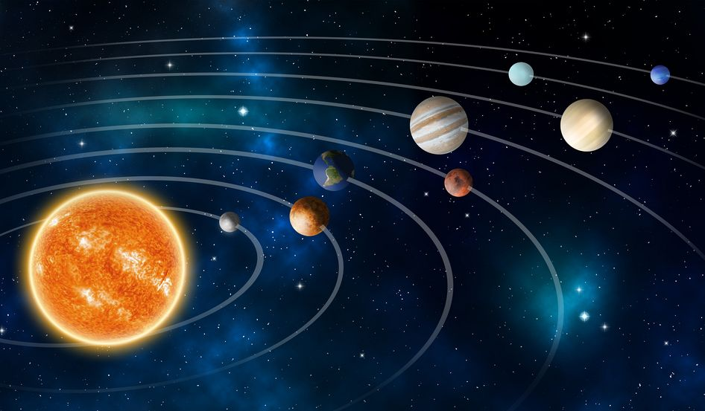
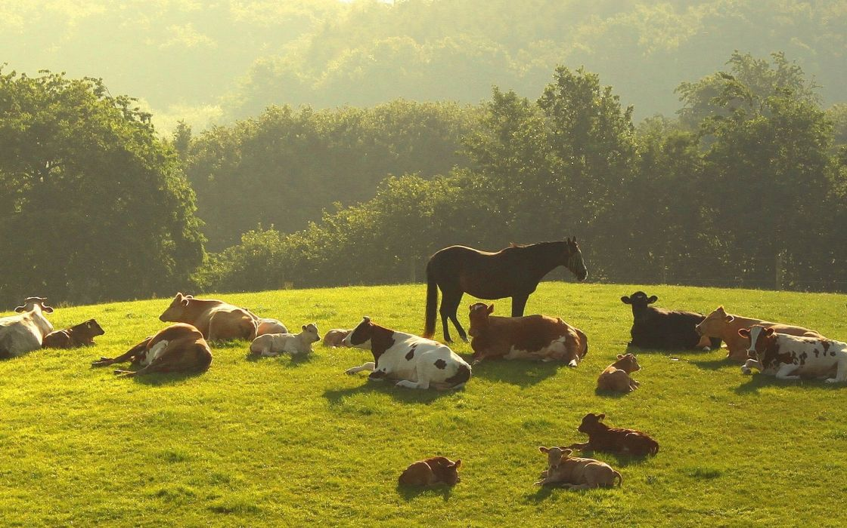

Slide 7
Hebrews 1:1
God, who at various times and in various ways…

Slide 9
1 Corinthians 13:12
For now we see in a mirror, dimly, but then face to face. Now I know in part, but then I shall know just as I also am known.

Slide 10
Hebrews 1:1
…spoke in time past to the fathers by the prophets,

Slide 11
Hebrews 1:2
has in these last days spoken to us by His Son,…

Slide 12
John 5:46
For if you believed Moses,
you would believe Me; for he
wrote about Me.

Slide 13
Hebrews 1:2
has in these last days…

Slide 14
Hebrews 1:2
…spoken to us by His Son, whom He has appointed heir of all things, through whom also He made the worlds;

Slide 16
John 1:1
In the beginning was the Word, and the Word was with God,
and the Word was God.

Slide 17
John 1:2
He was in the beginning with God.

Slide 18
John 1:3
All things were made through Him, and without Him nothing was made that was made.

Slide 19
Hebrews 1:3
who being the brightness of
His glory and the express image
of His person,…

Slide 20
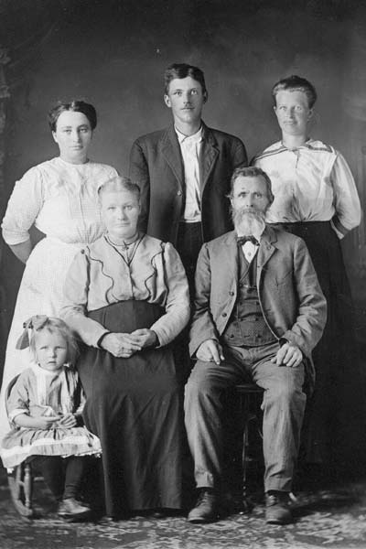

Slide 21
Hebrews 1:3
…and upholding all things by the word of His power,...

Slide 22
Colossians 1:16
For by Him all things were created that are in heaven and that are on earth, visible and invisible, whether thrones or dominions or principalities or powers. All things were created through Him and for Him.

Slide 23
Colossians 1:17
And He is before all things,
and in Him all things consist.

Slide 24
Hebrews 1:3
…when He had by Himself
purged our sins,…

Slide 25
Ephesians 2:13
But now in Christ Jesus you who once were far off have been brought near by the blood of Christ.

Slide 26
Hebrews 1:3
…sat down at the right hand of the Majesty on high,

Slide 27
Colossians 3:1
If then you were raised with Christ, seek those things which are above, where Christ is, sitting at the right hand of God.

Slide 28
Jesus is greater than the PROPHETS.

Slide 29
Jesus is greater than RELIGION.

Slide 30
Jesus’ work is
COMPLETED.

