Slide 1
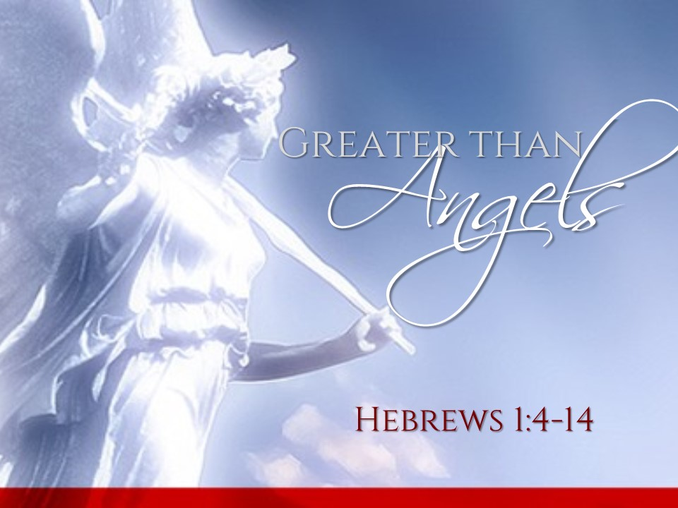

Slide 2
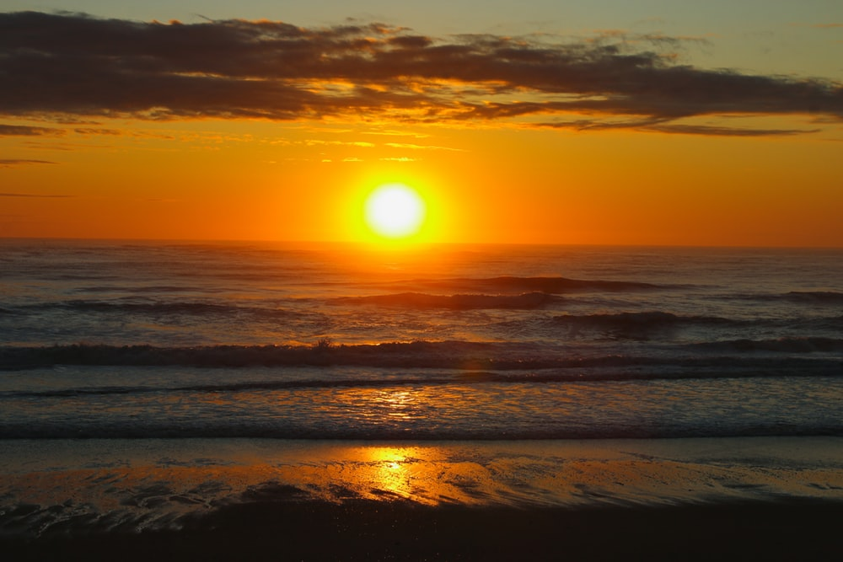

Slide 3

Galatians 3:19
What purpose then does the law serve? It was added because of transgressions, till the Seed should come to whom the promise was made; and it was appointed through angels by the hand of a mediator.

Slide 4
Acts 7:53
who have received the law by the direction of angels and have not kept it.”

Slide 5
Deuteronomy 33:2
And he said: “The Lord came from Sinai, and dawned on them from Seir; He shone forth from Mount Paran, and He came with ten thousands of saints; From His right hand came a fiery law for them.

Slide 6
Hebrews 1:1
God, who at various times and in various ways spoke in time past to the fathers by the prophets,

Slide 7
Hebrews 1:2
has in these last days spoken to us by His Son, whom He has appointed heir of all things, through whom also He made the worlds;

Slide 8
Hebrews 1:3
who being the brightness of His glory and the express image of His person, and upholding all things by the word of His power, when He had by Himself purged our sins,
sat down at the right hand of the Majesty on high,

Slide 9
Hebrews 1:4
having become so much better than the angels, as He has by inheritance obtained a more excellent name than they.

Slide 10
Hebrews 1:5
For to which of the angels did He ever say: “You are My Son, Today
I have begotten You”? And again:
“I will be to Him a Father, and He shall be to Me a Son”?

Slide 11
Hebrews 1:6
But when He again brings the firstborn into the world, He says: “Let all the angels of God worship Him.”

Slide 12
Hebrews 1:7
And of the angels He says:
“Who makes His angels spirits and His ministers a flame of fire.”

Slide 13
Hebrews 1:8
But to the Son He says:
“Your throne, O God, is forever and ever; A scepter of righteousness
is the scepter of Your kingdom.

Slide 14
Hebrews 1:9
You have loved righteousness and hated lawlessness; Therefore God, Your God, has anointed You with the oil of gladness more than Your companions.”

Slide 15
Hebrews 1:10
And: “You, Lord, in the beginning laid the foundation of the earth,
and the heavens are the work of Your hands.

Slide 16
Hebrews 1:11
They will perish, but You remain; And they will all grow old like a garment;

Slide 17
Hebrews 1:12
Like a cloak You will fold them up, and they will be changed. But You are the same, and Your years will not fail.”

Slide 18
Hebrews 1:13
But to which of the angels has He ever said: “Sit at My right hand,
till I make Your enemies Your footstool”?

Slide 19
Hebrews 1:14
Are they not all ministering spirits sent forth to minister for those who will inherit salvation?

Slide 20
Hebrews 1:4
having become so much better than the angels, as He has by inheritance obtained a more excellent name than they.

Slide 21
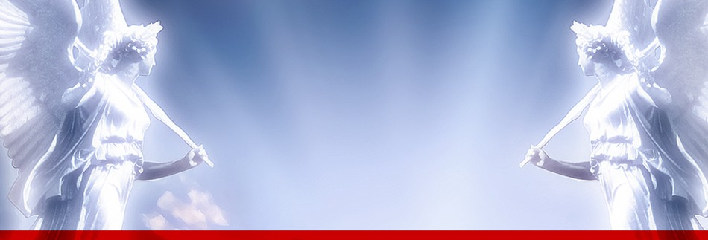
Jesus has a greater INHERITANCE, and a greater NAME than the angels.

Slide 22
Hebrews 1:5
For to which of the angels did He ever say: “You are My Son, Today
I have begotten You”? And again:
“I will be to Him a Father, and He shall be to Me a Son”?

Slide 23
Jesus has a greater RANK than any angel.

Slide 24
Hebrews 1:6
But when He again brings the firstborn into the world, He says: “Let all the angels of God worship Him.”

Slide 25
Jesus is greater than angels because of His HUMANITY
and His RESURRECTION from the dead.

Slide 26
Hebrews 1:7
And of the angels He says:
“Who makes His angels spirits and His ministers a flame of fire.”

Slide 27
Hebrews 1:8
But to the Son He says: “Your throne, O God, is forever and ever; A scepter of righteousness is the scepter of Your kingdom.

Slide 28
Jesus is greater because He is the ETERNAL KING.

Slide 29
Hebrews 1:9
You have loved righteousness and hated lawlessness; Therefore God, Your God, has anointed You with the oil of gladness more than Your companions.”

Slide 30
Jesus is greater than the angels because He is ANOINTED and RIGHTEOUS.

Slide 31
Hebrews 1:10
And: “You, Lord, in the beginning laid the foundation of the earth,
and the heavens are the work of Your hands.

Slide 32
Jesus is greater than the angels because He is the CREATOR of all things.

Slide 33
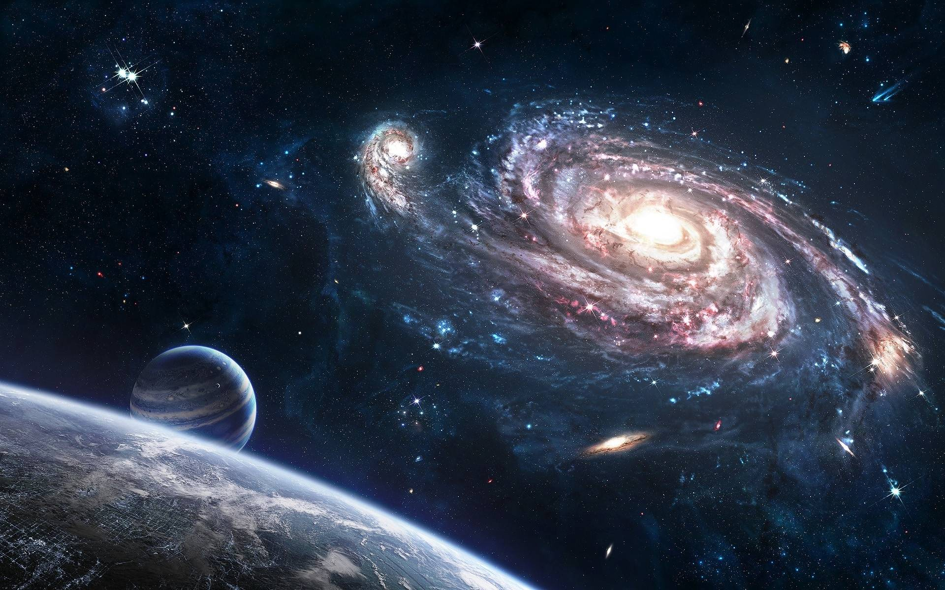

Slide 34
Hebrews 1:11
They will perish, but You remain; And they will all grow old like a garment;

Slide 35
Hebrews 1:12
Like a cloak You will fold them up, And they will be changed. But You are the same, and Your years will not fail.”

Slide 36
Jesus is greater than the angels because He does not CHANGE WITH TIME.

Slide 37
Hebrews 1:13
But to which of the angels has He ever said: “Sit at My right hand,
till I make Your enemies Your footstool”?

Slide 38
Jesus is greater in AUTHORITY.

Slide 39
Hebrews 1:14
Are they not all ministering spirits sent forth to minister for those who will inherit salvation?

Slide 40
Jesus is greater because angels are His SERVANTS.

