Slide 1
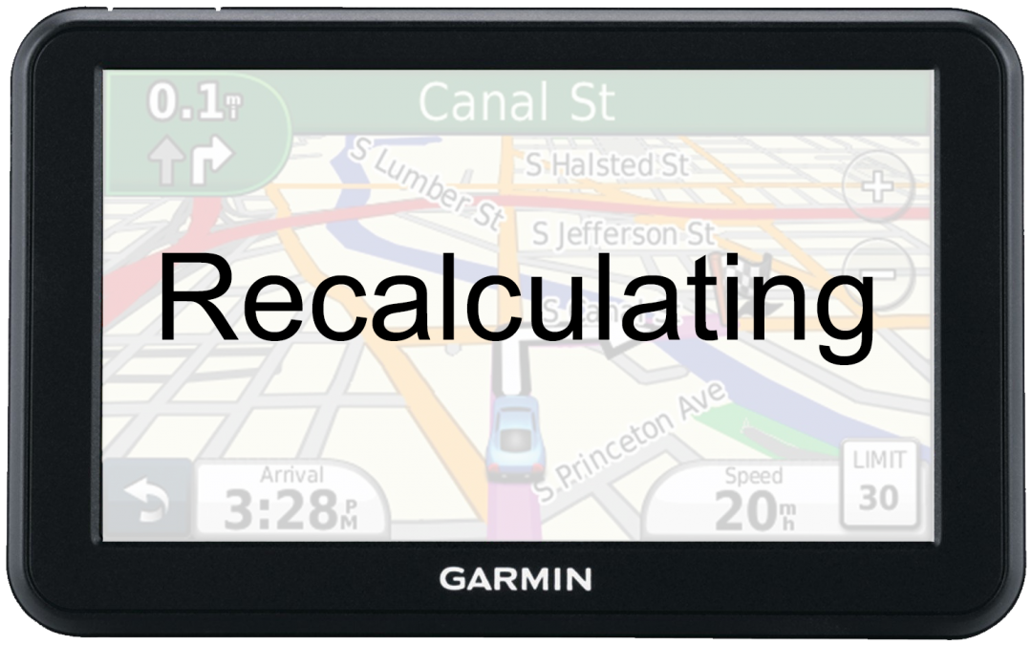
Psalm 81:10-14

Slide 2
Psalm 81:10
I am the Lord your God, who brought you out of the land of Egypt; Open your mouth wide, and I will fill it.

Slide 3
Psalm 81:11
“But My people would not heed My voice, and Israel would have none of Me.

Slide 4
Psalm 81:12
So I gave them over to their own stubborn heart, to walk in their own counsels.

Slide 5
Psalm 81:13
“Oh, that My people would listen to Me, that Israel would walk in My ways!

Slide 6
Psalm 81:14
I would soon subdue their enemies, and turn My hand against their adversaries.

Slide 7
Hebrews 3:7
Therefore, as the
Holy Spirit says: “Today, if you will hear His voice,

Slide 8
Hebrews 3:8
Do not harden your hearts as in the rebellion, in the day of trial in the wilderness,

Slide 9
Hebrews 3:9
Where your fathers tested Me, tried Me, and saw My works forty years.

Slide 10
Hebrews 3:10
Therefore I was angry with that generation, and said, ‘They always go astray in their heart, and they have not known My ways.’

Slide 11
Hebrews 3:11
So I swore in My wrath, ‘They shall not enter
My rest.’ ”

Slide 12
Hebrews 3:12
Beware, brethren, lest
there be in any of you an
evil heart of unbelief in departing from the living God;

Slide 13
Hebrews 3:13
but exhort one another daily, while it is called “Today,”
lest any of you be hardened through the deceitfulness
of sin.

Slide 14
Hebrews 3:14
For we have become partakers of Christ if we
hold the beginning of our confidence steadfast to the end,

Slide 15
Hebrews 3:15
while it is said: “Today, if you will hear His voice, do not harden your hearts as in the rebellion.”

Slide 16
Hebrews 3:16
For who, having heard, rebelled? Indeed, was it not all who came out of Egypt, led by Moses?

Slide 17
Hebrews 3:17
Now with whom was He angry forty years? Was it
not with those who sinned, whose corpses fell in the wilderness?

Slide 18
Hebrews 3:18
And to whom did He swear that they would not enter
His rest, but to those who did not obey?

Slide 19
Hebrews 3:19
So we see that they could not enter in because of unbelief.

Slide 20
Psalm 81:10-14

