Slide 2
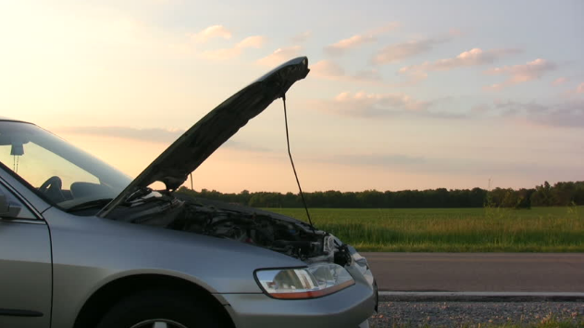

Slide 3
Exodus 4:10
Then Moses said to the Lord, “O my Lord,
I am not eloquent, neither before nor since
You have spoken to Your servant; but I am
slow of speech and slow of tongue.”

Slide 4
Exodus 4:11
So the Lord said to him,
“Who has made man’s mouth? Or who makes the mute, the deaf, the seeing,
or the blind? Have not I, the Lord?

Slide 5
Exodus 4:12
Now therefore, go, and I will be with your mouth and teach you what you shall say.”

Slide 6
Exodus 4:13
But he said, “O my Lord, please send by the hand of whomever else You may send.”

Slide 7
Exodus 4:14
So the anger of the Lord was kindled against Moses, and He said: “Is not Aaron the Levite your brother? I know that he can speak well. And look, he is also coming out to meet you. When he sees you, he will be glad in his heart.

Slide 8
Exodus 4:15
Now you shall speak to him and put the words in his mouth. And I will be with your mouth and with his mouth, and I will teach you what you shall do.

Slide 9
Exodus 4:16
So he shall be your spokesman to the people. And he himself shall be as a mouth for you, and you shall be to him as God.

Slide 10
Exodus 4:17
And you shall take this rod in your hand, with which you shall do the signs.”

Slide 11
2 Chronicles 16:9
For the eyes of the Lord run to and fro throughout the whole earth, to show Himself strong on behalf of those whose heart is loyal to Him. In this you have done foolishly; therefore from now on you shall have wars.”

Slide 12
Psalm 20:7
Some trust in chariots, and some in horses; But we will remember the name of the Lord our God.

Slide 13
Your greatest
ABILITY is your AVAILABILITY.

