Slide 1
Holding the
Map Correctly
Various Scriptures

Slide 2
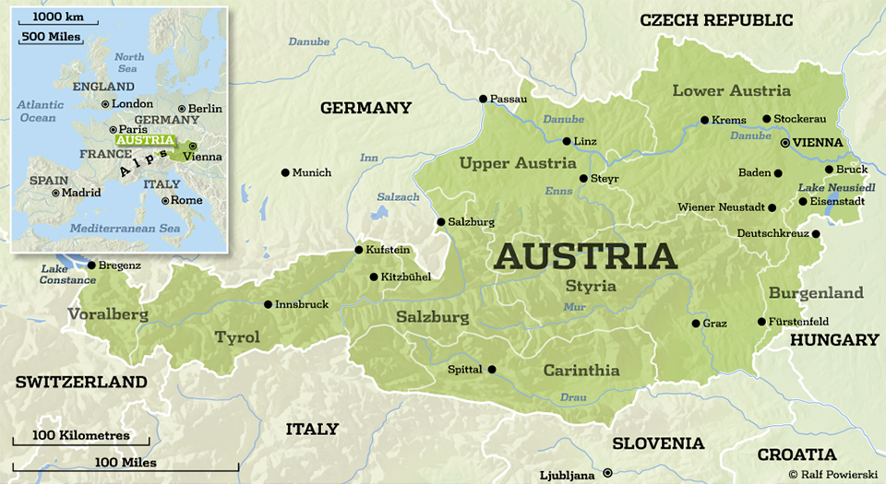

Slide 3
Romans 1:18
For the wrath of God is revealed
from heaven against all ungodliness and unrighteousness of men, who suppress the truth
in unrighteousness,

Slide 4
Romans 1:19
because what may be known of God is manifest in them, for God has shown it to them.

Slide 5
Romans 1:20
For since the creation of the world
His invisible attributes are clearly seen, being understood by the
things that are made, even His
eternal power and Godhead,
so that they are without excuse,

Slide 6
Romans 1:21
because, although they knew God, they did not glorify Him as God,
nor were thankful, but became futile in their thoughts, and their foolish hearts were darkened.

Slide 7
Romans 1:22
Professing to be wise,
they became fools,

Slide 8
Romans 1:23
and changed the glory of the incorruptible God into an image
made like corruptible man—
and birds and four-footed animals
and creeping things.

Slide 9
Romans 1:24
Therefore God also gave them up
to uncleanness, in the lusts of their hearts, to dishonor their bodies among themselves,

Slide 10
Matthew 4:18
And Jesus, walking by the Sea of Galilee, saw two brothers, Simon called Peter, and Andrew his
brother, casting a net into the sea; for they were fishermen.

Slide 11
Matthew 4:19
Then He said to them, “Follow Me, and I will make you fishers of men.”

Slide 12
Matthew 4:20
They immediately left their nets and followed Him.

Slide 13
Matthew 4:21
Going on from there, He saw two other brothers, James the son of Zebedee, and John his brother,
in the boat with Zebedee their father, mending their nets.
He called them,

Slide 14
Matthew 4:22
and immediately they left the boat and their father, and followed Him.

Slide 15
Matthew 9:9
As Jesus passed on from there,
He saw a man named Matthew sitting at the tax office. And He
said to him, “Follow Me.” So he arose and followed Him.

Slide 16
2 Timothy 3:16
All Scripture is given by inspiration of God, and is profitable for doctrine, for reproof, for correction, for instruction in righteousness,

Slide 17
2 Timothy 3:17
that the man of God may be complete, thoroughly equipped for every good work.

Slide 18
2 Peter 1:19
And so we have the prophetic
word confirmed, which you do well to heed as a light that shines in
a dark place, until the day dawns
and the morning star rises in
your hearts;

Slide 19
2 Peter 1:20
knowing this first, that no prophecy of Scripture is of any private interpretation,

Slide 20
2 Peter 1:21
for prophecy never came by the will of man, but holy men of God spoke as they were moved by
the Holy Spirit.

Slide 21
Hebrews 4:12
For the word of God is living and powerful, and sharper than any two-edged sword, piercing even to the division of soul and spirit, and of joints and marrow, and is a discerner of the thoughts and intents of the heart.

Slide 22
Psalm 119:9
How can a young man cleanse
his way? By taking heed according to Your word.

Slide 23
Psalm 119:10
With my whole heart I have sought You; Oh, let me not wander from Your commandments!

Slide 24
Psalm 119:11
Your word I have hidden in
my heart, that I might not sin against You.

Slide 25
Psalm 119:105
Your word is a lamp to my feet
and a light to my path.

Slide 26
Always remember the Bible
is the FINAL AUTHORITY
for every believer.

Slide 27
EXPERIENCE must always
be tested by Scripture.

Slide 28
Experience can give a DISTORTED view of God.

Slide 29
Holding the
Map Correctly
Various Scriptures

