Slide 1


Slide 2
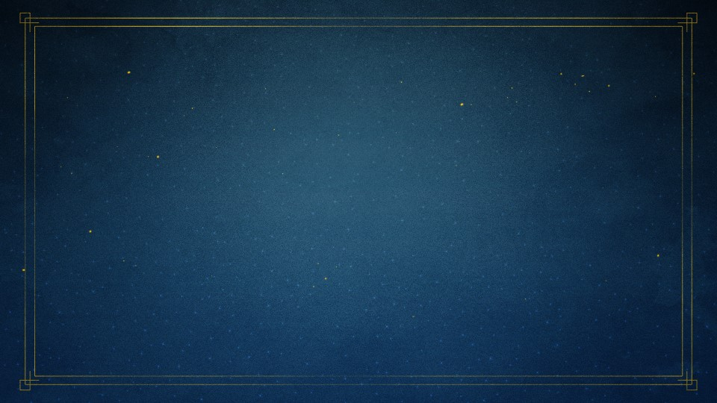
Matthew 18:21
Then Peter came to Him and said, “Lord, how often shall my brother
sin against me, and I forgive him?
Up to seven times?”

Slide 3
Matthew 18:22
Jesus said to him, “I do not say to you, up to seven times, but up to seventy times seven.

Slide 4
Matthew 18:23
Therefore the kingdom of heaven is like a certain king who wanted to settle accounts with his servants.

Slide 5
Matthew 18:24
And when he had begun to settle accounts, one was brought to him who owed him ten thousand talents.

Slide 6
Matthew 18:25
But as he was not able to pay, his master commanded that he be sold, with his wife and children and all that he had, and that payment be made.

Slide 7
Matthew 18:26
The servant therefore fell down before him, saying, ‘Master, have patience with me, and I will pay
you all.’

Slide 8
Matthew 18:27
Then the master of that servant was moved with compassion, released him, and forgave him the debt.

Slide 9
Matthew 18:28
“But that servant went out and found one of his fellow servants who owed him a hundred denarii; and he laid hands on him and took him by the throat, saying, ‘Pay me what
you owe!’

Slide 10
Matthew 18:29
So his fellow servant fell down at
his feet and begged him, saying,
‘Have patience with me,
and I will pay you all.’

Slide 11
Matthew 18:30
And he would not, but went and threw him into prison till he should pay the debt.

Slide 12
Matthew 18:31
So when his fellow servants saw what had been done, they were very grieved, and came and told their master all that had been done.

Slide 13
Matthew 18:32
Then his master, after he had called him, said to him, ‘You wicked servant! I forgave you all that debt because you begged me.

Slide 14
Matthew 18:33
Should you not also have had compassion on your fellow servant, just as I had pity on you?’

Slide 15
Matthew 18:34
And his master was angry, and delivered him to the torturers until he should pay all that was due to him.

Slide 16
Matthew 18:35
“So My heavenly Father also will do to you if each of you, from his heart, does not forgive his brother his trespasses.”

Slide 17
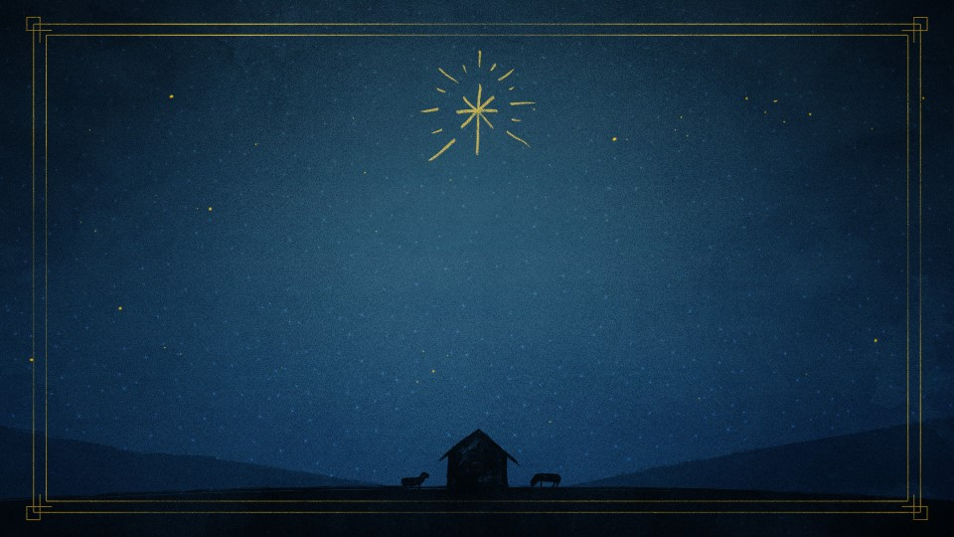
It is beyond our
ABILITY to repay.

Slide 18
It is greater than any OFFENSE we have suffered.

Slide 19
Without seeing ourselves as HELPLESS sinners:

Slide 20
We cannot APPRECIATE God’s grace.

Slide 21
We cannot truly FORGIVE others as we should.

Slide 22
It creates expressions of WONDER and PRAISE.

Slide 23
God has seen us at
our WORST and STILL loves us.

Slide 24
God knows everything
we have ever THOUGHT
or DONE.

Slide 25
There are no SKELETONS in the closet.

Slide 26
God’s love cannot be EARNED and therefore cannot be LOST.

Slide 27
Christ removes my CONDEMNATION.

Slide 28
Christ considers me INNOCENT.

Slide 29
Christ declares me RIGHTEOUS.

Slide 30
2 Corinthians 5:21
For He made Him who knew no sin
to be sin for us, that we might become the righteousness of God
in Him.

Slide 31
1 John 2:2
And He Himself is the propitiation for our sins, and not for ours only but also for the whole world.

Slide 32
1 John 4:10
In this is love, not that we loved God, but that He loved us and sent His Son to be the propitiation for our sins.

