Slide 2
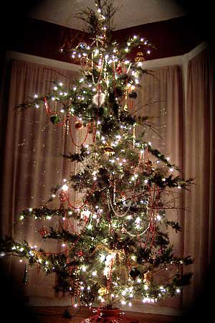

Slide 3
Matthew 1:1
The book of the genealogy of
Jesus Christ, the Son of David,
the Son of Abraham:

Slide 4
Matthew 1:2a
Abraham begot Isaac,…

Slide 5
Genesis 17:16
And I will bless her and also give you a son by her; then I will bless her, and she shall be a mother of nations; kings of peoples shall be from her.”

Slide 6
Genesis 17:17
Then Abraham fell on his face and laughed, and said in his heart,
“Shall a child be born to a man who
is one hundred years old? And shall Sarah, who is ninety years old,
bear a child?”

Slide 7
Genesis 17:18
And Abraham said to God, “Oh, that Ishmael might live before You!”

Slide 8
Genesis 17:19
Then God said: “No, Sarah your wife shall bear you a son, and you shall call his name Isaac; I will establish My covenant with him for an everlasting covenant, and with his descendants after him.

Slide 9
Genesis 17:20
And as for Ishmael, I have heard you. Behold, I have blessed him, and will make him fruitful, and will multiply him exceedingly. He shall beget twelve princes, and I will make him
a great nation.

Slide 10
Genesis 17:21
But My covenant I will establish with Isaac, whom Sarah shall bear to you at this set time next year.”

Slide 11
Genesis 18:10
And He said, “I will certainly return to you according to the time of life, and behold, Sarah your wife shall have a son.” (Sarah was listening in the tent door which was behind him.)

Slide 12
Genesis 18:11
Now Abraham and Sarah were old, well advanced in age; and Sarah had passed the age of childbearing.

Slide 13
Genesis 18:12
Therefore Sarah laughed within herself, saying, “After I have grown old, shall I have pleasure, my lord being old also?”

Slide 14
Genesis 18:13
And the Lord said to Abraham,
“Why did Sarah laugh, saying, ‘Shall I surely bear a child, since I am old?’

Slide 15
Genesis 18:14
Is anything too hard for the Lord?
At the appointed time I will return to you, according to the time of life, and Sarah shall have a son.”

Slide 16
Genesis 21:1
And the Lord visited Sarah as He had said, and the Lord did for Sarah as
He had spoken.

Slide 17
Genesis 21:2
For Sarah conceived and bore Abraham a son in his old age,
at the set time of which God had spoken to him.

Slide 18
Genesis 21:3
And Abraham called the name of his son who was born to him—whom Sarah bore to him—Isaac.

Slide 19
Galatians 4:22
For it is written that Abraham had two sons: the one by a bondwoman, the other by a freewoman.

Slide 20
Galatians 4:23
But he who was of the bondwoman was born according to the flesh,
and he of the freewoman through promise,

Slide 21
Galatians 4:24
which things are symbolic. For these are the two covenants: the one from Mount Sinai which gives birth to bondage, which is Hagar—

Slide 22
Galatians 4:28
Now we, brethren, as Isaac was,
are children of promise.

Slide 23
Hebrews 11:11
By faith Sarah herself also received strength to conceive seed, and she bore a child when she was past the age, because she judged Him faithful who had promised.

Slide 24
Hebrews 11:12
Therefore from one man, and him as good as dead, were born as many as the stars of the sky in multitude—innumerable as the sand which is
by the seashore.

Slide 25
Jesus’ family tree begins with a PROMISE from God.

Slide 26
Jesus’ family tree had
people of FAITH in it.

Slide 27
Jesus’ family tree shows God doing IMPOSSIBLE things.

Slide 28
Jesus’ family tree shows man cannot THWART God’s plan.

Slide 29
Jesus’ family tree shows God WILL DO what He promises.

