Slide 1


Slide 2
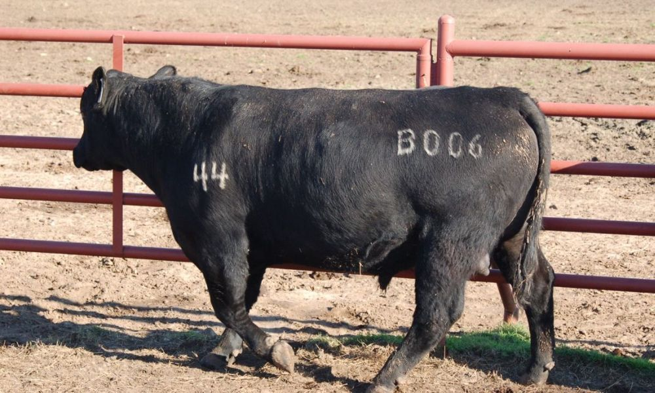

Slide 3

Galatians 6:15
For in Christ Jesus neither circumcision nor uncircumcision avails anything, but a new creation.

Slide 4
Galatians 6:16
And as many as walk according to this rule, peace and mercy be upon them, and upon the Israel
of God.

Slide 5
Galatians 6:17
From now on let no one trouble me, for I bear in my body the marks of the Lord Jesus.

Slide 6
Galatians 6:18
Brethren, the grace of our Lord Jesus Christ be with your spirit. Amen.

Slide 7
2 Corinthians 11:23
Are they ministers of Christ?—
I speak as a fool—I am more:
in labors more abundant,
in stripes above measure,
in prisons more frequently,
in deaths often.

Slide 8
2 Corinthians 11:24
From the Jews five times
I received forty stripes minus one.

Slide 9
2 Corinthians 11:25
Three times I was beaten with rods; once I was stoned;
three times I was shipwrecked; a night and a day I have been in the deep;

Slide 10
2 Corinthians 11:26
in journeys often, in perils of waters, in perils of robbers, in perils of my own countrymen, in perils of the Gentiles, in perils in the city, in perils in the wilderness, in perils in the sea, in perils among false brethren;

Slide 11
2 Corinthians 11:27
in weariness and toil,
in sleeplessness often, in hunger and thirst, in fastings often, in cold and nakedness—

Slide 12
2 Corinthians 11:28
besides the other things, what comes upon me daily: my deep concern for all the churches.

Slide 13
2 Corinthians 4:17
For our light affliction, which is but for a moment, is working for us a far more exceeding and eternal weight of glory,

Slide 14

Allow the HOLY SPIRIT to lead us in our walk.

Slide 15
Allow our MINDS
to be renewed.

Slide 16
Allow our AFFECTIONS to be under Spirit’s control.

Slide 17
Allow His WILL to be
our WILL.

Slide 18
Allow Him to be seen in our RELATIONSHIPS.

Slide 19
Allow Him to give
you a new REASON
for LIVING.

Slide 20
Galatians 6:17
From now on let no one trouble me, for I bear in my body the marks of the Lord Jesus.

