Slide 2
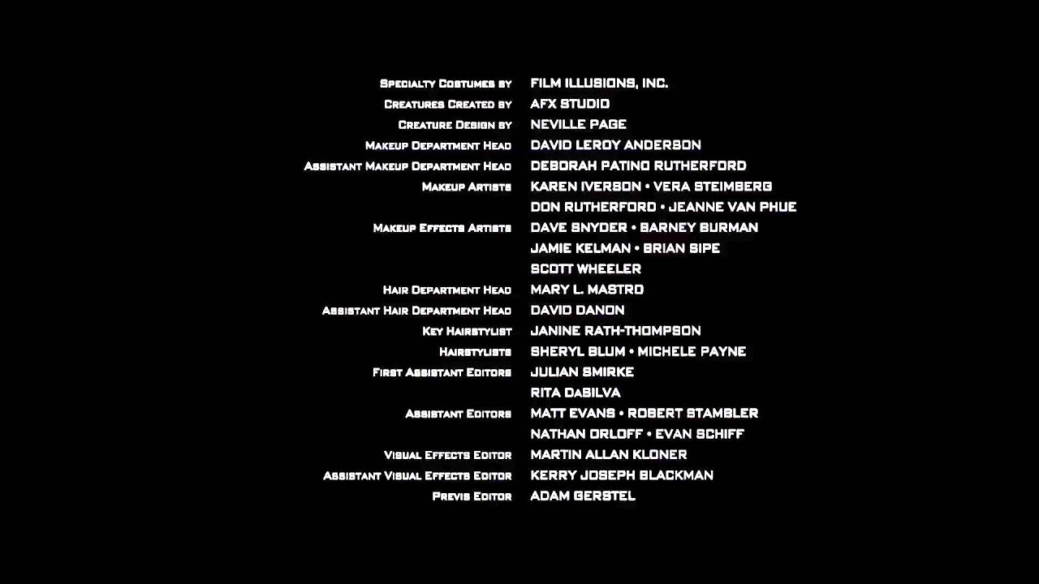

Slide 3
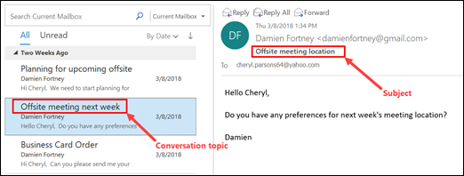

Slide 4
Galatians 6:11
See with what large letters
I have written to you with my own hand!

Slide 5
Galatians 6:12
As many as desire to make
a good showing in the flesh, these would compel you to be circumcised, only that they may not suffer persecution for the cross of Christ.

Slide 6
Galatians 6:13
For not even those who are circumcised keep the law,
but they desire to have you circumcised that they may boast in your flesh.

Slide 7
Galatians 6:14
But God forbid that I should boast except in the cross of our Lord Jesus Christ, by whom the world has been crucified to me, and I to the world.

Slide 8
Galatians 6:15
For in Christ Jesus neither circumcision nor uncircumcision avails anything, but a new creation.

Slide 9
Galatians 6:11
See with what large letters
I have written to you with my own hand!

Slide 10
Galatians 6:12
As many as desire to make
a good showing in the flesh, these would compel you to be circumcised, only that they may not suffer persecution for the cross of Christ.

Slide 11
Galatians 6:13
For not even those who are circumcised keep the law,
but they desire to have you circumcised that they may boast in your flesh.

Slide 12
Judaizers needed to be
LIKED by other people.

Slide 13
This core conviction
will NEVER make a difference for Jesus.

Slide 14
Galatians 6:14
But God forbid that I should boast except in the cross of our Lord Jesus Christ, by whom the world has been crucified to me, and I to the world.

Slide 15
Galatians 6:15
For in Christ Jesus neither circumcision nor uncircumcision avails anything, but a new creation.

Slide 16
1 Corinthians 1:18
For the message of the cross
is foolishness to those who
are perishing, but to us who
are being saved it is the
power of God.

Slide 17
“Jesus is all I NEED.”

Slide 18
“Don’t need to be a big PREACHER, you have a big MESSAGE.”

Slide 19
JESUS + NOTHING = EVERYTHING

