Slide 3
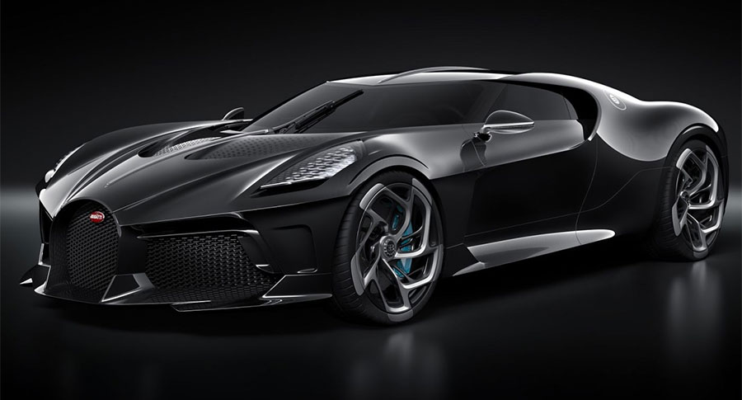

Slide 6
2 Corinthians 9:6
But this I say: He who sows sparingly will also reap sparingly, and he who sows bountifully will also reap bountifully.

Slide 7
2 Corinthians 9:7
So let each one give as he purposes in his heart,
not grudgingly or of necessity; for God loves a cheerful giver.

Slide 8
2 Corinthians 9:8
And God is able to make all grace abound toward you,
that you, always having all sufficiency in all things, may have an abundance
for every good work.

Slide 9
2 Corinthians 9:9
As it is written: “He has dispersed abroad, He has given to the poor; His righteousness endures forever.”

Slide 10
2 Corinthians 9:10
Now may He who supplies seed to the sower, and bread for food, supply and multiply the seed you have sown and increase the fruits of
your righteousness,

Slide 11
2 Corinthians 9:11
while you are enriched in everything for all liberality, which causes thanksgiving through us to God.

Slide 12
2 Corinthians 9:12
For the administration of this service not only supplies the needs of the saints, but also is abounding through many thanksgivings to God,

Slide 13
2 Corinthians 9:13
while, through the proof of this ministry, they glorify God for the obedience of your confession to the gospel of Christ, and for your
liberal sharing with
them and all men,

Slide 14
2 Corinthians 9:14
and by their prayer for you, who long for you because of the exceeding grace of God in you.

Slide 15
2 Corinthians 9:15
Thanks be to God for His indescribable gift!

Slide 16
2 Corinthians 8:9
For you know the grace of our Lord Jesus Christ, that though He was rich, yet for your sakes He became poor, that you through His poverty
might become rich.

Slide 17
Philippians 2:5
Let this mind be in you which was also in Christ Jesus,

Slide 18
Philippians 2:6
who, being in the form of God, did not consider it robbery to be equal with God,

Slide 19
Philippians 2:7
but made Himself of no reputation, taking the form of
a bondservant, and coming in the likeness of men.

Slide 20
Philippians 2:8
And being found in appearance as a man, He humbled Himself and became obedient to the point of death, even the death of the cross.

Slide 21
Philippians 2:9
Therefore God also has highly exalted Him and given Him
the name which is above
every name,

Slide 22
Philippians 2:10
that at the name of Jesus every knee should bow, of those in heaven, and of those on earth, and of those under the earth,

Slide 23
Philippians 2:11
and that every tongue
should confess that Jesus Christ is Lord, to the glory of
God the Father.

Slide 24
Acts 4:12
Nor is there salvation in any other, for there is no other name under heaven given among men by which we
must be saved.”

