Slide 3
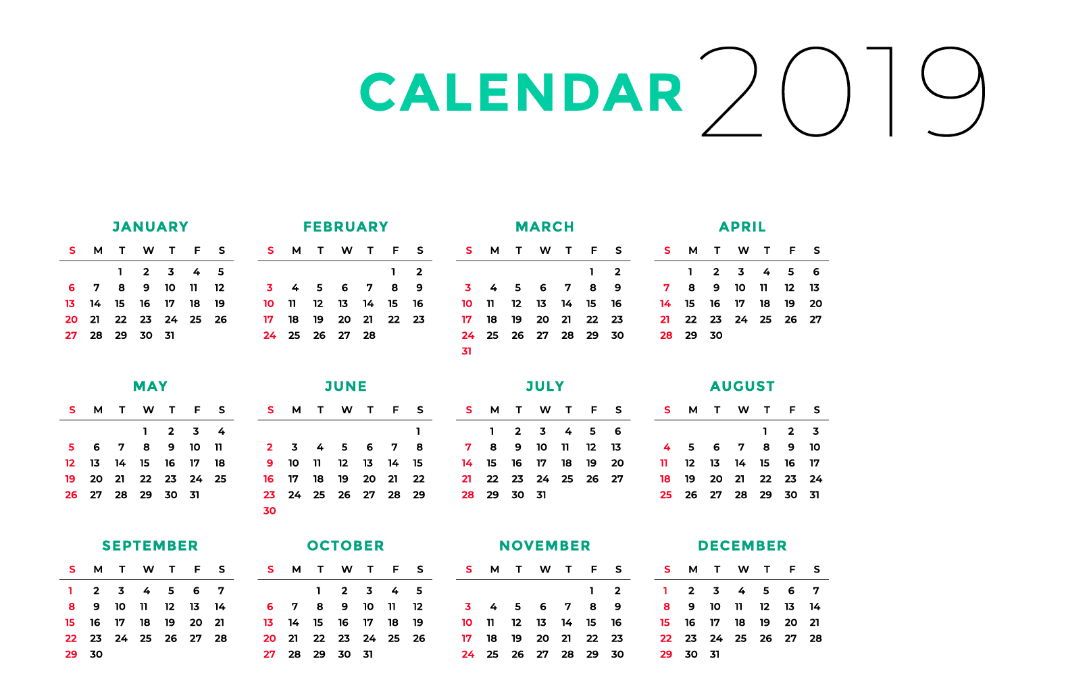

Slide 4
Matthew 6:33
Seek the Kingdom of God above all else, and live righteously,
and he will give you everything you need.

Slide 5
Matthew 6:34
So don’t worry about tomorrow,
for tomorrow will bring its own worries. Today’s trouble is
enough for today.

Slide 6
Genesis 12:1
Now the Lord had said to Abram: “Get out of your country, from your family and from your father’s house, to a land that I will
show you.

Slide 7
Genesis 12:2
I will make you a great nation;
I will bless you and make your name great; and you shall be a blessing.

Slide 8
Genesis 12:3
I will bless those who bless you, and I will curse him who curses you; and in you all the families of the earth shall be blessed.”

Slide 9
Genesis 12:4
So Abram departed as the Lord had spoken to him, and Lot went with him. And Abram was seventy-five years old when he departed from Haran.

Slide 10
God won't let us
STAY where we do not BELONG.

Slide 11
Genesis 12:5
Then Abram took Sarai his wife and Lot his brother’s son, and all their possessions that they had gathered, and the people whom they had acquired in Haran, and they departed to go to the land of Canaan. So they came to the land of Canaan.

Slide 12
Genesis 12:6
Abram passed through the land to the place of Shechem, as far as the terebinth tree of Moreh.
And the Canaanites were then in the land.

Slide 14
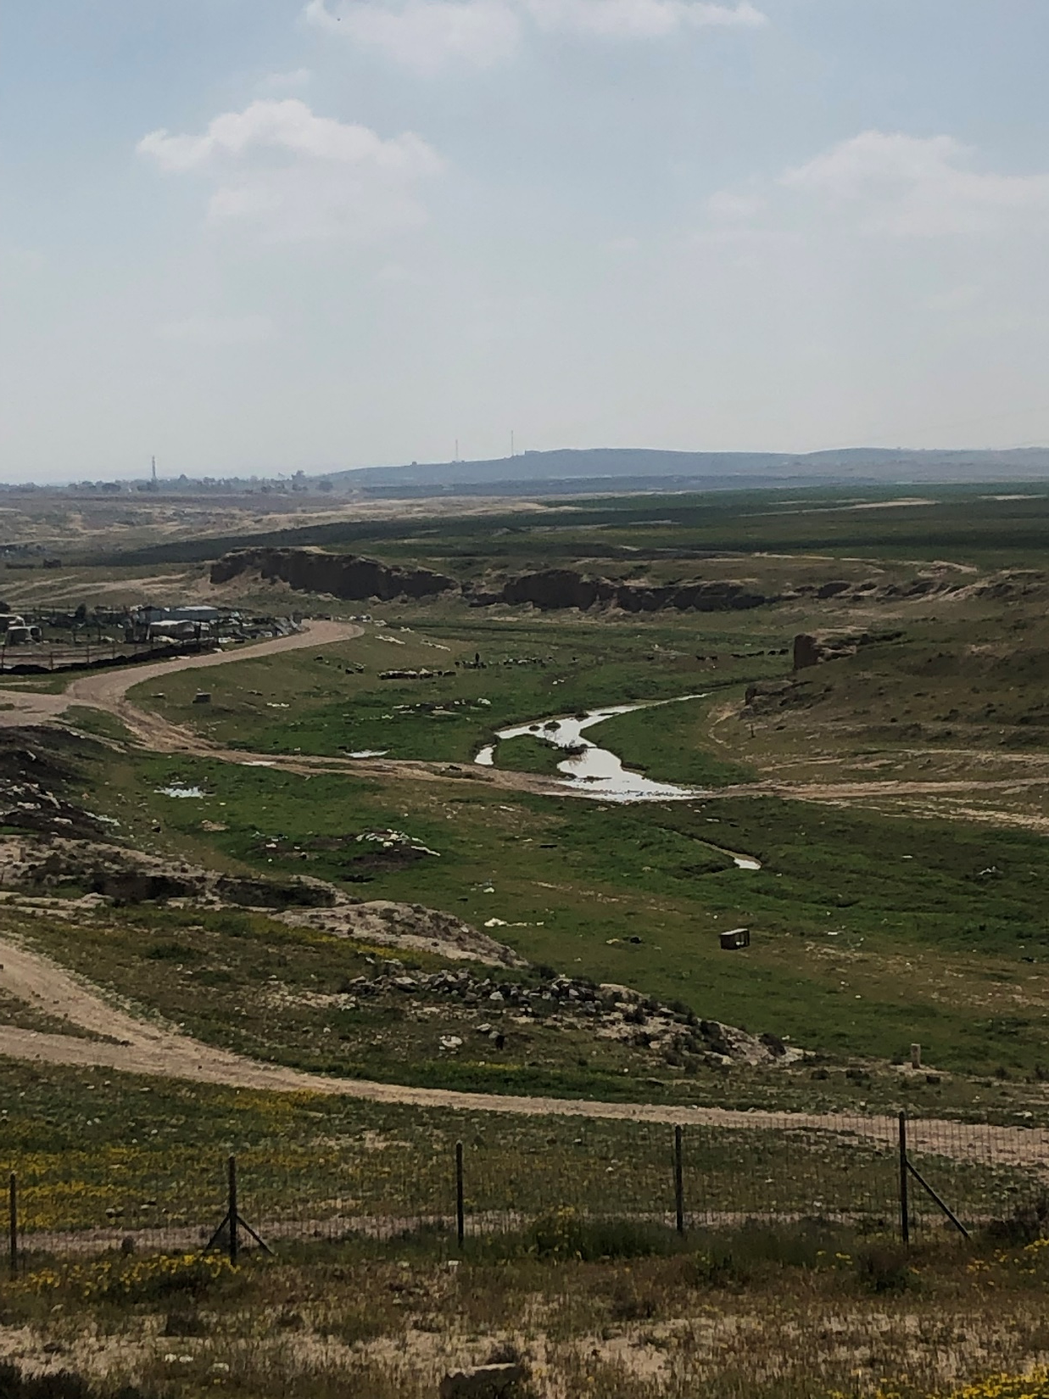

Slide 16
Genesis 12:7
Then the Lord appeared to Abram and said, “To your descendants
I will give this land.” And there he built an altar to the Lord, who had appeared to him.

Slide 17
Genesis 12:8
And he moved from there to the mountain east of Bethel, and he pitched his tent with Bethel on the west and Ai on the east; there he built an altar to the Lord and called on the name of the Lord.

Slide 18
Genesis 12:9
So Abram journeyed, going on
still toward the South.

Slide 19
Romans 4:1
What then shall we say that Abraham our father has found according to the flesh?

Slide 20
Romans 4:2
For if Abraham was justified by works, he has something to boast about, but not before God.

Slide 21
Romans 4:3
For what does the Scripture say? “Abraham believed God, and it was accounted to him for righteousness.”

Slide 22
Romans 4:4
Now to him who works,
the wages are not counted as grace but as debt.

Slide 23
Hebrews 11:8
By faith Abraham obeyed when he was called to go out to the place which he would receive as an inheritance. And he went out,
not knowing where he was going.

Slide 24
Faith is OBEYING God
even when it makes
NO earthly SENSE.

Slide 25
DAILY obedience puts us in the CENTER of His will.

Slide 26
Daily obedience helps us
be READY for the
NEXT ASSIGNMENT
He has for us.

