Slide 1
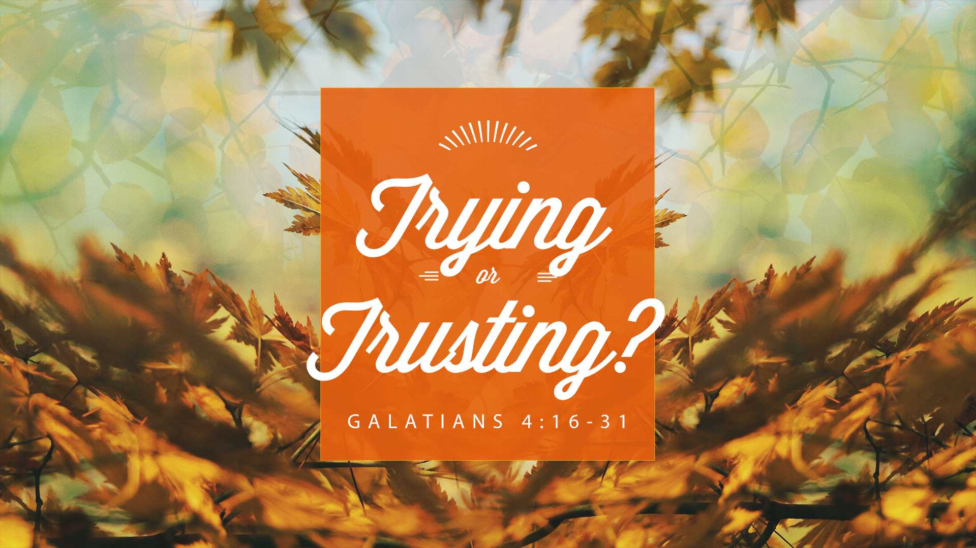

Slide 2

Galatians 4:16
Have I therefore become your enemy because I tell you the truth?

Slide 3
Galatians 4:17
They zealously court you, but for no good; yes, they want to exclude you, that you may be zealous for them.

Slide 4
Galatians 4:18
But it is good to be zealous in
a good thing always, and not only when I am present with you.

Slide 5
Galatians 4:19
My little children, for whom
I labor in birth again until Christ is formed in you,

Slide 6
Galatians 4:21
Tell me, you who desire to be under the law, do you not hear the law?

Slide 7
Galatians 4:22
For it is written that Abraham had two sons: the one by a bondwoman, the other by a freewoman.

Slide 8
Galatians 4:23
But he who was of the bondwoman was born according to the flesh, and he of the freewoman through promise,

Slide 9
Galatians 4:24
which things are symbolic. For these are the two covenants: the one from Mount Sinai which gives birth to bondage, which is Hagar—

Slide 10
Galatians 4:25
for this Hagar is Mount Sinai in Arabia, and corresponds to Jerusalem which now is, and is in bondage with her children—

Slide 11
Galatians 4:28
Now we, brethren, as Isaac
was, are children of promise.

Slide 12
Galatians 4:29
But, as he who was born according to the flesh then persecuted him who was born according to the Spirit, even so it is now.

Slide 13
Galatians 4:30
Nevertheless what does the Scripture say? “Cast out the bondwoman and her son, for the son of the bondwoman shall not be heir with the son
of the freewoman.”

Slide 14
Galatians 4:31
So then, brethren, we are not children of the bondwoman
but of the free.

Slide 15
Ephesians 2:8
For by grace you have been saved through faith, and that not of yourselves; it is the gift of God,

Slide 16
Ephesians 2:9
not of works, lest anyone
should boast.

