Slide 1
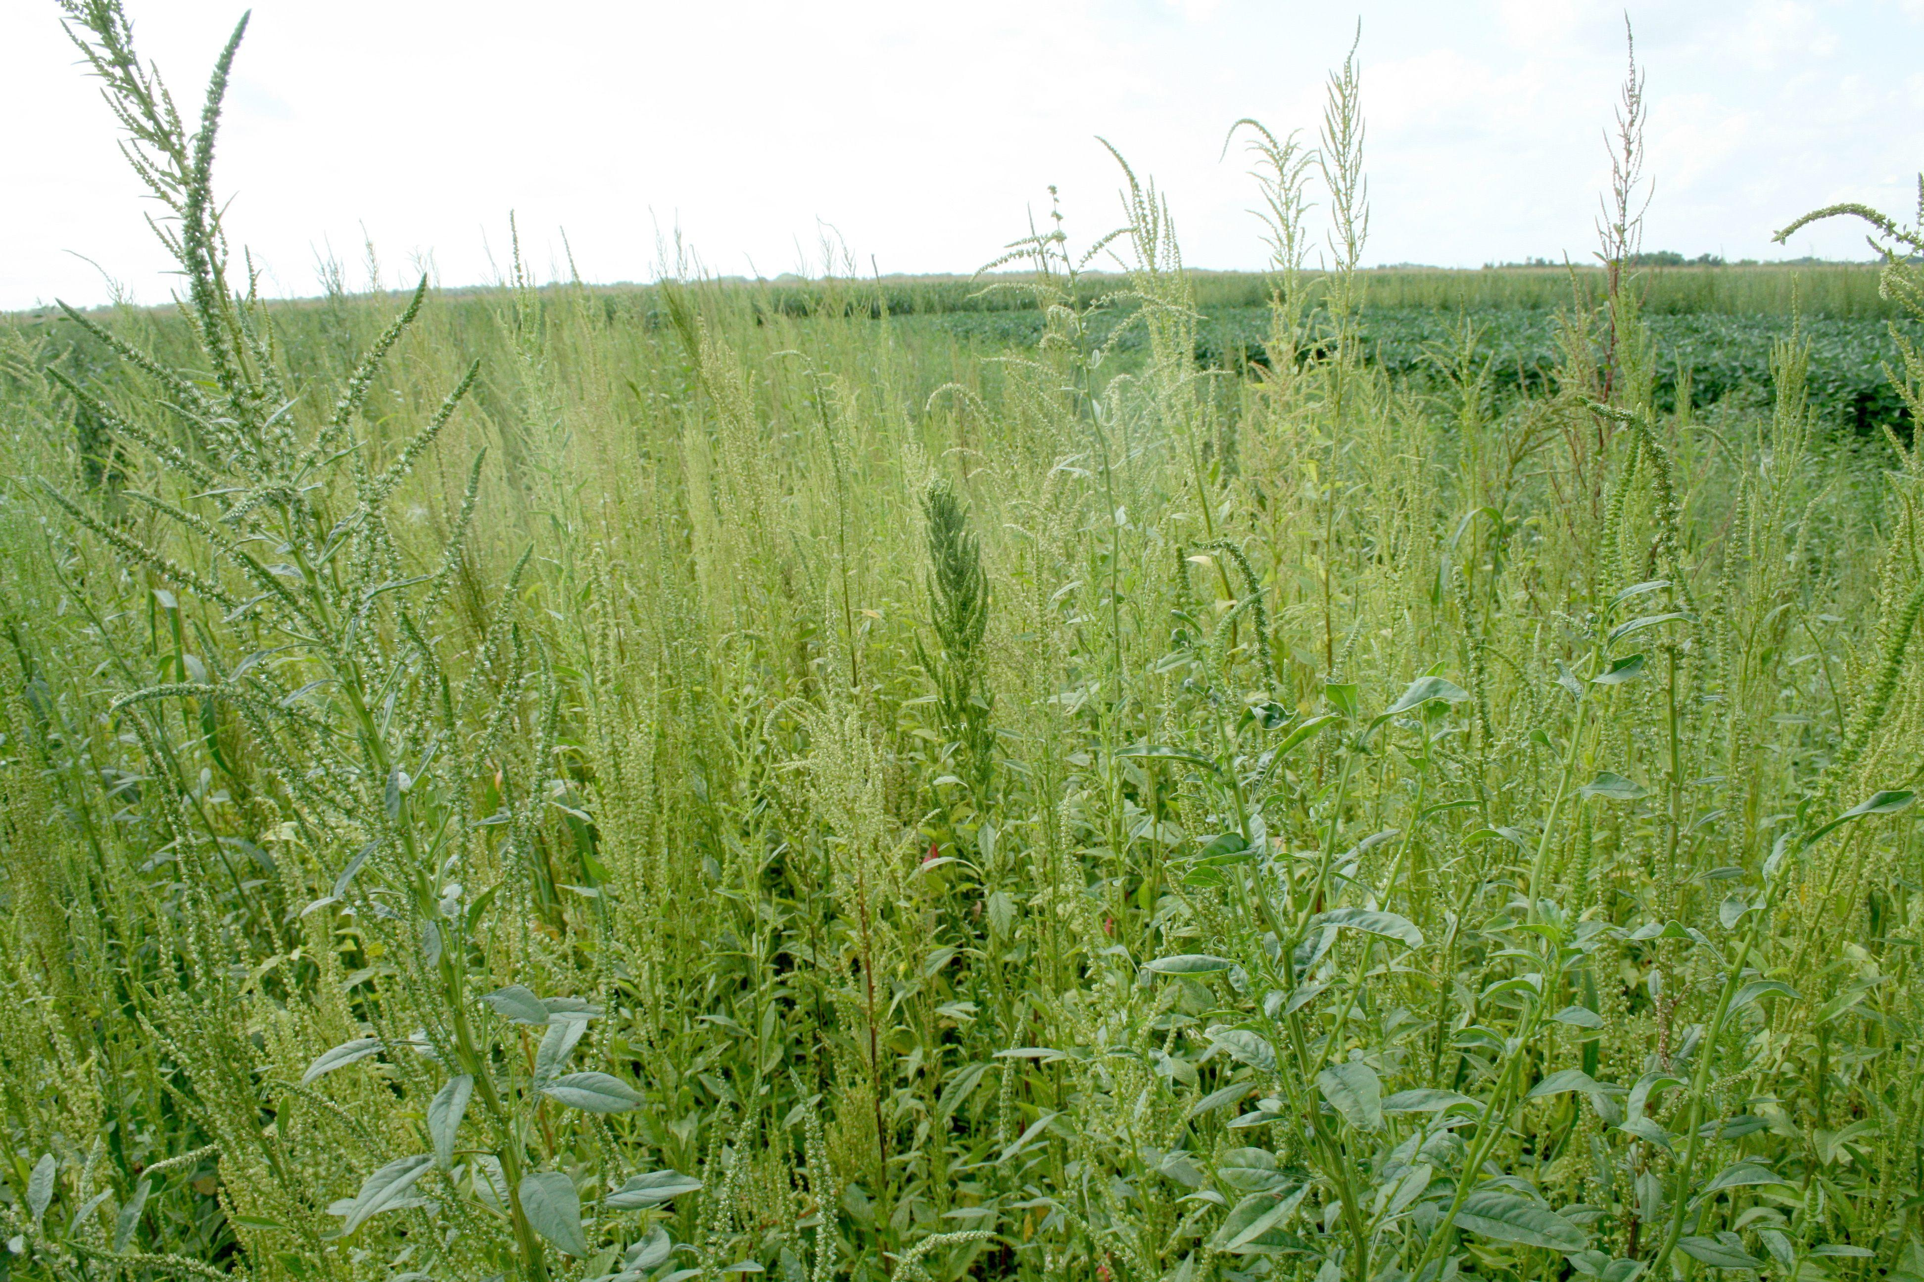
Pulling Weeds
Galatians 5:16-25

Slide 2
Galatians 5:16
I say then: Walk in the Spirit, and you shall not fulfill the lust of the flesh.

Slide 3
Galatians 5:17
For the flesh lusts against the Spirit, and the Spirit against the flesh; and these are contrary to one another, so that you do not do the things that you wish.

Slide 4
Galatians 5:18
But if you are led by the Spirit,
you are not under the law.

Slide 5
Galatians 5:19
Now the works of the flesh are evident, which are: adultery, fornication, uncleanness, lewdness,

Slide 6
Galatians 5:20
idolatry, sorcery, hatred, contentions, jealousies, outbursts of wrath, selfish ambitions, dissensions, heresies,

Slide 7
Galatians 5:21
envy, murders, drunkenness, revelries, and the like; of which I tell you beforehand, just as I also told you in time past, that those who practice such things will not inherit the kingdom of God.

Slide 8
Galatians 5:22
But the fruit of the Spirit is love, joy, peace, longsuffering, kindness, goodness, faithfulness,

Slide 9
Galatians 5:23
gentleness, self-control.
Against such there is no law.

Slide 10
Galatians 5:24
And those who are Christ’s have crucified the flesh with its passions and desires.

Slide 11
Galatians 5:25
If we live in the Spirit, let us also walk in the Spirit.

Slide 12
We must SURRENDER
our will to Holy Spirit.

Slide 13
Laws cannot CHANGE or CONTROL men’s hearts.

Slide 14
The Spirit and flesh have conflicting APPETITES.

Slide 15
Galatians 5:16
I say then: Walk in the Spirit, and you shall not fulfill the lust of the flesh.

Slide 16
Galatians 5:17
For the flesh lusts against the Spirit, and the Spirit against the flesh; and these are contrary to one another, so that you do not do the things that you wish.

Slide 17
Jeremiah 17:9
“The heart is deceitful above all things, and desperately wicked; Who can know it?

Slide 18
Jeremiah 17:10
I, the Lord, search the heart, I test the mind, even to give every man according to his ways, according to the fruit of his doings.

Slide 19
Holy living does not come by OUR living FOR God, but by HIS living THROUGH us.

Slide 20
Galatians 5:25
If we live in the Spirit, let us also walk in the Spirit.

Slide 21
Christ died for us to remove the PENALTY of our sin.

Slide 22
We die with Christ to break sin’s POWER.

Slide 23
We must not FEED the flesh.

Slide 24
Romans 13:14
But put on the Lord Jesus Christ, and make no provision for the flesh, to fulfill its lusts.

Slide 25
Romans 7:18
For I know that in me (that is, in my flesh) nothing good dwells;
for to will is present with me,
but how to perform what is good
I do not find.

Slide 26
Hebrews 9:14
how much more shall the blood of Christ, who through the eternal Spirit offered Himself without spot to God, cleanse your conscience from dead works to serve the living God?

Slide 27
The work of the Spirit is to make us more like Christ for His GLORY, not for the PRAISE of men.

Slide 28
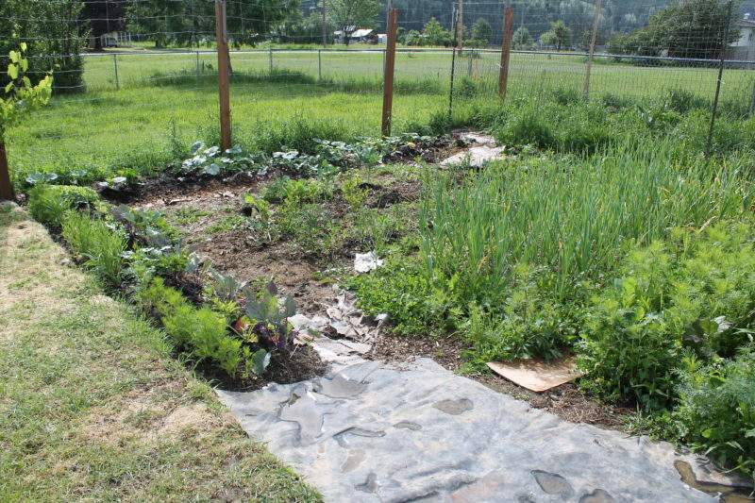

Slide 29
Pulling Weeds
Galatians 5:16-25

