Slide 1
“Is the Dog Eating
Your Homework?”
Galatians 5:7-12

Slide 2
10. Running is social.

Slide 3
9. Running relieves
stress.

Slide 4
8. Strengthens bones
and joints.

Slide 5
7. Improves memory.

Slide 6
6. Live longer.

Slide 7
5. Get rid of toxins.

Slide 8
4. Prevent illness and disease.

Slide 9
3. Inexpensive exercise.

Slide 10
2. Can do it anytime and anywhere.

Slide 11
1. A bear is chasing you!

Slide 12
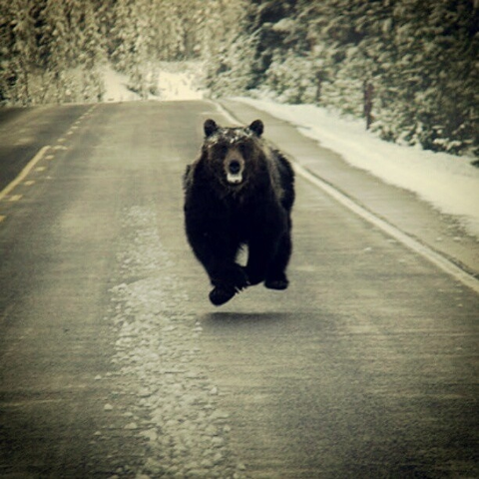

Slide 13
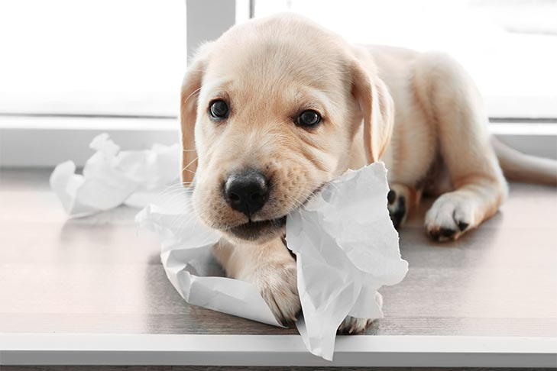

Slide 14
GALATIANS 5:7
You ran well. Who hindered you from obeying the truth?

Slide 15
GALATIANS 5:8
This persuasion does not come from Him who calls you.

Slide 16
GALATIANS 5:9
A little leaven leavens the whole lump.

Slide 17
GALATIANS 5:10
I have confidence in you,
in the Lord, that you will have no other mind; but he who troubles you shall bear his judgment, whoever he is.

Slide 18
GALATIANS 5:11
And I, brethren, if I still preach circumcision, why do I still suffer persecution? Then the offense of the cross has ceased.

Slide 19
GALATIANS 5:12
I could wish that those who trouble you would even cut themselves off!

Slide 20
2 TIMOTHY 4:7
I have fought the good fight,
I have finished the race,
I have kept the faith.

Slide 21
“Is the Dog Eating
Your Homework?”
Galatians 5:7-12

