Slide 1


Slide 2
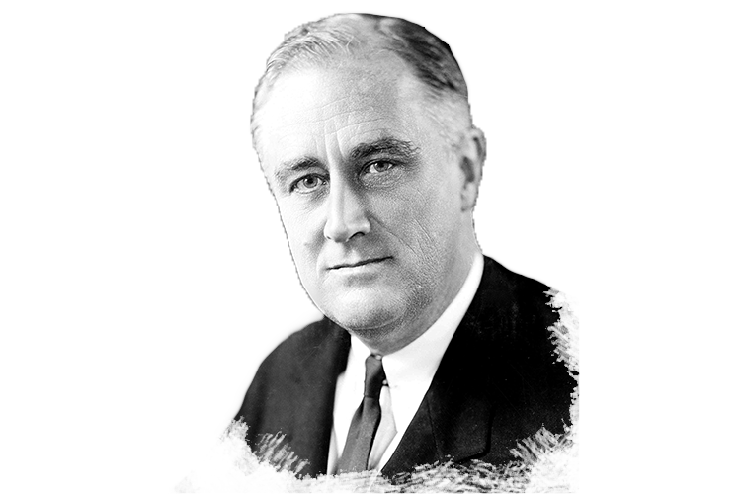

Slide 3

Galatians 5:13
For you, brethren, have been called to liberty; only do not
use liberty as an opportunity
for the flesh, but through love serve one another.

Slide 4
Galatians 5:14
For all the law is fulfilled in
one word, even in this:
“You shall love your neighbor
as yourself.”

Slide 5
Galatians 5:15
But if you bite and devour one another, beware lest you be consumed by one another!

Slide 6

Liberty is only liberty when
it is under the control of LOVE otherwise it is LICENSE.

Slide 7
Love makes liberty your
most VALUABLE POSSESSION.

Slide 8
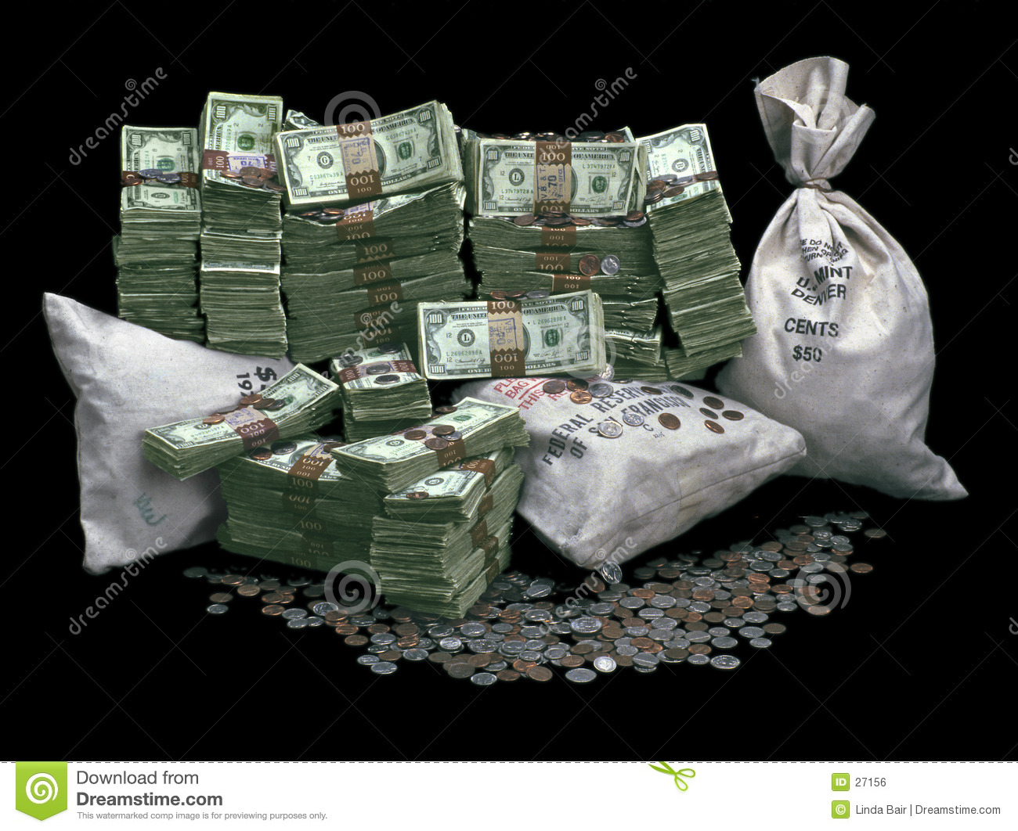

Slide 9
Freedom from legalism
is BOUND in love.

Slide 10
1 Corinthians 9:19
For though I am free from
all men, I have made myself
a servant to all, that I might
win the more;

Slide 11
It is not law on the OUTSIDE, but love on the INSIDE that makes the difference.

Slide 12
The greater the FREEDOM, the greater the responsibility.

Slide 13
Love is INTENTIONAL
and purposeful.

Slide 14
1 John 4:20
If someone says, “I love God,” and hates his brother, he is a
liar; for he who does not love
his brother whom he has seen, how can he love God whom he has not seen?

Slide 15
1 John 4:21
And this commandment we
have from Him: that he who loves God must love his
brother also.

Slide 16
Matthew 22:38
This is the first and great commandment.

Slide 17
Matthew 22:39
And the second is like it:
‘You shall love your neighbor
as yourself.’

Slide 18
Matthew 22:40
On these two commandments hang all the Law and the Prophets.”

Slide 19
Christian liberty is not a license to SIN but an opportunity to SERVE.

Slide 20
Love in the HEART is
God’s substitute for LAWS.

