Slide 1
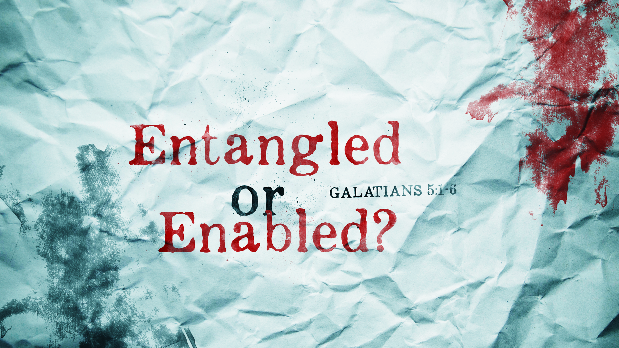

Slide 2

Galatians 5:1
Stand fast therefore in the liberty by which Christ has made us free, and do not be entangled again with a yoke of bondage.

Slide 3
Galatians 5:2
Indeed I, Paul, say to you that
if you become circumcised, Christ will profit you nothing.

Slide 4
Galatians 5:3
And I testify again to every man who becomes circumcised
that he is a debtor to keep the whole law.

Slide 5
Galatians 5:4
You have become estranged from Christ, you who attempt to be justified by law; you have fallen from grace.

Slide 6
Galatians 5:5
For we through the Spirit eagerly wait for the hope of righteousness by faith.

Slide 7
Galatians 5:6
For in Christ Jesus neither circumcision nor uncircumcision avails anything, but faith working through love.

Slide 8

Self effort:
leads to frustration and REBELLION.

Slide 9
Grace:
leads to HUMILITY and SURRENDER.

Slide 10
Self effort:
lives for SELF.

Slide 11
Grace:
lives for OTHERS.

Slide 12
Self effort:
depends on the power of the FLESH.

Slide 13
Grace:
is EMPOWERED and ENABLED by the
Holy Spirit.

Slide 14
Self effort:
tries to please MEN.

Slide 15
Grace:
seeks only to
GLORIFY GOD.

