Slide 1


Slide 2
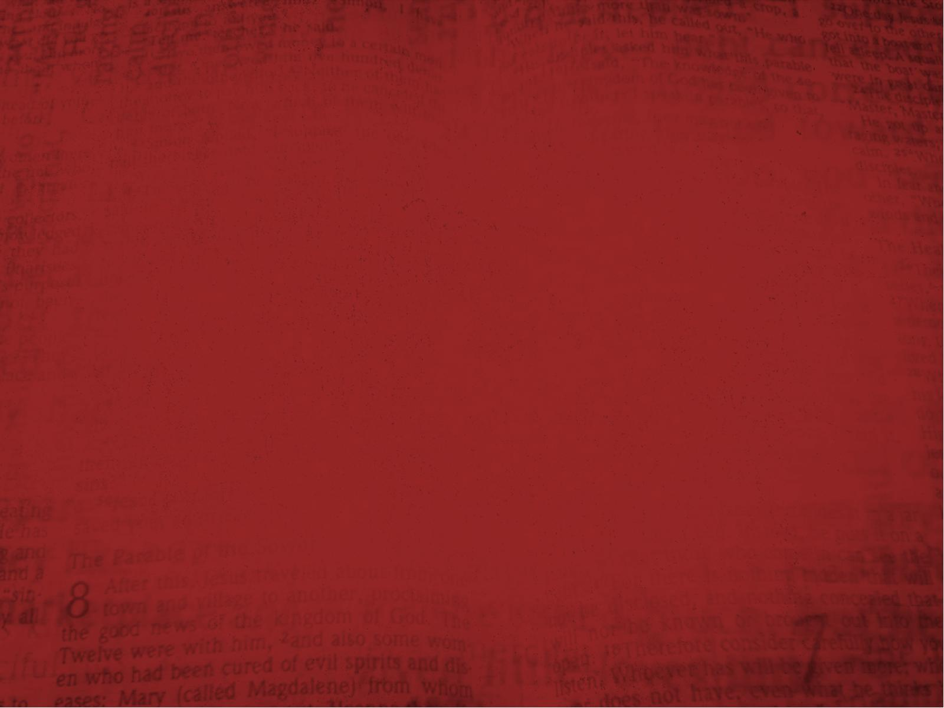
Galatians 1:11
But I make known to you, brethren, that the gospel which was preached by me is not according to man.

Slide 3
Galatians 1:12
For I neither received it from man, nor was I taught it, but it came through the revelation of Jesus Christ.

Slide 4
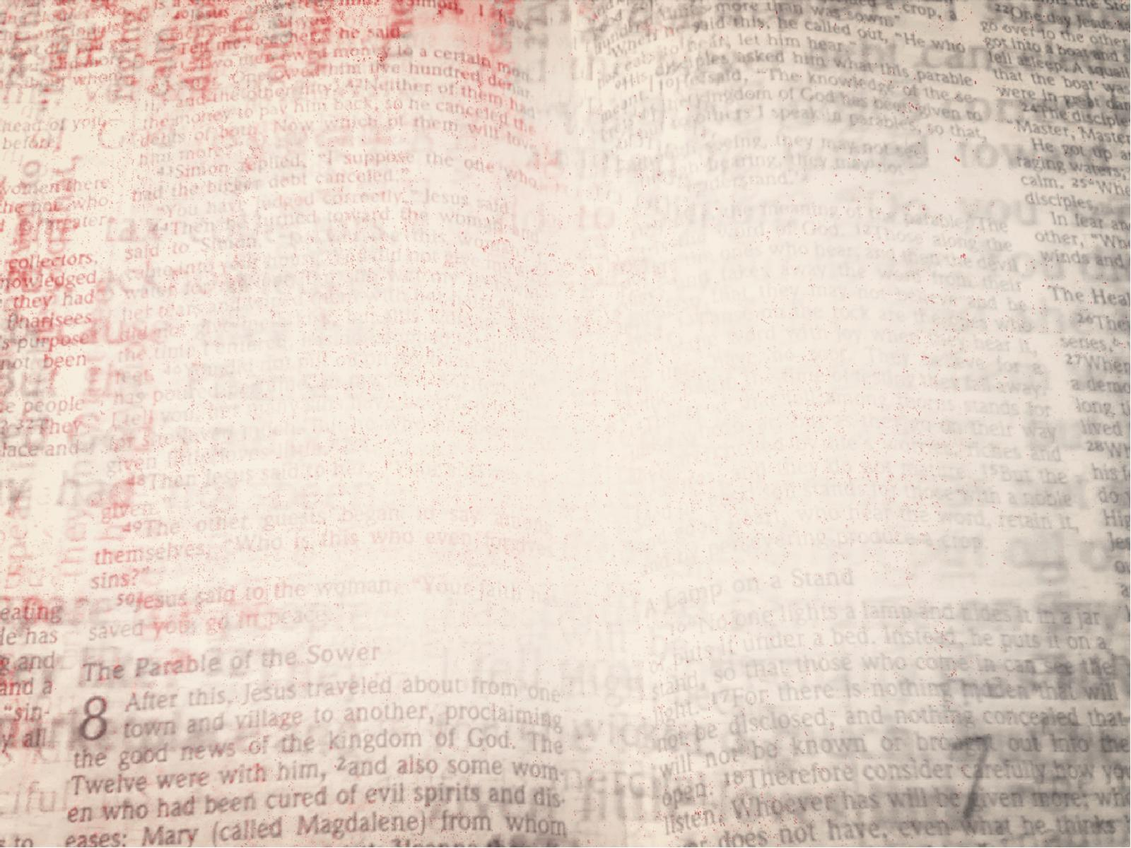
The CHANGE the gospel
will make in a man’s life.

Slide 5
Galatians 1:13
For you have heard of my former conduct in Judaism, how I persecuted the church of God beyond measure and tried to destroy it.

Slide 6
Galatians 1:14
And I advanced in Judaism beyond many of my contemporaries in my own nation, being more exceedingly zealous for the traditions of my fathers.

Slide 7
The gospel prepares men
for GOD’S SERVICE.

Slide 8
Galatians 1:15
But when it pleased God,
who separated me from my mother’s womb and called me through His grace,

Slide 9
Galatians 1:16
to reveal His Son in me, that I might preach Him among the Gentiles, I did not immediately confer with flesh and blood,

Slide 10
The gospel came by
GOD’S DELIVERANCE
not man’s influence.

Slide 11
Galatians 1:16
to reveal His Son in me, that I might preach Him among the Gentiles, I did not immediately confer with flesh and blood,

Slide 12
Galatians 1:17
nor did I go up to Jerusalem
to those who were apostles before me; but I went to Arabia, and returned again to Damascus.

Slide 13
The true gospel brings
great REJOICING.

Slide 14
Galatians 1:18
Then after three years I went up to Jerusalem to see Peter, and remained with him
fifteen days.

Slide 15
Galatians 1:19
But I saw none of the other apostles except James,
the Lord’s brother.

Slide 16
Galatians 1:20
(Now concerning the things which I write to you, indeed, before God, I do not lie.)

Slide 17
Galatians 1:21
Afterward I went into the regions of Syria and Cilicia.

Slide 18
Galatians 1:22
And I was unknown by face to the churches of Judea which were in Christ.

Slide 19
Galatians 1:23
But they were hearing only, “He who formerly persecuted us now preaches the faith which he once tried to destroy.”

Slide 20
Galatians 1:24
And they glorified God in me.

