Slide 1
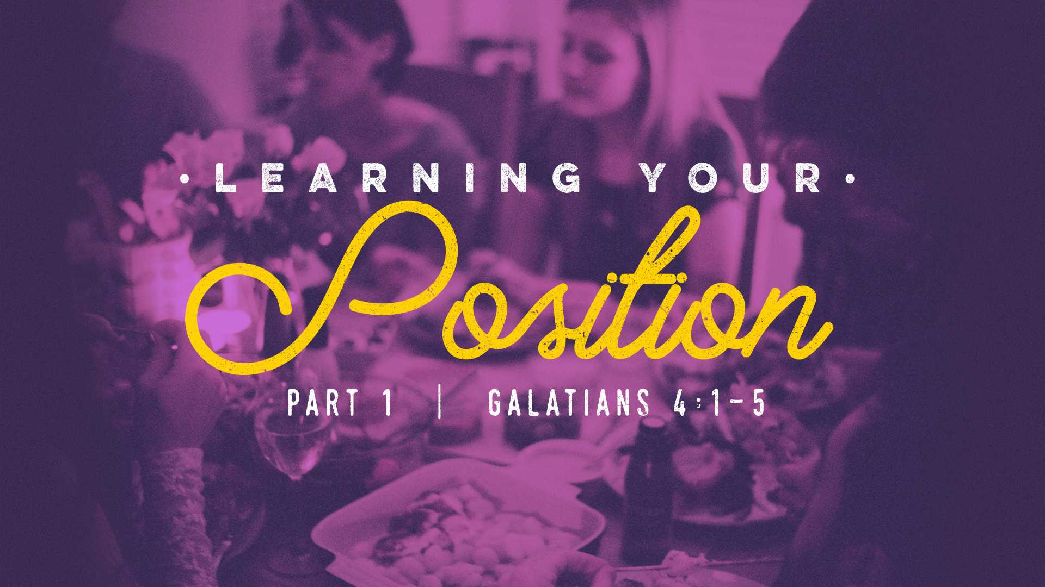

Slide 2
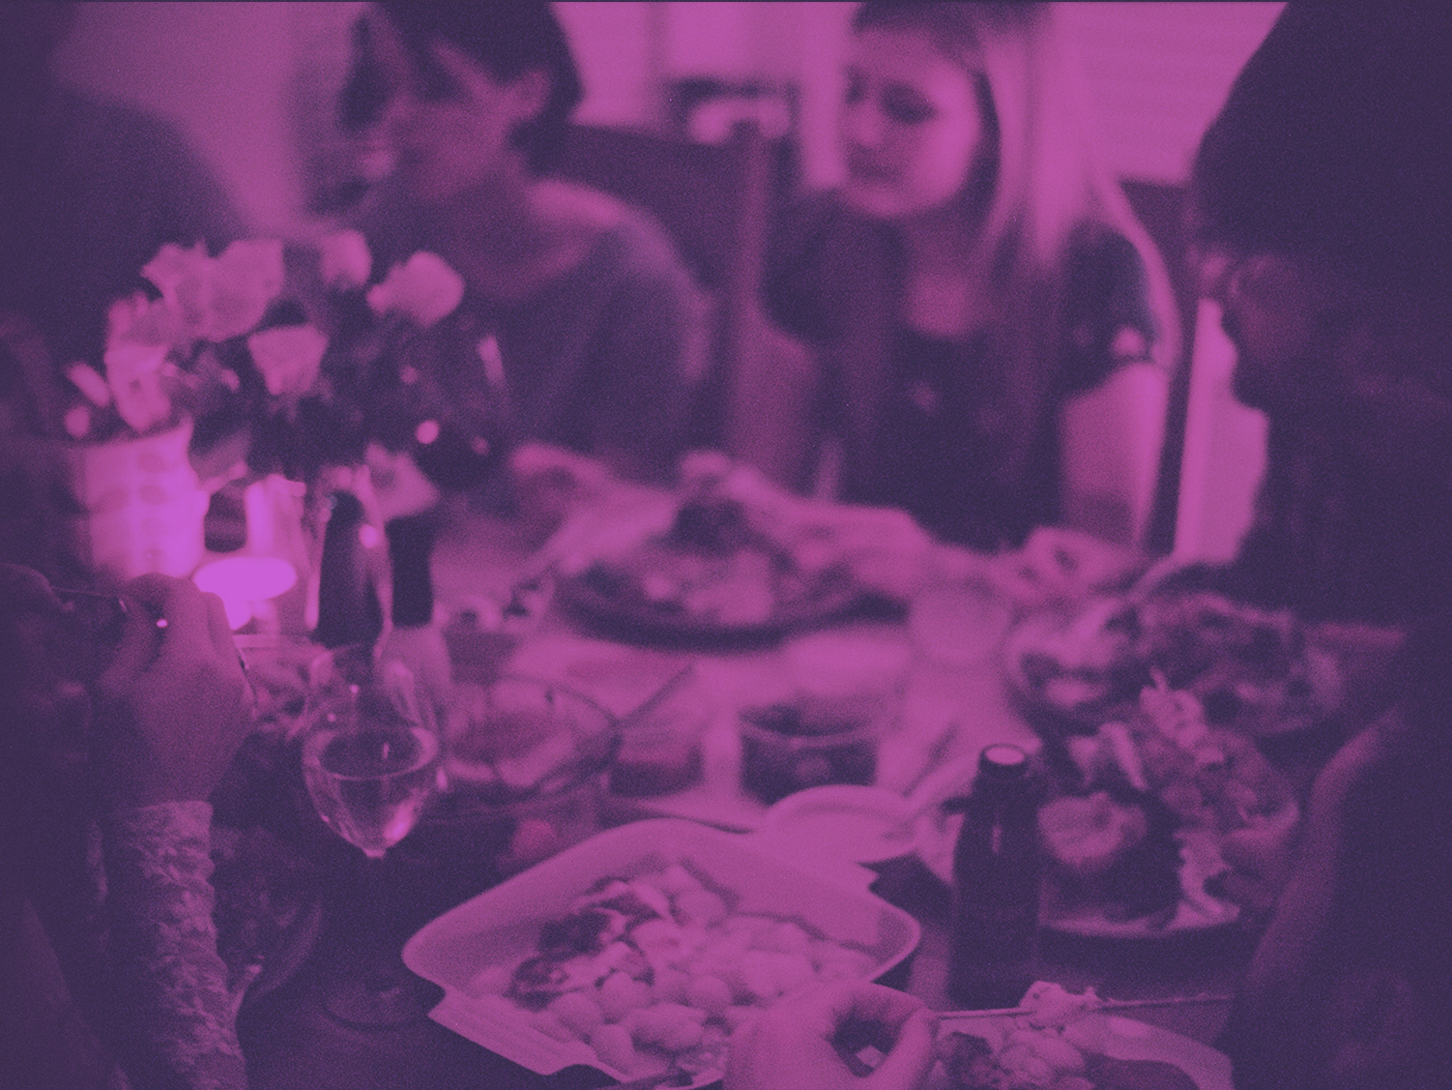
At salvation our CONDITION is
spiritual babes.

Slide 3
Our POSITION
is sons of God.

Slide 4

Galatians 4:1
Now I say that the heir, as long as he is a child, does not differ at all from a slave, though he is master of all,

Slide 5
Galatians 4:2
but is under guardians and stewards until the time appointed by the father.

Slide 6
Galatians 4:3
Even so we, when we were children, were in bondage under the elements of
the world.

Slide 7
We were children in BONDAGE.

Slide 8
Galatians 4:4
But when the fullness of the time had come, God sent forth His Son, born of a woman, born under the law,

Slide 9
Galatians 4:5
to redeem those who were under the law, that we might receive the adoption as sons.

Slide 10
We have been REDEEMED.

