Slide 1
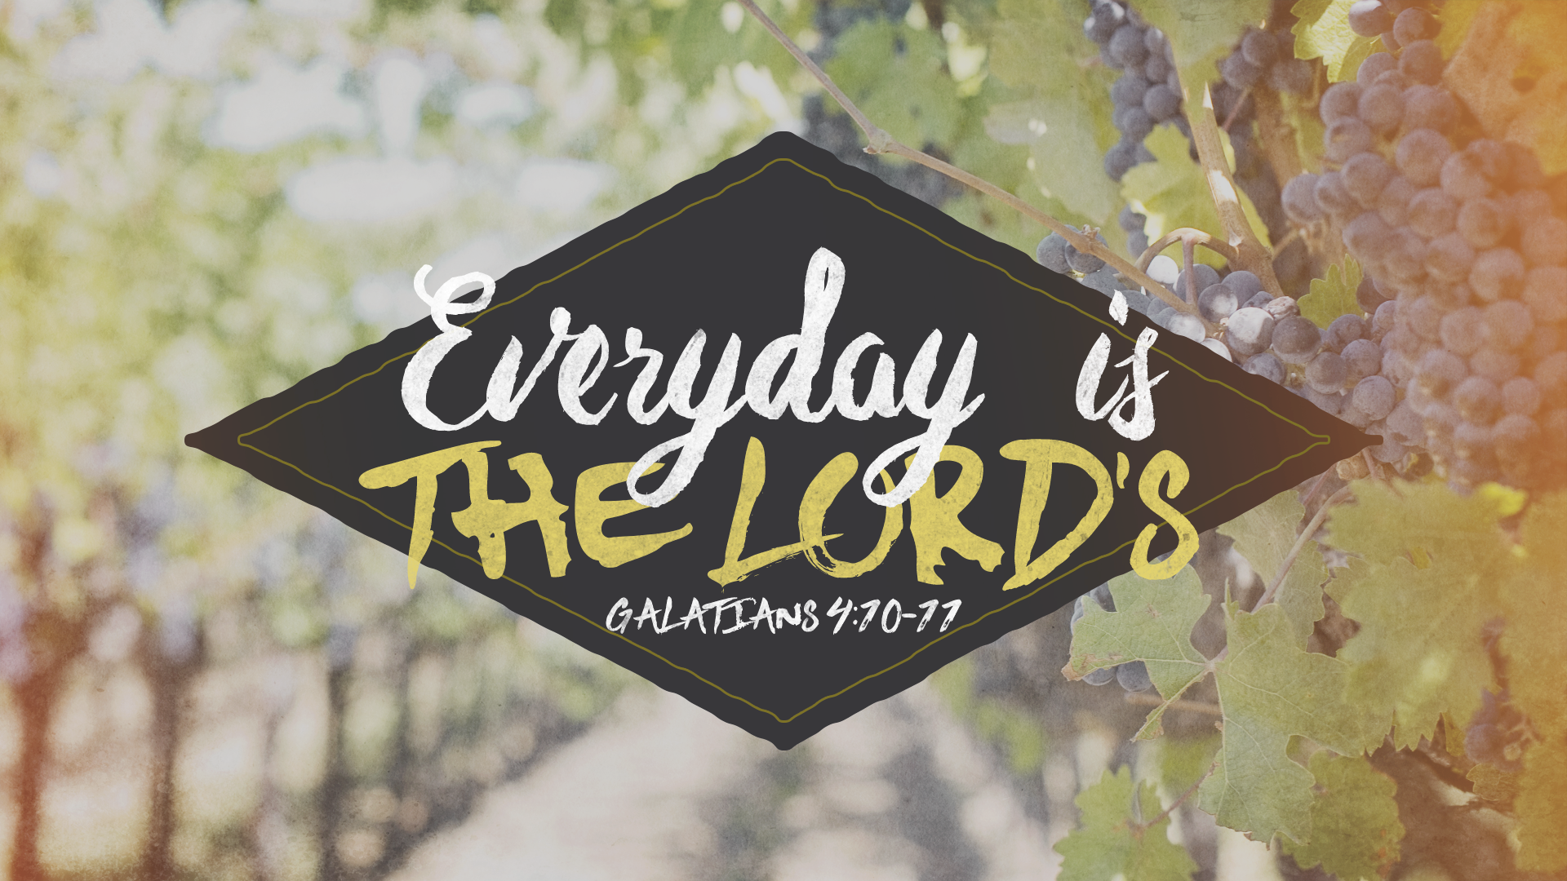

Slide 2

Galatians 4:8
But then, indeed, when you did not know God, you served those which by nature are not gods.

Slide 3
Galatians 4:9
But now after you have known God, or rather are known by God, how is it that you turn again to the weak and beggarly elements, to which you desire again to be in bondage?

Slide 4
Galatians 4:10
You observe days and months and seasons and years.

Slide 5
Galatians 4:11
I am afraid for you, lest I have labored for you in vain.

Slide 6
There are NATURAL observances.

Slide 7
There are NORMAL observances.

Slide 8
There are SUPERSTITIOUS observances.

Slide 9
There are EVIL observances.

Slide 10
Dedicated believer commits EVERYDAY
to the Lord.

Slide 11
God rules
providentially over EVERYDAY.

Slide 12
We should be
FAITHFUL and leave
the END to Him.

Slide 13
Galatians 4:11
I am afraid for you, lest I have labored for you in vain.

Slide 14
His messages would have no CONVERSIONS.

Slide 15
His converts would not LIVE according to their PROFESSION.

Slide 16
His converts would BACKSLIDE and turn from truth.

Slide 17
Keep GOING
in spite of them.

Slide 18
Don’t allow them to
lead to DESPAIR.

Slide 19
Do ALL he can.

Slide 20
Remember we are working for
GOD’S GLORY.

Slide 21
GOD is responsible
for the results.

Slide 22
God’s Word will NOT return VOID.

Slide 23
Don’t be the CAUSE of these fears.

