Slide 3
In order to see OURSELVES correctly we need to see
GOD correctly.

Slide 4
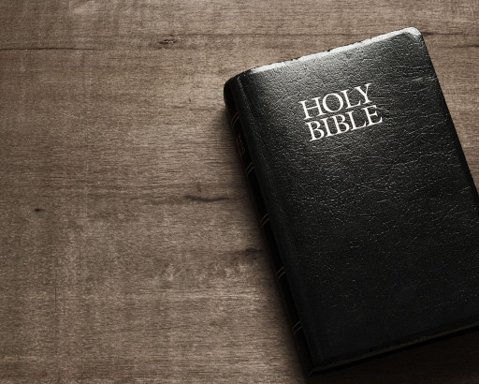

Slide 5
Jeremiah 32:39
then I will give them one heart
and one way, that they may fear
Me forever, for the good of them and their children after them.

Slide 6
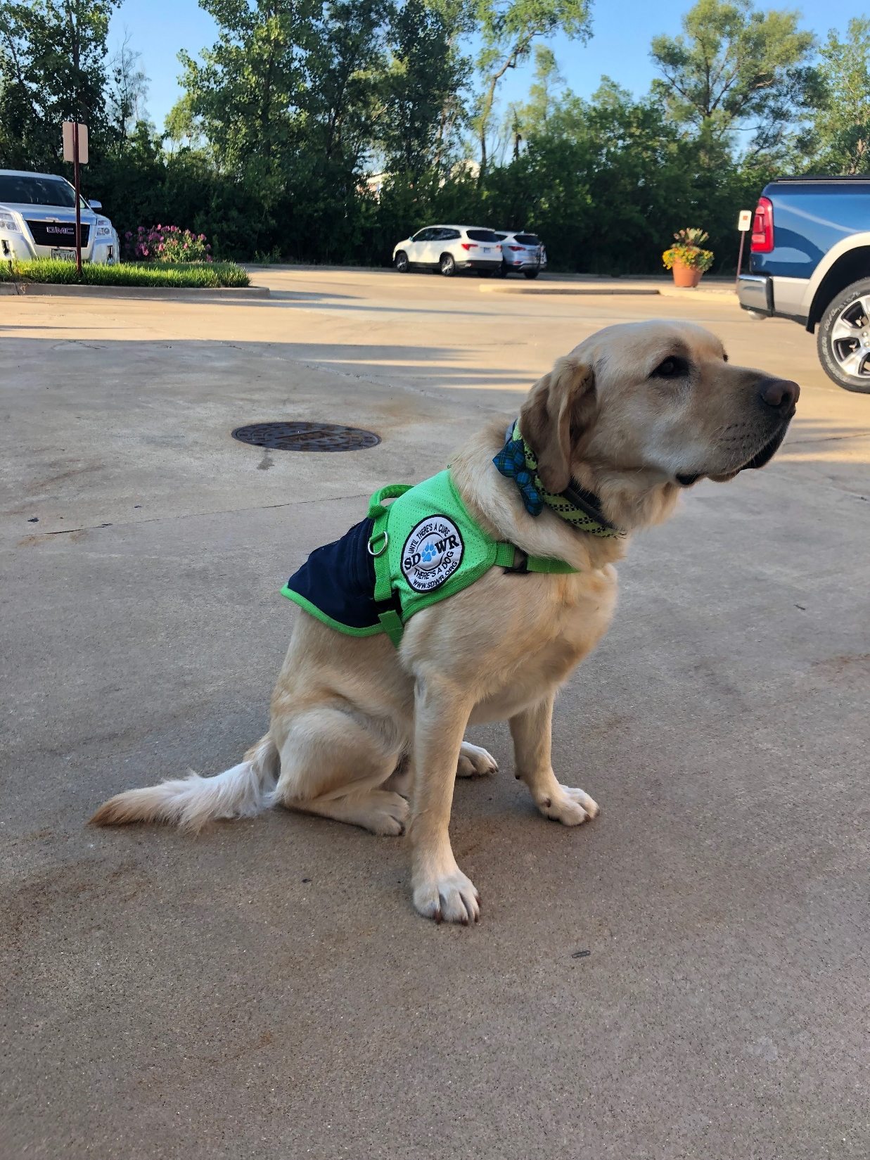

Slide 7
Psalm 25:12
Who is the man that fears the
Lord? Him shall He teach in
the way He chooses.

Slide 8
The fear of the Lord
is a GUIDE for us.

Slide 9
The fear of God is
good for our SOUL.

Slide 10
Psalm 25:13
He himself shall dwell in
prosperity, and his descendants shall inherit the earth.

Slide 12
The fear of God
is good for your FAMILY.

Slide 13
Psalm 25:13
He himself shall dwell in
prosperity, and his descendants shall inherit the earth.

Slide 14
Psalm 112:1
Praise the Lord! Blessed is
the man who fears the Lord,
who delights greatly in His commandments.

Slide 15
Psalm 112:2
His descendants will be
mighty on earth; The generation
of the upright will be blessed.

Slide 17
The fear of the Lord leads
to FRIENDSHIP with God.

Slide 19
Psalm 25:14
The secret of the Lord is with
those who fear Him, and He will show them His covenant.

Slide 20
Psalm 111:1
Praise the Lord! I will praise
the Lord with my whole heart,
in the assembly of the upright
and in the congregation.

