Slide 1


Slide 2
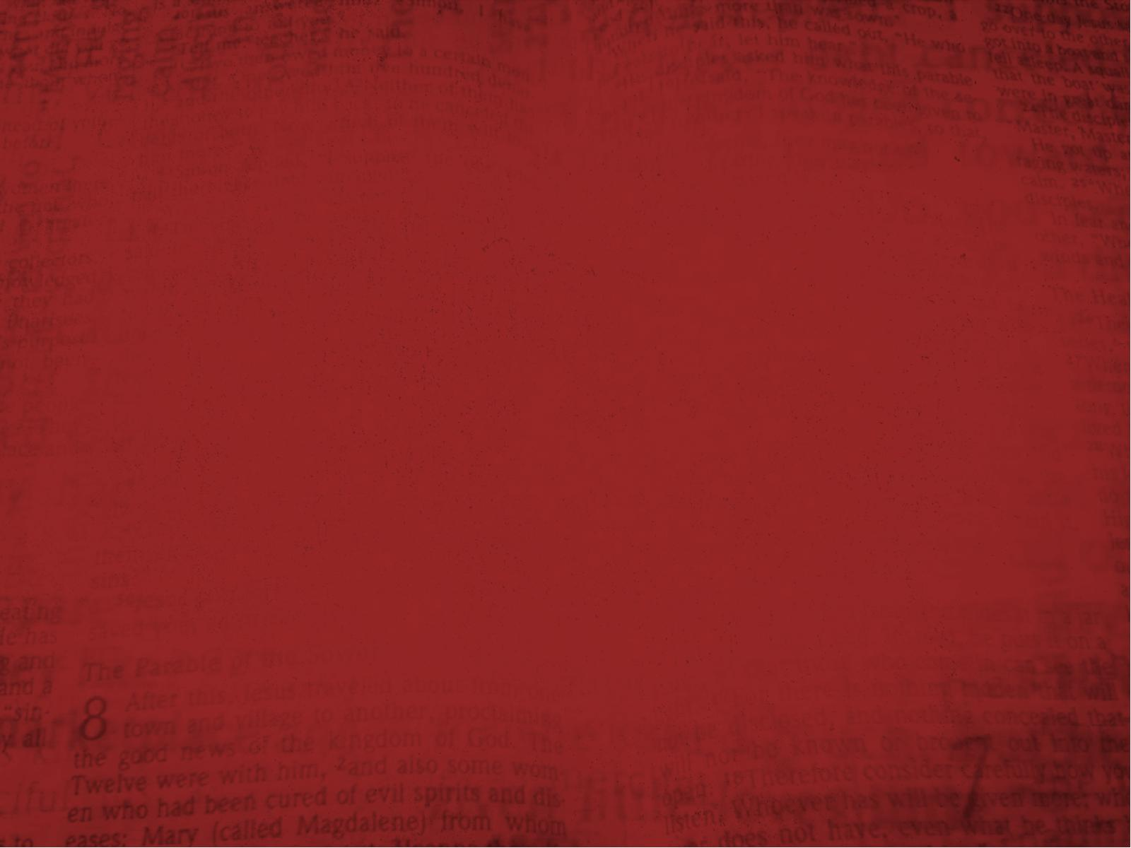
Romans 8:15
For you did not receive the spirit of bondage again to fear, but you received the Spirit of adoption by whom we cry out, “Abba, Father.”

Slide 3
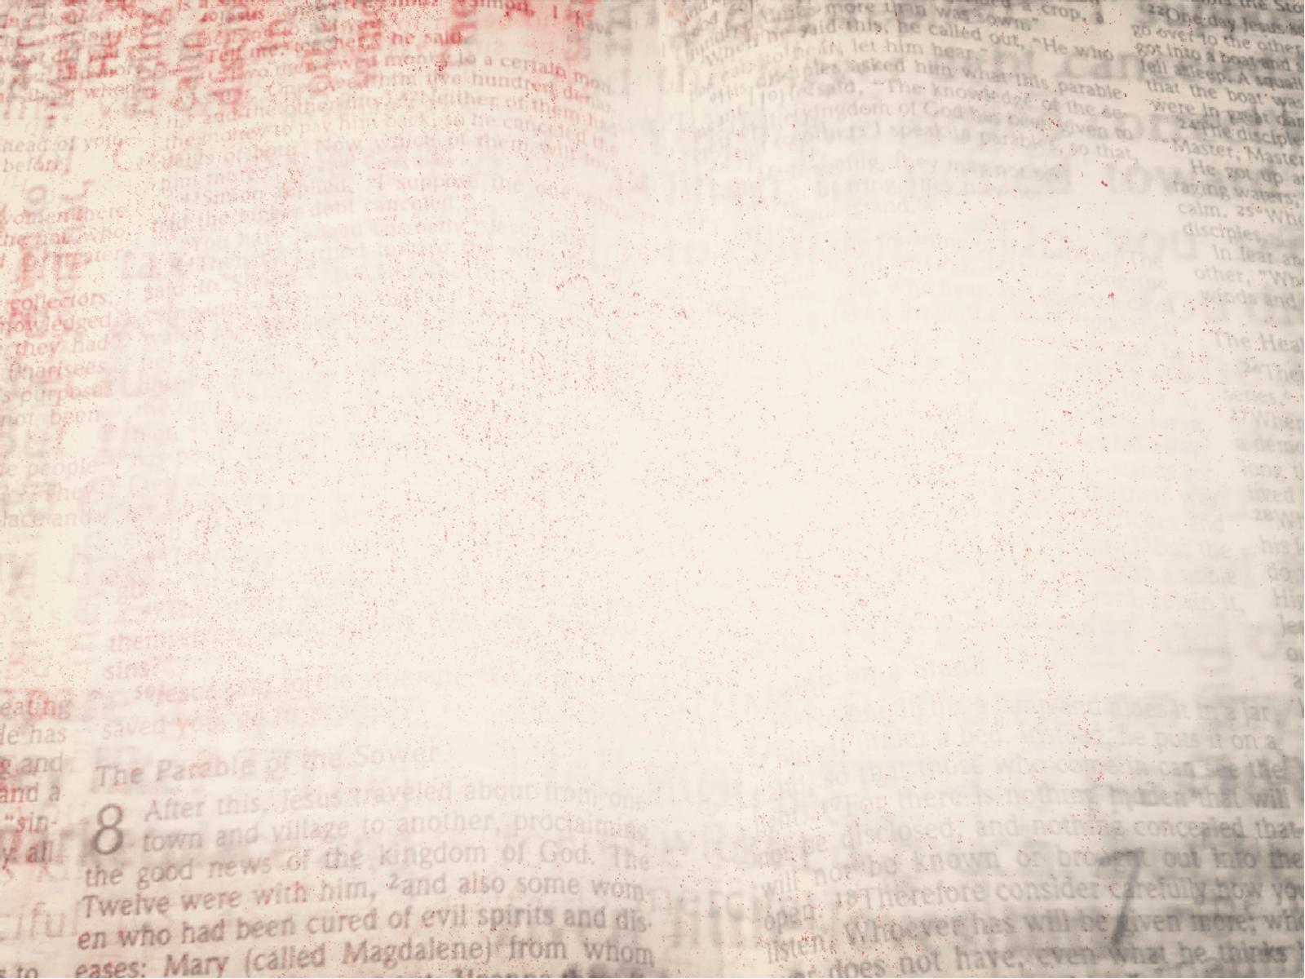
Godly fear is
REQUIRED to live a life
that honors God.

Slide 4
Deuteronomy 10:12
“And now, Israel, what does the Lord your God require of you, but to fear the Lord your God, to walk in all His ways and to love Him, to serve the Lord your God with all your heart and with all your soul,

Slide 5
Deuteronomy 10:13
and to keep the commandments of the Lord and His statutes which I command you today for your good?

Slide 6
Matthew 10:28
And do not fear those who kill the body but cannot kill the soul. But rather fear Him who is able to destroy both soul and body in hell.

Slide 7
1 Peter 1:17
And if you call on the Father, who without partiality judges according to each one’s work, conduct yourselves throughout the time of your stay here
in fear;

Slide 8
Psalm 115:3
But our God is in heaven; He does whatever He pleases.

Slide 9
Psalm 115:4
Their idols are silver and gold, The work of men’s hands.

Slide 10
Psalm 115:5
They have mouths, but they do not speak; Eyes they have, but they do not see;

Slide 11
Psalm 115:6
They have ears, but they do not hear; Noses they have, but they do not smell;

Slide 12
Psalm 115:7
They have hands, but they do not handle; Feet they have, but they do not walk; Nor do they mutter through their throat.

Slide 13
Psalm 115:8
Those who make them are like them; So is everyone who trusts in them.

Slide 14
God is to be feared
as the SUSTAINER
of all things.

Slide 15
Acts 17:28
for in Him we live and move and have our being, as also some of your own poets have said, ‘For we are also His offspring.’

Slide 16
Colossians 1:17
And He is before all things, and in Him all things consist.

Slide 17
God is to be feared
because He is
SOVEREIGN over all.

Slide 18
Psalm 24:1
The earth is the Lord’s, and all its fullness, the world and those who dwell therein.

Slide 19
Daniel 4:35
All the inhabitants of the earth are reputed as nothing; He does according to His will in the army of heaven And among the inhabitants of the earth. No one can restrain His hand or say to Him, “What have You done?”

Slide 20
Psalm 103:19
The Lord has established His throne in heaven, And His kingdom rules over all.

Slide 21
God is to be feared
as He is JUDGE
of all men.

Slide 22
Acts 17:31
because He has appointed a day on which He will judge the world in righteousness by the Man whom He has ordained. He has given assurance of this to all by raising Him from the dead.”

Slide 23
Romans 14:12
So then each of us shall give account of himself to God.

Slide 24
Hebrews 9:27
And as it is appointed for men to die once, but after this the judgment,

Slide 25
Our God is to be feared
as He is the only
REDEEMER of men.

Slide 26
Acts 4:12
Nor is there salvation in any other, for there is no other name under heaven given among men by which we must be saved.”

Slide 27
1 Timothy 2:5
For there is one God and one Mediator between God and men, the Man Christ Jesus,

Slide 28
John 3:36
He who believes in the Son has everlasting life; and he who does not believe the Son shall not see life, but the wrath of God abides on him.”

Slide 29
Our God is to be feared
as He is SUPERIOR
over all things.

Slide 30
Deuteronomy 7:21
You shall not be terrified of them; for the Lord your God, the great and awesome God,
is among you.

Slide 31
Exodus 15:11
“Who is like You, O Lord, among the gods? Who is like You, glorious in holiness, Fearful in praises, doing wonders?

Slide 32
Exodus 15:12
You stretched out Your right hand; The earth swallowed them.

Slide 33
Our God should be feared
as all NATIONS are like a speck of dust.

Slide 34
Isaiah 40:15
Behold, the nations are as a drop in a bucket, and are counted as the small dust on the scales; Look, He lifts up the isles as a very little thing.

Slide 35


Slide 36
Jeremiah 10:6
Inasmuch as there is none
like You, O Lord (You are great, and Your name is great in might),

Slide 37
Jeremiah 10:7
Who would not fear You,
O King of the nations? For this is Your rightful due. For among all the wise men of the nations, And in all their kingdoms, There is none like You.

