Slide 1
KICK OFF
THE COVERS
Proverbs 28:13

Slide 2
2 Samuel 11:27
And when her mourning was over, David sent and brought her to his house, and she became his wife and bore him a son. But the thing that David had done displeased the Lord.

Slide 3
2 Samuel 12:5
So David’s anger was greatly aroused against the man, and he said to Nathan, “As the Lord lives,
the man who has done this shall surely die!

Slide 4
2 Samuel 12:7
Then Nathan said to David, “You are the man! Thus says the Lord God of Israel: ‘I anointed you king over Israel, and I delivered you from the hand of Saul.

Slide 5
2 Samuel 12:13
So David said to Nathan, “I have sinned against the Lord.” And Nathan said to David, “The Lord also has put away your sin; you shall not die.

Slide 6
Restoration with God
begins in genuine REPENTANCE.

Slide 7
We can COVER
it up.

Slide 8
We can
UNCOVER it.

Slide 9
Proverbs 28:13
He who covers his sins will not prosper, but whoever confesses and forsakes them will have mercy.

Slide 10
Scripture teaches REPENTANCE.

Slide 11
Leviticus 26:40
‘But if they confess their iniquity and the iniquity of their fathers, with their unfaithfulness in which they were unfaithful to Me, and that they also have walked contrary to Me,

Slide 12
Leviticus 26:41
and that I also have walked contrary to them and have brought them into the land of their enemies; if their uncircumcised hearts are humbled, and they accept their guilt—

Slide 13
Leviticus 26:42
then I will remember My covenant with Jacob, and My covenant with Isaac and My covenant with Abraham I will remember; I will remember the land.

Slide 14
Jeremiah 3:12
Go and proclaim these words toward the north, and say: ‘Return, backsliding Israel,’ says the Lord;
‘I will not cause My anger to fall on you. For I am merciful,’ says the Lord;
‘I will not remain angry forever.

Slide 15
Jeremiah 3:13
Only acknowledge your iniquity, that you have transgressed against the Lord your God, and have scattered your charms to alien deities under every green tree, and you have not obeyed My voice,’ says the Lord.

Slide 16
Jeremiah 3:14
“Return, O backsliding children,” says the Lord; “for I am married to you.
I will take you, one from a city and two from a family, and I will bring
you to Zion.

Slide 17
Jeremiah 3:15
And I will give you shepherds according to My heart, who will feed you with knowledge and understanding.

Slide 18
Ezekiel 33:10
“Therefore you, O son of man, say to the house of Israel: ‘Thus you say,
“If our transgressions and our sins lie upon us, and we pine away in them, how can we then live?” ’

Slide 19
Ezekiel 33:11
Say to them: ‘As I live,’ says the Lord God, ‘I have no pleasure in the death of the wicked, but that the wicked turn from his way and live. Turn, turn from your evil ways! For why should you die, O house of Israel?’

Slide 20
Ezekiel 33:19
But when the wicked turns from his wickedness and does what is lawful and right, he shall live because of it.

Slide 22
Isaiah 1:2
Hear, O heavens, and give ear,
O earth! For the Lord has spoken:
“I have nourished and brought up children, and they have rebelled against Me;

Slide 23
Isaiah 1:3
The ox knows its owner and the donkey its master’s crib; but Israel does not know, My people do not consider.”

Slide 24
Isaiah 1:4
Alas, sinful nation, a people laden with iniquity, a brood of evildoers, children who are corrupters! They have forsaken the Lord, they have provoked to anger The Holy One of Israel, they have turned away backward.

Slide 25
Isaiah 1:5
Why should you be stricken again? You will revolt more and more. The whole head is sick, and the whole heart faints.

Slide 26
Isaiah 1:6
From the sole of the foot even to the head, there is no soundness in it, but wounds and bruises and putrefying sores; They have not been closed or bound up, or soothed with ointment.

Slide 27
Isaiah 1:16
“Wash yourselves, make yourselves clean; Put away the evil of your doings from before My eyes. Cease to do evil,

Slide 28
Isaiah 1:17
Learn to do good; Seek justice, Rebuke the oppressor; Defend the fatherless, Plead for the widow.

Slide 29
Isaiah 1:18
“Come now, and let us reason together,” Says the Lord, “Though your sins are like scarlet, They shall be as white as snow; Though they are red like crimson, They shall be as wool.

Slide 30
1 Timothy 1:15
This is a faithful saying and worthy of all acceptance, that Christ Jesus came into the world to save sinners, of whom I am chief.

Slide 31
Acts 2:37
Now when they heard this, they were cut to the heart, and said to Peter and the rest of the apostles, “Men and brethren, what shall we do?”

Slide 32
Acts 2:38
Then Peter said to them, “Repent, and let every one of you be baptized in the name of Jesus Christ for the remission of sins; and you shall receive the gift of the Holy Spirit.

Slide 33
Luke 13:5
I tell you, no; but unless you repent you will all likewise perish.”

Slide 34
Acts 17:30
Truly, these times of ignorance God overlooked, but now commands all men everywhere to repent,

Slide 35
Acts 20:21
testifying to Jews, and also to Greeks, repentance toward God and faith toward our Lord Jesus Christ.

Slide 36
2 Peter 3:9
The Lord is not slack concerning His promise, as some count slackness, but is longsuffering toward us, not willing that any should perish but that all should come to repentance.

Slide 37
Repentance is a LIFESTYLE.

Slide 38
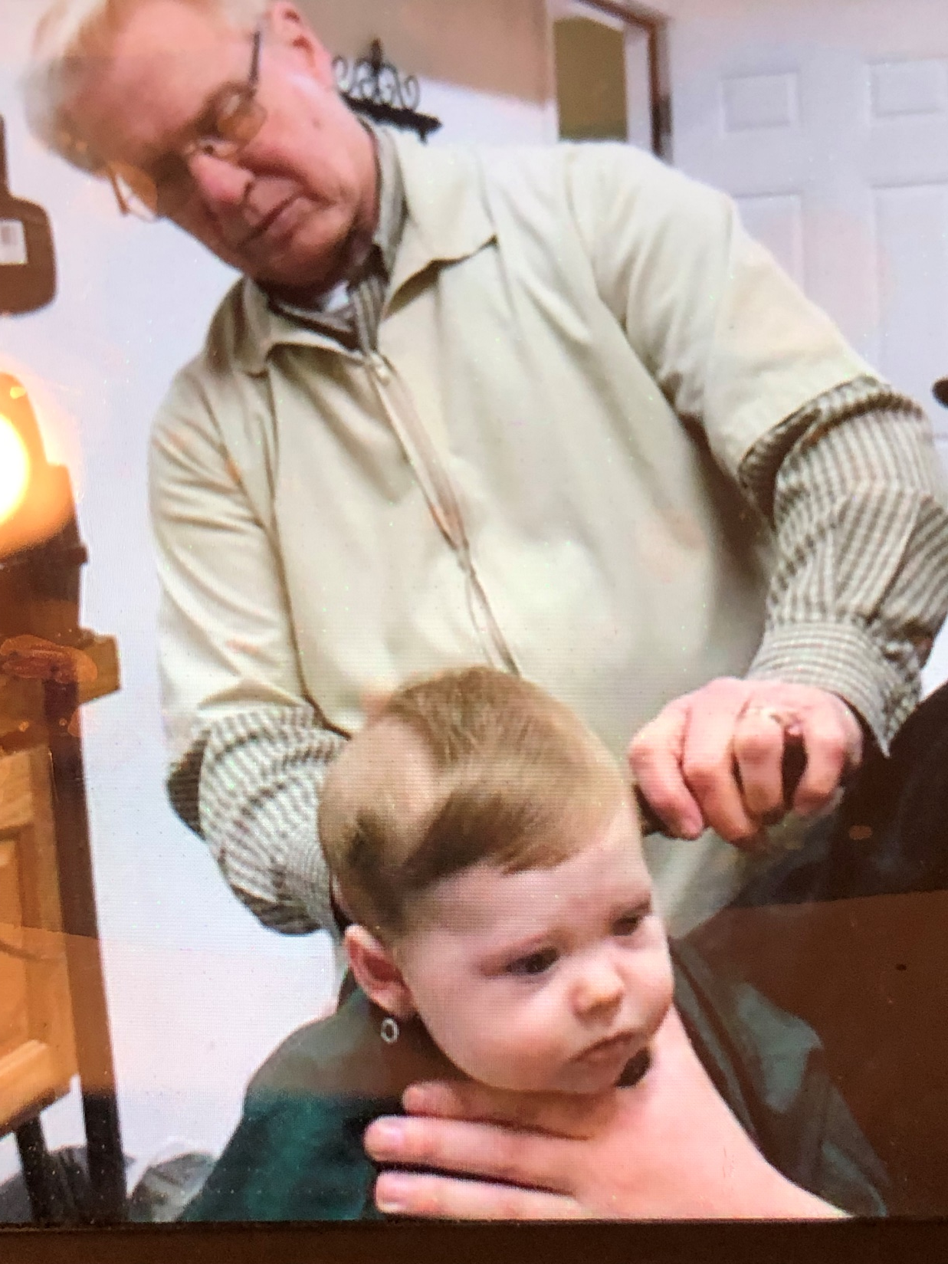

Slide 39
DENY it or
CONFESS it.

Slide 40
1 John 1:8
If we say that we have no sin,
we deceive ourselves, and the
truth is not in us.

Slide 41
1 John 1:9
If we confess our sins, He is faithful and just to forgive us our sins and to cleanse us from all unrighteousness.

Slide 42
2 Corinthians 7:9
Now I rejoice, not that you were made sorry, but that your sorrow led to repentance. For you were made sorry in a godly manner, that you might suffer loss from us in nothing.

Slide 43
2 Corinthians 7:10
For godly sorrow produces repentance leading to salvation,
not to be regretted; but the sorrow
of the world produces death.

Slide 44
KICK OFF
THE COVERS
Proverbs 28:13

