Slide 1


Slide 2

Fear is sinful when it keeps you from OBEYING GOD.

Slide 3

2 Timothy 1:6
Therefore I remind you to stir up the gift of God which is in you through the laying on of my hands.

Slide 4
2 Timothy 1:7
For God has not given us a spirit of fear, but of power and of love and of a sound mind.

Slide 5
2 Timothy 1:8
Therefore do not be ashamed of the testimony of our Lord, nor of me His prisoner, but share with me in the sufferings for the gospel according to the power
of God,

Slide 6
Matthew 25:24
“Then he who had received the one talent came and said, ‘Lord,
I knew you to be a hard man, reaping where you have not sown, and gathering where you have not scattered seed.

Slide 7
Matthew 25:25
And I was afraid, and went and hid your talent in the ground. Look, there you have what is yours.’

Slide 8
Matthew 25:26
“But his lord answered and said to him, ‘You wicked and lazy servant, you knew that I reap where I have not sown, and gather where I have not scattered seed.

Slide 9
Exodus 4:14
So the anger of the Lord was kindled against Moses, and He said: “Is not Aaron the Levite your brother? I know that he can speak well. And look,
he is also coming out to meet you. When he sees you, he will be glad in his heart.

Slide 10
Fear is sinful
when it causes to disobey God’s CLEAR COMMANDS.

Slide 11
Nehemiah 6:11
And I said, “Should such a man as I flee? And who is there such as I who would go into the temple to save his life? I will not go in!”

Slide 12
Nehemiah 6:12
Then I perceived that God had not sent him at all, but that he pronounced this prophecy against me because Tobiah and Sanballat had hired him.

Slide 13
Nehemiah 6:13
For this reason he was hired,
that I should be afraid and act that way and sin, so that they might have cause for an evil report, that they might
reproach me.

Slide 14
Fear is sinful when
it causes you to
ACT SELFISHLY.

Slide 15
1 John 4:18
There is no fear in love; but perfect love casts out fear, because fear involves torment. But he who fears has not been made perfect in love.

Slide 16
Fear is sinful when it comes from THINKING UNSCRIPTURALLY.

Slide 17
Philippians 4:8
Finally, brethren, whatever things are true, whatever things are noble, whatever things are just, whatever things are pure, whatever things are lovely, whatever things are of good report, if there is any virtue and if there is anything praiseworthy—meditate on these things.

Slide 18
2 Timothy 1:7
For God has not given us a spirit of fear, but of power and of love and of a sound mind.

Slide 19
Fear is sinful when
it comes out of
OUR UNBELIEF.

Slide 20
Daniel 11:32
Those who do wickedly against the covenant he shall corrupt with flattery; but the people who know their God shall be strong, and carry out great exploits.

Slide 21
Romans 8:28
And we know that all things work together for good to those who love God, to those who are the called according to His purpose.

Slide 22
Romans 5:3
And not only that, but we also glory in tribulations, knowing
that tribulation produces perseverance;

Slide 23
Romans 5:4
and perseverance, character; and character, hope.

Slide 24
Romans 5:5
Now hope does not disappoint, because the love of God has been poured out in our hearts by the Holy Spirit who was given
to us.

Slide 25
Godly fear comes from a fear of SIN.

Slide 26
1 Peter 1:17
And if you call on the Father,
who without partiality judges according to each one’s work, conduct yourselves throughout the time of your stay here in fear;

Slide 27
Philippians 2:12
Therefore, my beloved, as you have always obeyed, not as in my presence only, but now much more in my absence, work out your own salvation with fear and trembling;

Slide 28
Jude 22
And on some have compassion, making a distinction;

Slide 29
Jude 23
but others save with fear, pulling them out of the fire, hating even the garment defiled by the flesh.

Slide 30
Godly fear
produces a fear of
GOD’S WORD.

Slide 31
Psalm 119:161
Princes persecute me without a cause, but my heart stands in awe of Your word.

Slide 32
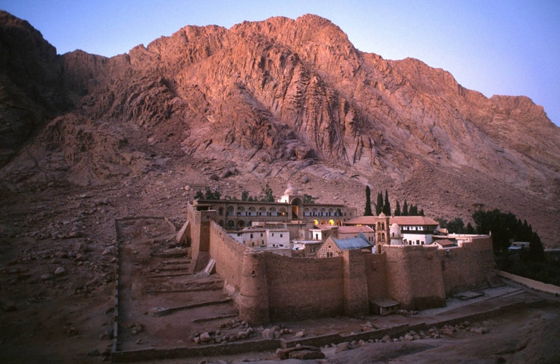

Slide 33
Proverbs 1:7
The fear of the Lord is the beginning of knowledge,
but fools despise wisdom and instruction.

Slide 34
Proverbs 15:33
The fear of the Lord is the instruction of wisdom, and
before honor is humility.

Slide 35
Proverbs 16:6
In mercy and truth Atonement
is provided for iniquity;
And by the fear of the Lord
one departs from evil.

Slide 36
Genesis 39:9
There is no one greater in this house than I, nor has he kept back anything from me but you, because you are his wife. How then can I do this great wickedness, and sin against God?”

Slide 37
Exodus 1:17
But the midwives feared God, and did not do as the king of Egypt commanded them, but saved the male children alive.

Slide 38
Holy fear
produces JOY.

Slide 39
Proverbs 15:16
Better is a little with the fear of the Lord, than great treasure
with trouble.

