Slide 2
1 Samuel 10:24
And Samuel said to all the people, “Do you see him whom the Lord has chosen, that there is no one like him among all the people?” So all the people shouted and said, “Long live the king!”

Slide 3
1 Samuel 18:8
Then Saul was very angry, and the saying displeased him; and he said, “They have ascribed to David ten thousands, and to me they have ascribed only thousands. Now what more can he have but the kingdom?”

Slide 4
1 Samuel 18:12
Now Saul was afraid of David, because the Lord was with him, but had departed from Saul.

Slide 5
1 Samuel 18:15
Therefore, when Saul saw that
he behaved very wisely, he was afraid of him.

Slide 6
1 Samuel 18:21
So Saul said, “I will give her to
him, that she may be a snare to him, and that the hand of the Philistines may be against him.” Therefore Saul said to David a second time, “You shall be my
son-in-law today.”

Slide 7
1 Samuel 18:26
So when his servants told David these words, it pleased David well to become the king’s son-in-law. Now the days had not expired;

Slide 8
1 Samuel 18:27
therefore David arose and went, he and his men, and killed two hundred men of the Philistines. And David brought their foreskins, and they gave them in full count to the king, that he might become the king’s son-in-law. Then Saul gave him Michal his daughter as a wife.

Slide 9
1 Samuel 18:28
Thus Saul saw and knew that the Lord was with David, and that Michal, Saul’s daughter, loved him;

Slide 10
1 Samuel 18:29
and Saul was still more afraid of David. So Saul became David’s enemy continually.

Slide 11
1 Samuel 20:30
Then Saul’s anger was aroused against Jonathan, and he said to him, “You son of a perverse, rebellious woman! Do I not know that you have chosen the son of Jesse to your own shame and to the shame of your mother’s nakedness?

Slide 12
Proverbs 29:25
The fear of man brings a snare,
but whoever trusts in the Lord shall be safe.

Slide 13
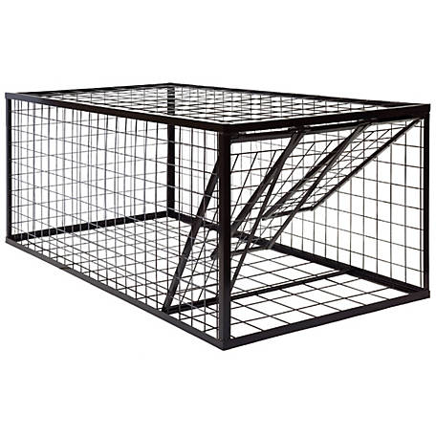

Slide 14
Traps are
DECEPTIVE.

Slide 15
Fear leads us
from our real
PURPOSE.

Slide 16
Hinders
RELATIONSHIPS.

Slide 18
Traps are
DISTRACTING.

Slide 19
Matthew 6:24
“No one can serve two masters;
for either he will hate the one and love the other, or else he will be loyal to the one and despise the other. You cannot serve God and mammon.

Slide 20
Galatians 1:10
For do I now persuade men, or God? Or do I seek to please men? For if I still pleased men, I would not be a bondservant of Christ.

Slide 21
Keeps us from
THINKING about
what God wants.

Slide 22
Galatians 1:10
For do I now persuade men, or God? Or do I seek to please men? For if I still pleased men, I would not be a bondservant of Christ.

Slide 23
Philippians 2:3
Let nothing be done through selfish ambition or conceit, but in lowliness of mind let each esteem others better than himself.

Slide 24
Philippians 2:4
Let each of you look out not only for his own interests, but also for the interests of others.

Slide 25
Romans 12:10
Be kindly affectionate to one another with brotherly love, in honor giving preference to one another;

Slide 26
Causes us to
SERVE others with
wrong motives.

Slide 27
Traps are
DESTRUCTIVE.

Slide 28
Exodus 14:10
And when Pharaoh drew near, the children of Israel lifted their eyes, and behold, the Egyptians marched after them. So they were very afraid, and the children of Israel cried out to the Lord.

Slide 29
Exodus 14:11
Then they said to Moses,
“Because there were no graves in Egypt, have you taken us away to die in the wilderness? Why have you so dealt with us, to bring us
up out of Egypt?

Slide 30
Fear TROUBLES
the heart.

Slide 31
Deuteronomy 1:21
Look, the Lord your God has set the land before you; go up and possess it, as the Lord God of your fathers has spoken to you; do not fear or be discouraged.’

Slide 32
Deuteronomy 20:3
And he shall say to them, ‘Hear,
O Israel: Today you are on the verge of battle with your enemies. Do not let your heart faint, do not be afraid, and do not tremble or be terrified because of them;

Slide 33
Leads to
COMPROMISE.

Slide 34
It creates
HYPOCRISY.

Slide 36
Fear of man
SHIPWRECKS
our faith.

Slide 37
Fear of man
stirs up
JEALOUSY.

Slide 38
Creates
IRRATIONAL
thinking.

Slide 39
Destroys
RELATIONSHIPS.

