Slide 2
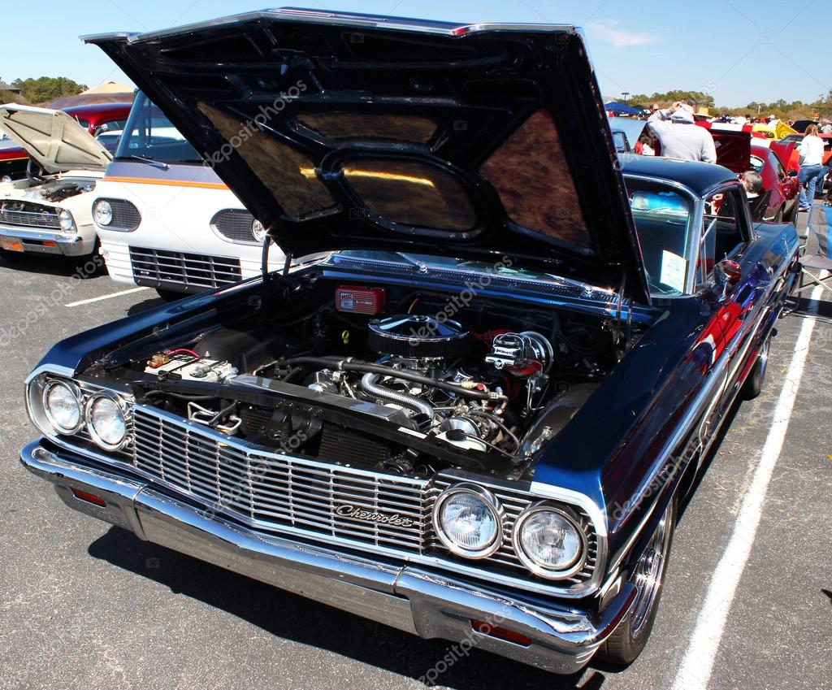

Slide 5
PROVERBS 29:25
The fear of man brings a snare,
but whoever trusts in the Lord
shall be safe.

Slide 6
JEREMIAH 17:9
The heart is deceitful above all things, and desperately wicked; Who can know it?

Slide 7
JEREMIAH 17:10
I, the Lord, search the heart, I test the mind, even to give every man according to his ways, according
to the fruit of his doings.

Slide 8
MATTHEW 15:19
For out of the heart proceed evil thoughts, murders, adulteries, fornications, thefts, false witness, blasphemies.

