Slide 1
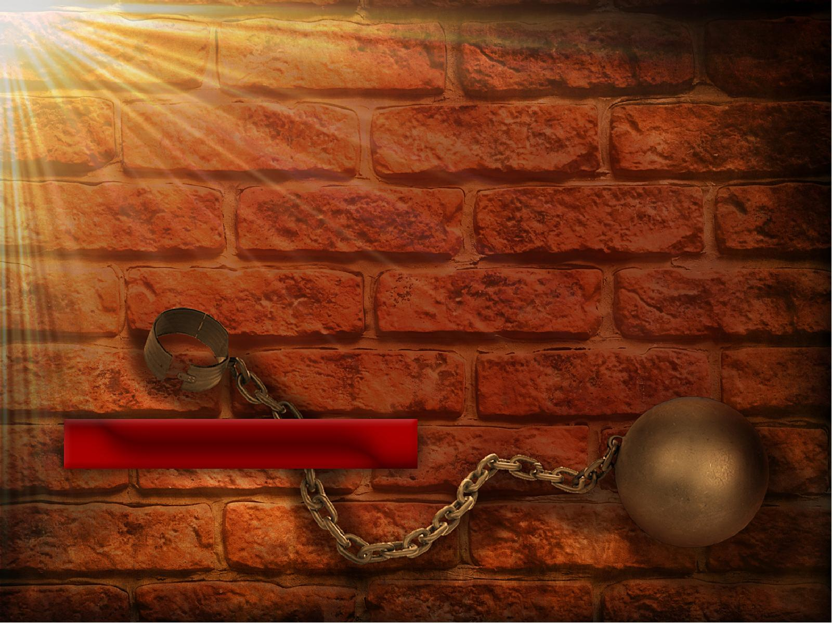
SELF-MADE
PRISONERS
2 Timothy 1:7

Slide 2
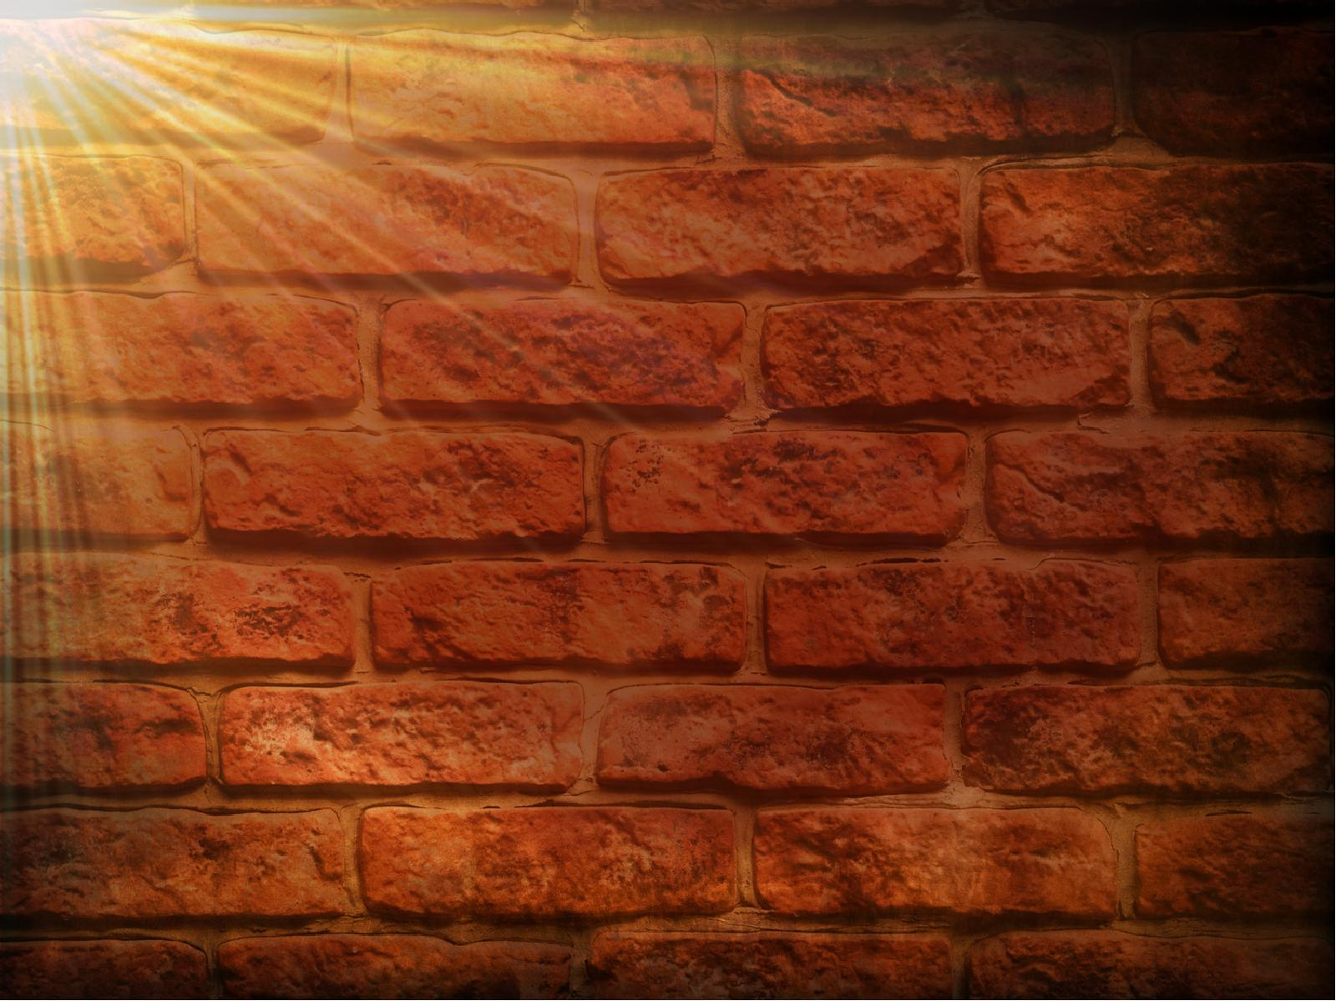
Keep you from doing things you normally WOULD do.

Slide 3
Can cause you to do things you normally
would NOT do.

Slide 4
Sinful fear - a fear that keeps one from OBEYING God.

Slide 5
2 Timothy 1:15
This you know, that all those in Asia have turned away from me, among whom are Phygellus and Hermogenes.

Slide 6
2 Timothy 1:1
Paul, an apostle of Jesus Christ by the will of God, according to the promise of life which is in Christ Jesus,

Slide 7
2 Timothy 1:2
To Timothy, a beloved son: Grace, mercy, and peace from God the Father and Christ Jesus our Lord.

Slide 8
2 Timothy 1:3
I thank God, whom I serve with a pure conscience, as my forefathers did, as without ceasing I remember you in my prayers night and day,

Slide 9
2 Timothy 1:4
greatly desiring to see you, being mindful of your tears, that I may be filled with joy,

Slide 10
2 Timothy 1:5
when I call to remembrance the genuine faith that is in you, which dwelt first in your grandmother Lois and your mother Eunice, and I am persuaded is in you also.

Slide 11
2 Timothy 1:6
Therefore I remind you to stir up the gift of God which is in you through the laying on of my hands.

Slide 12
2 Timothy 1:7
For God has not given us a spirit of fear, but of power and of love and of a sound mind.

Slide 13
2 Timothy 1:8
Therefore do not be ashamed of the testimony of our Lord, nor of me His prisoner, but share with me in the sufferings for the gospel according to the power of God,

Slide 14
Do not be
controlled by
“SINFUL FEAR”.

Slide 15
2 Timothy 1:7
For God has not given us a spirit of fear, but of power and of love and of a sound mind.

Slide 16
Romans 8:15
For you did not receive the spirit of bondage again to fear, but you received the Spirit of adoption by whom we cry out, “Abba, Father.”

Slide 17
SELF-MADE
PRISONERS
2 Timothy 1:7

