Slide 2
Exodus 20:12
“Honor your father and your mother, that your days may be long upon the land which the Lord your God is giving you.

Slide 3
Deuteronomy 5:16
‘Honor your father and your mother, as the Lord your God has commanded you, that your days may be long, and that it may be well with you in the land which the Lord your God is giving you.

Slide 4
Ephesians 6:1
Children, obey your parents in the Lord, for this is right.

Slide 5
Ephesians 6:2
“Honor your father and mother,” which is the first commandment with promise:

Slide 6
Ephesians 6:3
“that it may be well with you and you may live long on the earth.”

Slide 7
Colossians 3:20
Children, obey your parents in all things, for this is well pleasing to the Lord.

Slide 8
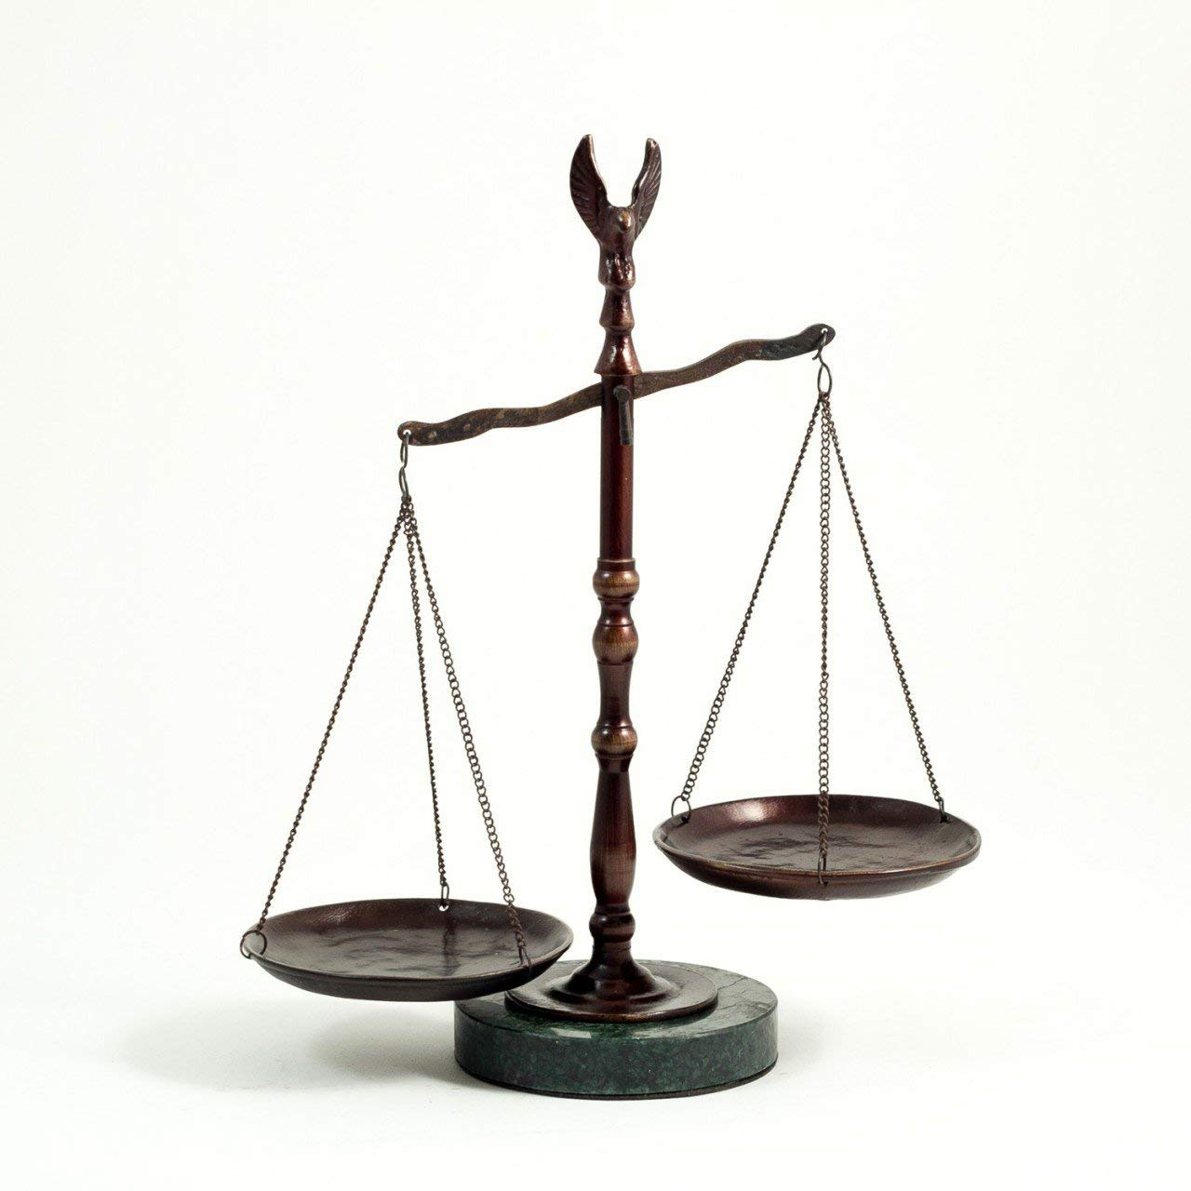

Slide 9
Show great
RESPECT for.

Slide 10
CARE for
her needs.

Slide 11
Speak KINDLY
to her.

Slide 12
Speak HIGHLY
of her.

Slide 13
Be LOVING
toward her.

Slide 14
Don’t LIVE in a way
that breaks her heart.

Slide 15
Help her with PROBLEMS.

Slide 16
PRAY for her.

Slide 17
Spend TIME
with her.

Slide 18
LISTEN to her.

Slide 19
CALL her.

Slide 20
PROVIDE her
basic needs.

