Slide 2
Self confidence won’t
beat REALITY.

Slide 3
Beating “sinful fear” doesn’t come from
YOU.

Slide 4
It comes from
who GOD is and what
GOD has done.

Slide 5
2 Timothy 1:7
For God has not given us a spirit of fear, but of power and of love and of a sound mind.

Slide 6
First, God has
given us the spirit of
POWER.

Slide 7
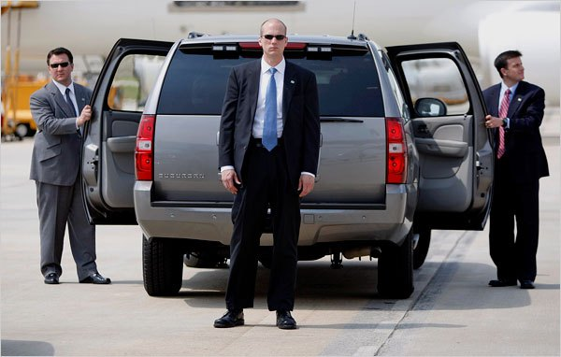

Slide 8
Our problems are NOTHING for the
Holy Spirit.

Slide 9
Ephesians 1:18
the eyes of your understanding being enlightened; that you may know what is the hope of His calling, what are the riches of the glory of His inheritance in the saints,

Slide 10
Ephesians 1:19
and what is the exceeding greatness of His power toward us who believe, according to the working of His mighty power

Slide 11
Romans 8:11
But if the Spirit of Him who raised Jesus from the dead dwells in you, He who raised Christ from the dead will also give life to your mortal bodies through His Spirit who dwells in you.

Slide 12
1 Corinthians 15:54
So when this corruptible has put on incorruption, and this mortal has put on immortality, then shall be brought to pass the saying that is written: “Death is swallowed up in victory.”

Slide 13
1 Corinthians 15:55
“O Death, where is your sting? O Hades, where is your victory?”

Slide 14
Instead of fearing FUTURE, trust God for the strength you need TODAY.

Slide 16
1 Corinthians 2:3
I was with you in weakness, in fear, and in much trembling.

Slide 17
Stop looking to YOURSELF for
courage and look to GOD.

Slide 18
Second, God has given
us the spirit of LOVE.

Slide 19
The cause is often being SELF CENTERED.

Slide 20
1 John 4:18
There is no fear in love; but perfect love casts out fear, because fear involves torment. But he who fears has not been made perfect in love.

Slide 21
Love = self GIVING.

Slide 22
Fear =
self PROTECTING.

Slide 23
Believers are to be characterized by LOVE not SELFISHNESS.

Slide 24
Romans 8:38
For I am persuaded that neither death nor life, nor angels nor principalities nor powers, nor things present nor things to come,

Slide 25
Romans 8:39
nor height nor depth, nor any other created thing, shall be able to separate us from
the love of God which is in
Christ Jesus our Lord.

Slide 26
2 Corinthians 5:14
For the love of Christ
compels us, because we judge thus: that if One died for all, then all died;

Slide 27
Third, God gives us
the spirit of SOUND JUDGMENT.

Slide 28
Fear produces CONFUSION
and chaos.

Slide 31
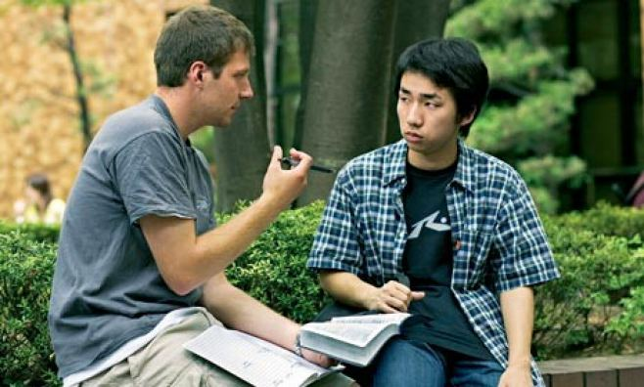

Slide 32
Fear makes us think IRRATIONALLY.

Slide 34
