Slide 2
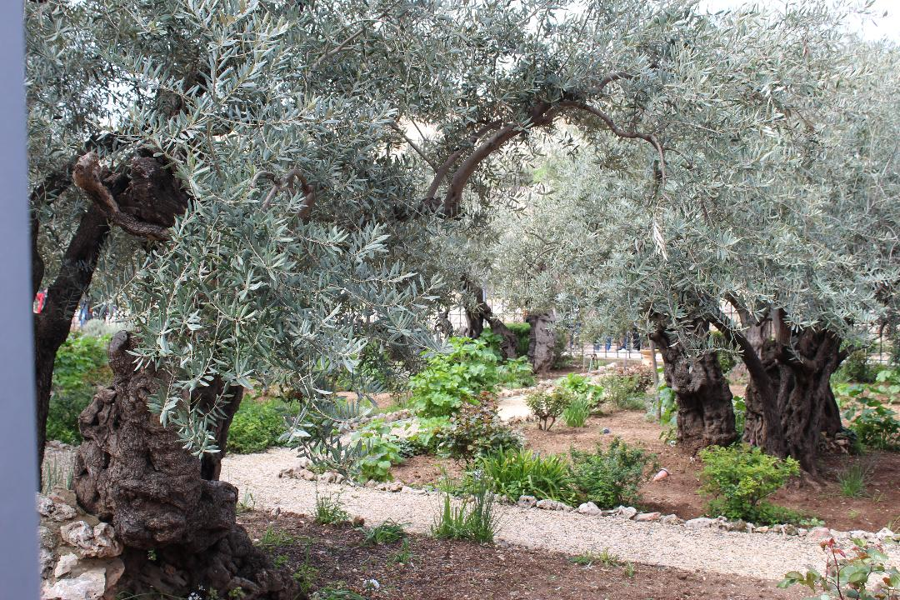

Slide 3
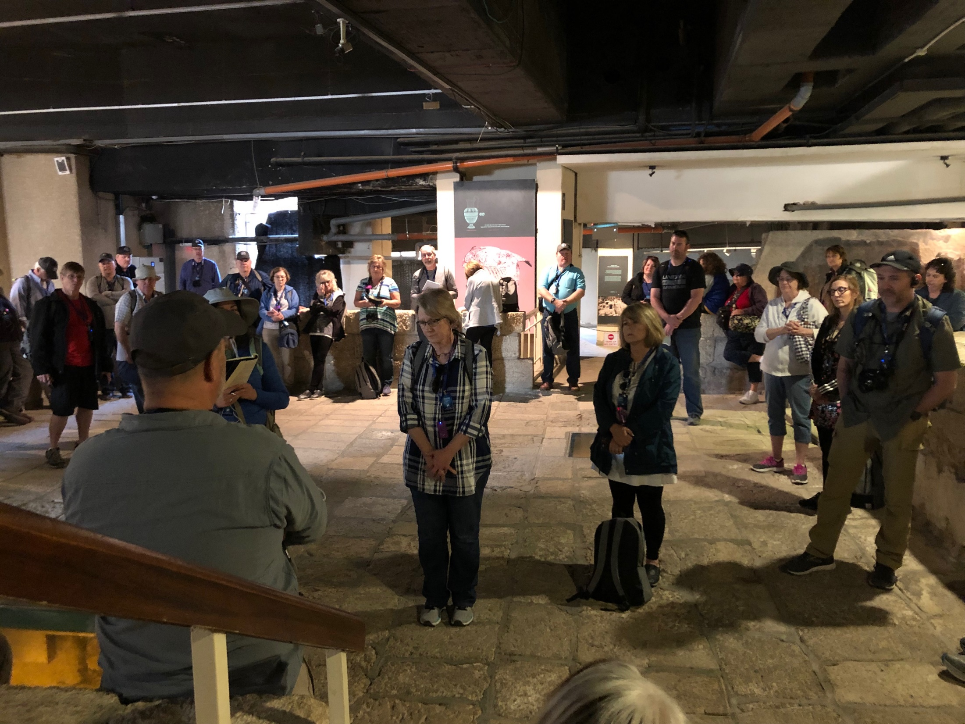

Slide 4
LUKE 23:26
Now as they led Him away, they laid hold of a certain man, Simon a Cyrenian, who was coming from the country, and on him they laid the cross that he might bear it after Jesus.

Slide 5
LUKE 23:27
And a great multitude of the people followed Him, and women who also mourned and lamented Him.

Slide 6
LUKE 23:28
But Jesus, turning to them, said, “Daughters of Jerusalem, do not weep for Me, but weep for yourselves and for your children.

Slide 7
LUKE 23:29
For indeed the days are coming in which they will say, ‘Blessed are the barren, wombs that never bore, and breasts which never nursed!’

Slide 8
LUKE 23:30
Then they will begin ‘to say to the mountains, “Fall on us!” and to the hills, “Cover us!” ’

Slide 9
LUKE 23:31
For if they do these things in the green wood, what will be done in
the dry?”

Slide 10
LUKE 23:32
There were also two others, criminals, led with Him to be put to death.

Slide 11
LUKE 23:33
And when they had come to the place called Calvary, there they crucified Him, and the criminals, one on the right hand and the other on the left.

Slide 12
LUKE 23:34
Then Jesus said, “Father, forgive them, for they do not know what they do.” And they divided His garments and cast lots.

Slide 13
LUKE 23:35
And the people stood looking on. But even the rulers with them sneered, saying, “He saved others; let Him save Himself if He is the Christ, the chosen of God.”

Slide 14
LUKE 23:36
The soldiers also mocked Him, coming and offering Him sour wine,

Slide 15
LUKE 23:37
and saying, “If You are the King of the Jews, save Yourself.”

Slide 16
LUKE 23:38
And an inscription also was written over Him in letters of Greek, Latin, and Hebrew: THIS IS THE KING OF THE JEWS

Slide 17
LUKE 23:39
Then one of the criminals who were hanged blasphemed Him, saying, “If You are the Christ, save Yourself and us.”

Slide 18
LUKE 23:40
But the other, answering, rebuked him, saying, “Do you not even fear God, seeing you are under the same condemnation?

Slide 19
LUKE 23:41
And we indeed justly, for we receive the due reward of our deeds; but this Man has done nothing wrong.”

Slide 20
LUKE 23:42
Then he said to Jesus, “Lord, remember me when You come into Your kingdom.”

Slide 21
LUKE 23:43
And Jesus said to him, “Assuredly, I say to you, today you will be with Me in Paradise.”

Slide 22
LUKE 23:44
Now it was about the sixth hour, and there was darkness over all the earth until the ninth hour.

Slide 23
LUKE 23:45
Then the sun was darkened, and the veil of the temple was torn in two.

Slide 24
LUKE 23:46
And when Jesus had cried out with a loud voice, He said, “Father, ‘into Your hands I commit My spirit.’ ” Having said this, He breathed His last.

Slide 25
LUKE 23:47
So when the centurion saw what had happened, he glorified God, saying, “Certainly this was a righteous Man!”

Slide 26
LUKE 23:48
And the whole crowd who came together to that sight, seeing what had been done, beat their breasts and returned.

Slide 27
LUKE 23:49
But all His acquaintances, and the women who followed Him from Galilee, stood at a distance, watching these things.

Slide 28
LUKE 23:50
Now behold, there was a man named Joseph, a council member,
a good and just man.

Slide 29
LUKE 23:51
He had not consented to their decision and deed. He was from Arimathea, a city of the Jews, who himself was also waiting for the kingdom of God.

Slide 30
LUKE 23:52
This man went to Pilate and asked for the body of Jesus.

Slide 31
LUKE 23:53
Then he took it down, wrapped it in linen, and laid it in a tomb that was hewn out of the rock, where no one had ever lain before.

Slide 32
LUKE 23:54
That day was the Preparation,
and the Sabbath drew near.

Slide 33
LUKE 23:55
And the women who had come with Him from Galilee followed after, and they observed the tomb and how
His body was laid.

Slide 34
LUKE 23:56
Then they returned and prepared spices and fragrant oils. And they rested on the Sabbath according to the commandment.

Slide 35
