Slide 3
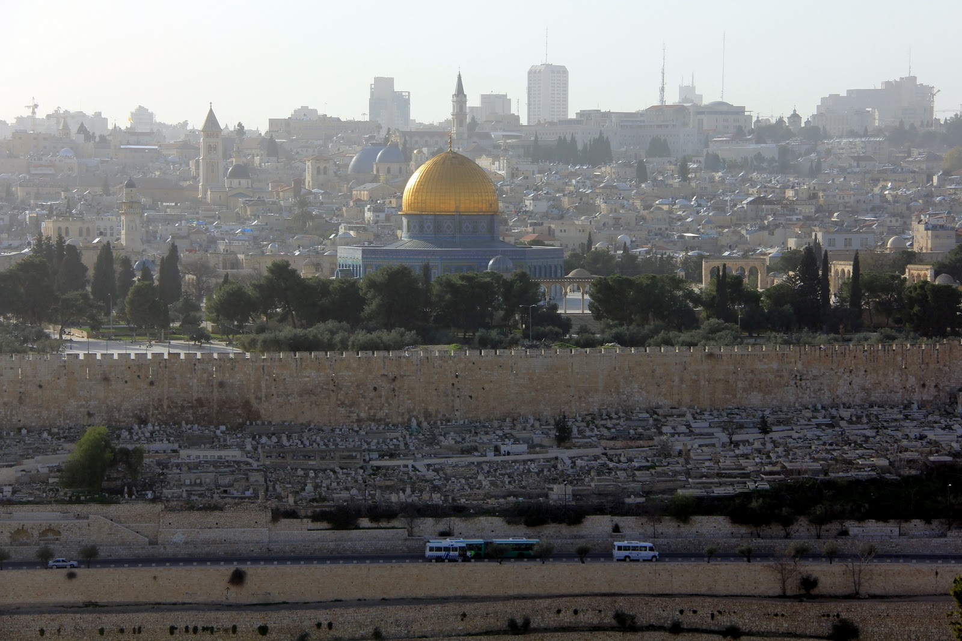

Slide 4
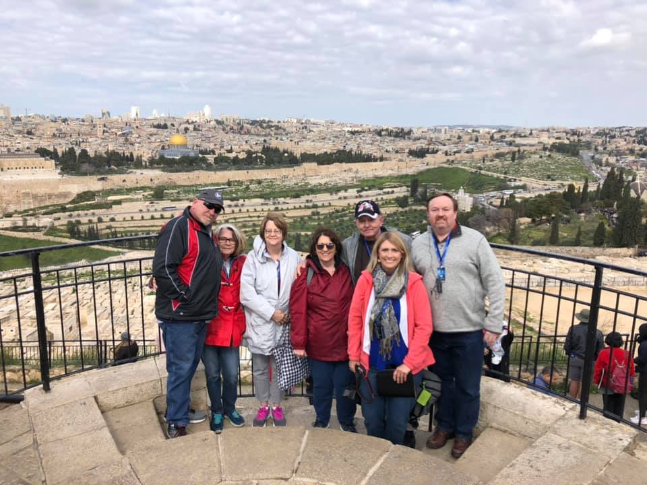

Slide 5
Luke 19:28
When He had said this, He went on ahead, going up to Jerusalem.

Slide 6
Luke 19:29
And it came to pass, when He drew near to Bethphage and Bethany, at the mountain called Olivet, that He sent two of His disciples,

Slide 7
Luke 19:30
saying, “Go into the village opposite you, where as you enter you will find a colt tied, on which no one has ever sat. Loose it and bring it here.

Slide 8
Luke 19:31
And if anyone asks you, ‘Why are you loosing it?’ thus you shall say to him, ‘Because the Lord has need of it.’ ”

Slide 9
Luke 19:32
So those who were sent went their way and found it just as He had said
to them.

Slide 10
Luke 19:33
But as they were loosing the colt,
the owners of it said to them,
“Why are you loosing the colt?”

Slide 11
Luke 19:34
And they said,
“The Lord has need of him.”

Slide 12
Luke 19:35
Then they brought him to Jesus.
And they threw their own clothes
on the colt, and they set Jesus on him.

Slide 13
Luke 19:36
And as He went, many spread their clothes on the road.

Slide 14
Luke 19:37
Then, as He was now drawing near the descent of the Mount of Olives, the whole multitude of the disciples began to rejoice and praise God with a loud voice for all the mighty works they had seen,

Slide 15
Luke 19:38
saying: “ ‘Blessed is the King who comes in the name of the Lord!’ Peace in heaven and glory in the highest!”

Slide 16
Luke 19:39
And some of the Pharisees called
to Him from the crowd, “Teacher,
rebuke Your disciples.”

Slide 17
Luke 19:40
But He answered and said to them,
“I tell you that if these should keep silent, the stones would immediately cry out.”

Slide 18
Zechariah 9:9
“Rejoice greatly, O daughter of Zion! Shout, O daughter of Jerusalem! Behold, your King is coming to you; He is just and having salvation, Lowly and riding on a donkey, A colt, the foal of a donkey.

Slide 19
Matthew 26:3
Then the chief priests, the scribes, and the elders of the people assembled at the palace of the high priest, who was called Caiaphas,

Slide 20
Matthew 26:4
and plotted to take Jesus by trickery and kill Him.

Slide 21
Matthew 26:5
But they said, “Not during the feast, lest there be an uproar among
the people.”

Slide 22
John 1:29
The next day John saw Jesus coming toward him, and said, “Behold! The Lamb of God who takes away the sin of the world!

Slide 23
1 Corinthians 5:7
Therefore purge out the old leaven, that you may be a new lump, since you truly are unleavened. For indeed Christ, our Passover, was sacrificed for us.

Slide 24
John 7:30
Therefore they sought to take Him; but no one laid a hand on Him, because His hour had not yet come.

Slide 25
Matthew 26:14
Then one of the twelve, called Judas Iscariot, went to the chief priests

Slide 26
Matthew 26:15
and said, “What are you willing to give me if I deliver Him to you?” And they counted out to him thirty pieces of silver.

Slide 27
Matthew 26:16
So from that time he sought opportunity to betray Him.

Slide 28
Luke 12:49
“I came to send fire on the earth, and how I wish it were already kindled!

Slide 29
Luke 12:50
But I have a baptism to be baptized with, and how distressed I am till it is accomplished!

Slide 30
Luke 12:51
Do you suppose that I came to give peace on earth? I tell you, not at all, but rather division.

Slide 31
Luke 12:52
For from now on five in one house will be divided: three against two, and two against three.

Slide 32
Luke 12:53
Father will be divided against son and son against father, mother against daughter and daughter against mother, mother-in-law against her daughter-in-law and daughter-in-law against her mother-in-law.”

Slide 33
Romans 5:1
Therefore, having been justified by faith, we have peace with God through our Lord Jesus Christ,

