Slide 2
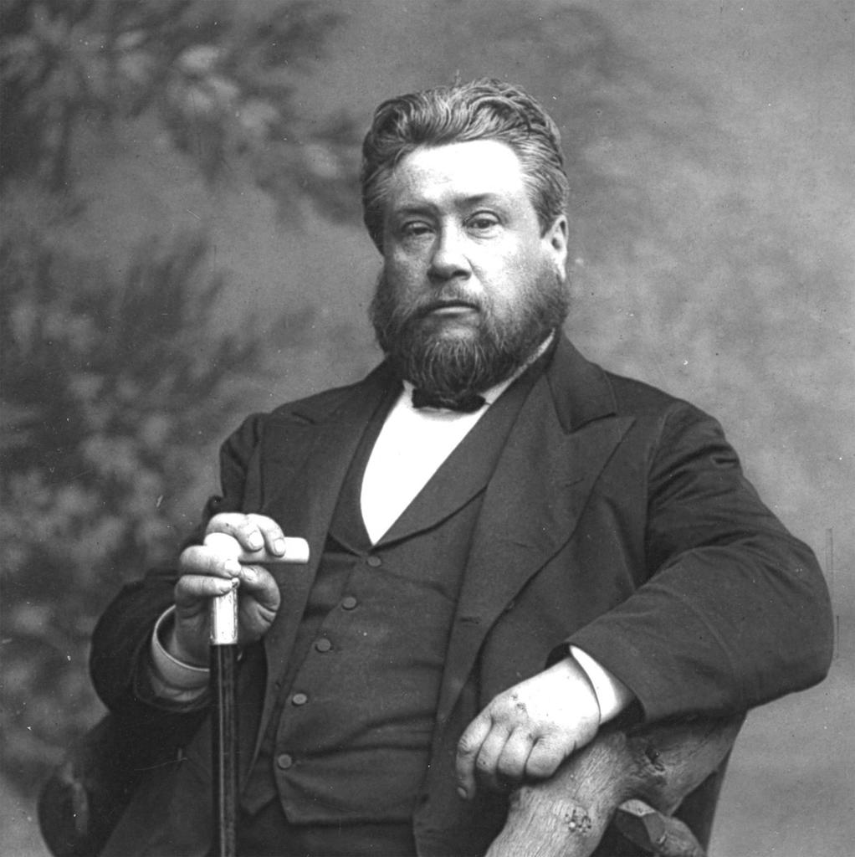

Slide 3
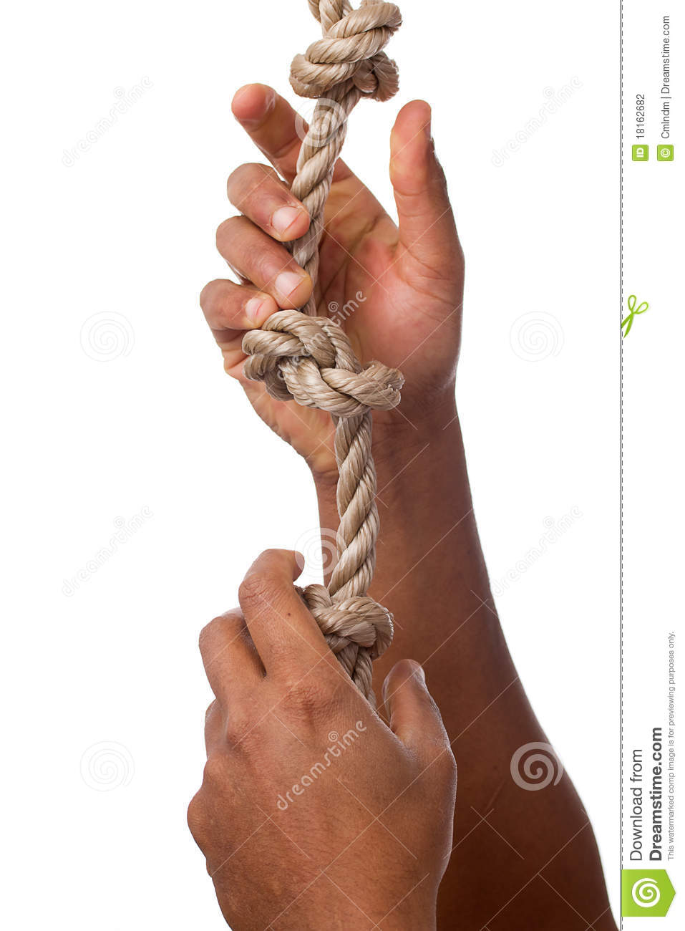

Slide 4
Acts 7:8
Then He gave him the covenant of circumcision; and so Abraham begot Isaac and circumcised him on the eighth day; and Isaac begot Jacob, and Jacob begot the twelve patriarchs.

Slide 5
Acts 7:9
“And the patriarchs, becoming envious, sold Joseph into Egypt. But God was with him

Slide 6
Acts 7:10
and delivered him out of all his troubles, and gave him favor and wisdom in the presence of Pharaoh, king of Egypt; and he made him governor over Egypt and all his house.

Slide 7
Genesis 37:3
Now Israel loved Joseph more than all his children, because he was the son of his old age. Also he made him a tunic of many colors.

Slide 8
Genesis 37:4
But when his brothers saw that their father loved him more than all his brothers, they hated him and could not speak peaceably to him.

Slide 9
JEALOUSY
is a terrible cancer.

Slide 10
Allowing ONE STEP
in the wrong direction
was bad.

Slide 11
Genesis 39:1
Now Joseph had been taken down to Egypt. And Potiphar, an officer of Pharaoh, captain of the guard, an Egyptian, bought him from the Ishmaelites who had taken him down there.

Slide 12
Genesis 39:2
The Lord was with Joseph, and he was a successful man; and he was in the house of his master the Egyptian.

Slide 13
The Lord was
WITH HIM there.

Slide 14
Genesis 39:3
And his master saw that the Lord was with him and that the Lord made all he did to prosper in his hand.

Slide 15
Genesis 39:4
So Joseph found favor in his sight, and served him. Then he made him overseer of his house, and all that he had he put under his authority.

Slide 16
Genesis 39:5
So it was, from the time that he had made him overseer of his house and all that he had, that the Lord blessed the Egyptian’s house for Joseph’s sake; and the blessing of the Lord was on all that he had in the house and in the field.

Slide 17
Genesis 39:6
Thus he left all that he had in Joseph’s hand, and he did not know what he had except for the bread which he ate. Now Joseph was handsome in form and appearance.

Slide 18
Genesis 39:7
And it came to pass after these things that his master’s wife cast longing eyes on Joseph, and she said, “Lie with me.”

Slide 19
Genesis 39:8
But he refused and said to his master’s wife, “Look, my master does not know what is with me in the house, and he has committed all that he has to
my hand.

Slide 20
Genesis 39:9
There is no one greater in this house than I, nor has he kept back anything from me but you, because you are his wife. How then can I do this great wickedness, and sin against God?”

Slide 21
Sin is always
AGAINST GOD.

Slide 22
Genesis 39:10
So it was, as she spoke to Joseph day by day, that he did not heed her, to lie with her or to be with her.

Slide 23
Genesis 39:11
But it happened about this time, when Joseph went into the house to do his work, and none of the men of the house was inside,

Slide 24
Genesis 39:12
that she caught him by his garment, saying, “Lie with me.” But he left his garment in her hand, and fled and ran outside.

Slide 25
Genesis 39:13
And so it was, when she saw that he had left his garment in her hand and fled outside,

Slide 26
Genesis 39:14
that she called to the men of her house and spoke to them, saying, “See, he has brought in to us a Hebrew to mock us. He came in to me to lie with me, and I cried out with a loud voice.

Slide 27
Genesis 39:15
And it happened, when he heard that I lifted my voice and cried out, that he left his garment with me, and fled and went outside.”

Slide 28
Genesis 39:16
So she kept his garment with her until his master came home.

Slide 29
Genesis 39:17
Then she spoke to him with words like these, saying, “The Hebrew servant whom you brought to us came in to me to mock me;

Slide 30
Genesis 39:18
so it happened, as I lifted my voice and cried out, that he left his garment with me and fled outside.”

Slide 31
Genesis 39:19
So it was, when his master heard the words which his wife spoke to him, saying, “Your servant did to me after this manner,” that his anger was aroused.

Slide 32
Genesis 39:20
Then Joseph’s master took him and put him into the prison, a place where the king’s prisoners were confined. And he was there in the prison.

Slide 33
Genesis 39:21
But the Lord was with Joseph and showed him mercy, and He gave him favor in the sight of the keeper of the prison.

Slide 34
Genesis 39:22
And the keeper of the prison committed to Joseph’s hand all the prisoners who were in the prison; whatever they did there, it was his doing.

Slide 35
Genesis 39:23
The keeper of the prison did not look into anything that was under Joseph’s authority, because the Lord was with him; and whatever he did, the Lord made it prosper.

Slide 36
Always do your
BEST in the WORST situations.

Slide 37
Genesis 50:20
But as for you, you meant evil against me; but God meant it for good, in order to bring it about as it is this day, to save many people alive.

Slide 38
No matter how BAD THINGS get, God is still in control.

Slide 39
Jeremiah 29:10
For thus says the Lord: After seventy years are completed at Babylon, I will visit you and perform My good word toward you, and cause you to return to this place.

Slide 40
Jeremiah 29:11
For I know the thoughts that I think toward you, says the Lord, thoughts of peace and not of evil, to give you a future and a hope.

Slide 41
If God is in control,
then things will FALL INTO PLACE.

Slide 42
If not, then we want to know WHY NOT.

Slide 43
Let go of what we CANNOT control.

Slide 44
God gives us
examples so we
don’t STUMBLE.

Slide 45
John 16:1
“These things I have spoken to you, that you should not be made to stumble.

