Slide 4
Jeremiah 15:18
Why is my pain perpetual And my wound incurable, Which refuses to be healed? Will You surely be to me like an unreliable stream, As waters that fail?

Slide 5
Job 3:3
“May the day perish on which I was born, And the night in which it was said, ‘A male child is conceived.’

Slide 6
Job 3:4
May that day be darkness; May God above not seek it, Nor the light shine upon it.

Slide 7
Ruth 1:20
But she said to them, “Do not call me Naomi; call me Mara, for the Almighty has dealt very bitterly with me.

Slide 8
Ruth 1:21
I went out full, and the Lord has brought me home again empty. Why do you call me Naomi, since the Lord has testified against me, and the Almighty has afflicted me?”

Slide 9
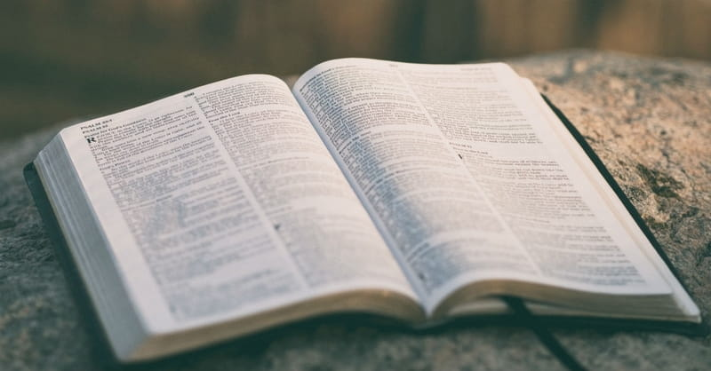

Slide 10
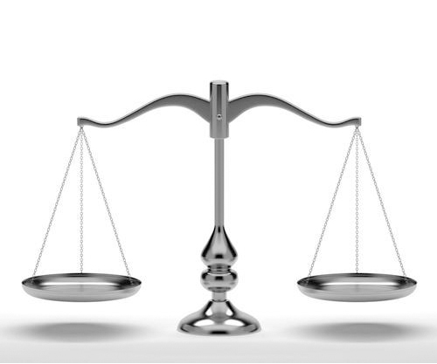

Slide 11
God is a LOVING God.

Slide 12
God is an
ALL POWERFUL God.

Slide 13
Deuteronomy 29:29
“The secret things belong to the Lord our God, but those things which are revealed belong to us and to our children forever,
that we may do all the words of this law.

Slide 14
1 Corinthians 13:12
For now we see in a mirror, dimly, but then face to face. Now I know in part, but then I shall know just as I also am known.

Slide 15
First, we are living in a FALLEN world.

Slide 16
Romans 8:18
For I consider that the sufferings of this present time are not worth comparing with the glory that is to be revealed to us.

Slide 17
Romans 8:19
For the creation waits with eager longing for the revealing of the sons of God.

Slide 18
Romans 8:20
For the creation was subjected to futility, not willingly, but because of him who subjected it, in hope

Slide 19
Romans 8:21
that the creation itself will be
set free from its bondage to corruption and obtain the freedom of the glory of the children of God.

Slide 20
Romans 8:22
For we know that the whole creation has been groaning together in the pains of
childbirth until now.

Slide 21
Romans 8:23
And not only the creation,
but we ourselves, who have the firstfruits of the Spirit, groan inwardly as we wait eagerly for adoption as sons, the redemption of our bodies.

Slide 22
Romans 8:24
For in this hope we were saved. Now hope that is seen is not hope. For who hopes for what
he sees?

Slide 23
Romans 8:25
But if we hope for what we do not see, we wait for it with patience.

Slide 24
Second, Christ is REDEEMING this world.

Slide 25
Third, we are not
HOME yet.

Slide 26
2 Corinthians 4:17
For our light affliction, which is but for a moment, is working for us a far more exceeding and eternal weight of glory,

Slide 27
2 Corinthians 4:18
while we do not look at the things which are seen, but at the things which are not seen. For the things which are seen are temporary, but the things which are not seen are eternal.

Slide 28
Fourth, we are
never ALONE.

Slide 29
Psalm 34:18
The Lord is near to those who have a broken heart, And saves such as have a contrite spirit.

Slide 30
Hebrews 13:5
Let your conduct be without covetousness; be content with such things as you have. For He Himself has said, “I will never leave you nor forsake you.”

