Slide 1


Slide 2
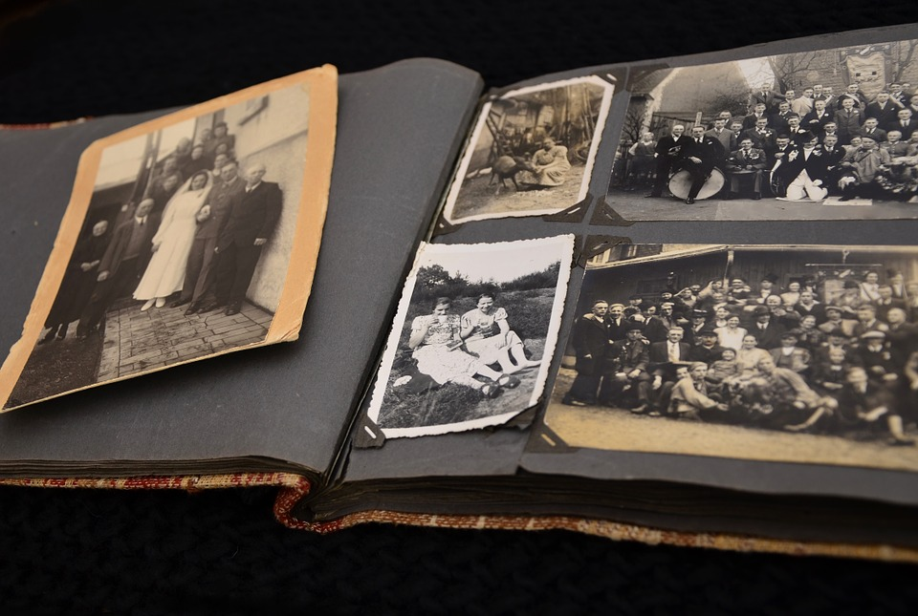

Slide 3
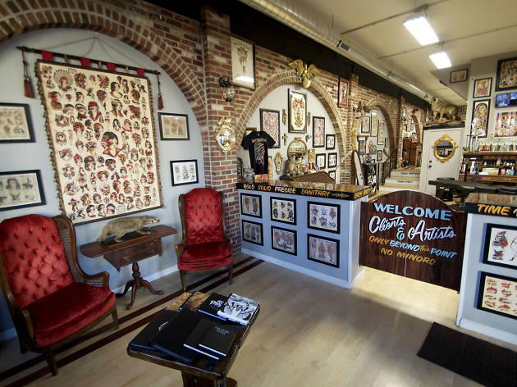

Slide 4
Isaiah 49:15
“Can a woman forget her nursing child, and not have compassion on the son of her womb? Surely they may forget, yet I will not forget you.

Slide 5
Isaiah 49:16
See, I have inscribed you on the palms of My hands; Your walls are continually before Me.

Slide 6
Isaiah 9:6
For unto us a Child is born, unto us a
Son is given; and the government will be upon His shoulder. And His name
will be called Wonderful, Counselor, Mighty God, Everlasting Father,
Prince of Peace.

Slide 7
Isaiah 9:7
Of the increase of His government and peace there will be no end, upon the throne of David and over His kingdom, to order it and establish it with judgment and justice from that time forward, even forever. The zeal of the Lord of hosts will perform this.

Slide 8
John 20:19
Then, the same day at evening, being the first day of the week, when the doors were shut where the disciples were assembled, for fear of the Jews, Jesus came and stood in the midst, and said to them, “Peace be with you.”

Slide 9
John 20:20
When He had said this, He showed
them His hands and His side. Then
the disciples were glad when they
saw the Lord.

Slide 10
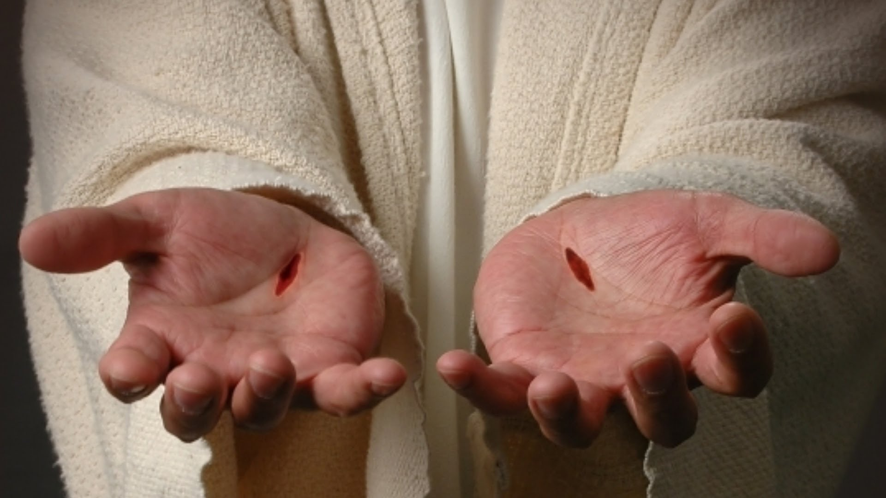

Slide 11
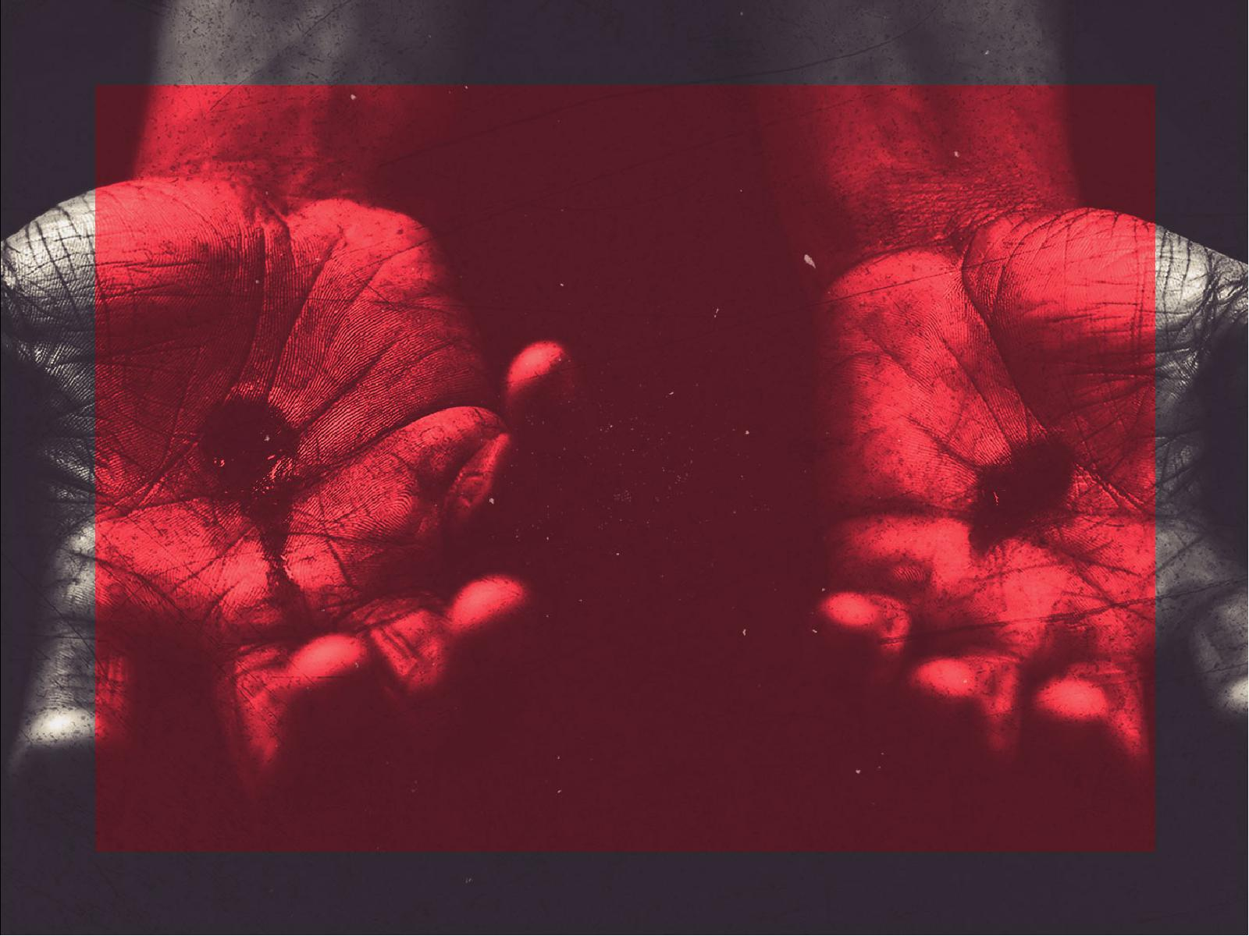
Scars can only
come from
WOUNDS.

Slide 12
Isaiah 53:4
Surely He has borne our griefs and carried our sorrows; yet we esteemed Him stricken, smitten by God, and afflicted.

Slide 13
Isaiah 53:5
But He was wounded for our transgressions, He was bruised for our iniquities; the chastisement for our peace was upon Him, and by His stripes we are healed.

Slide 14
Scars remind me
of His LOVE for me.

Slide 15
Scars of Jesus
tell the GREATEST STORY ever.

