Slide 3
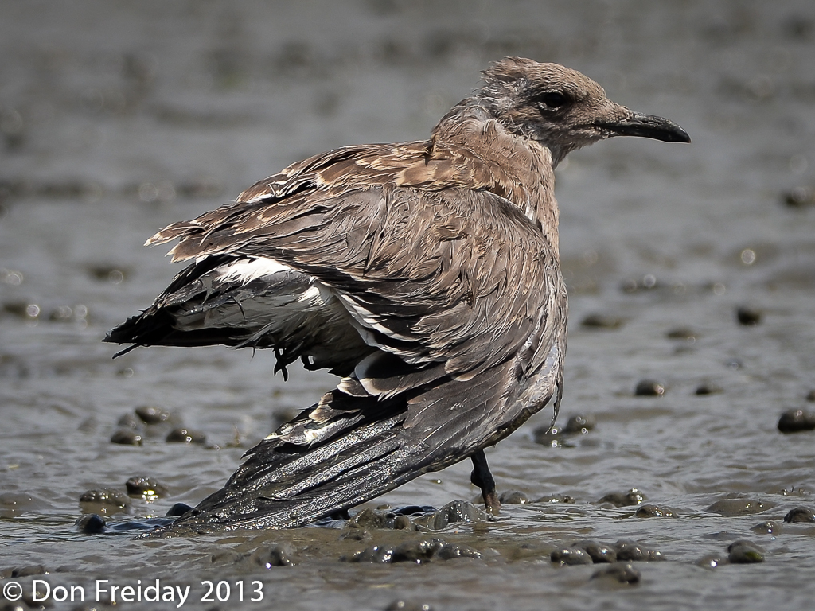

Slide 4
Mark 6:33
But the multitudes saw them departing, and many knew Him and ran there on foot from all the cities. They arrived before them and came together to Him.

Slide 5
Mark 6:34
And Jesus, when He came out, saw a great multitude and was moved with compassion for them, because they were like sheep not having a shepherd. So He began to teach them many things.

Slide 6
Mark 6:35
When the day was now far spent, His disciples came to Him and said, “This is a deserted place, and already the hour is late.

Slide 7
Mark 6:36
Send them away, that they may go into the surrounding country and villages and buy themselves bread; for they have nothing to eat.”

Slide 8
Mark 6:37
But He answered and said to them, “You give them something to eat.” And they said to Him, “Shall we go and buy two hundred denarii worth of bread and give them something to eat?”

Slide 9
Mark 6:38
But He said to them, “How many loaves do you have? Go and see.” And when they found out they said, “Five, and two fish.”

Slide 10
Mark 6:39
Then He commanded them to make them all sit down in groups on the green grass.

Slide 11
Mark 6:40
So they sat down in ranks, in hundreds and in fifties.

Slide 12
Mark 6:41
And when He had taken the five loaves and the two fish, He looked up to heaven, blessed and broke the loaves, and gave them to His disciples to set before them; and the two fish He divided among them all.

Slide 13
Mark 6:42
So they all ate and were filled.

Slide 14
Mark 6:43
And they took up twelve baskets full of fragments and of the fish.

Slide 15
Mark 6:44
Now those who had eaten the loaves were about five thousand men.

Slide 16
We will NEVER
have enough.

Slide 17
We are not SUPPOSE
to have enough.

Slide 18
We can have JOY even in disappointment.

Slide 19
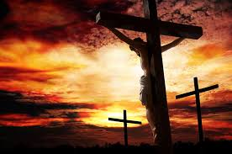

Slide 20
Hebrews 12:1
Therefore we also, since we are surrounded by so great a cloud of witnesses, let us lay aside every weight, and the sin which so easily ensnares us, and let us run with endurance the race that is set before us,

Slide 21
Hebrews 12:2
looking unto Jesus, the author and finisher of our faith, who for the joy that was set before Him endured the cross, despising the shame, and has sat down at the right hand of the throne of God.

