Slide 1


Slide 2
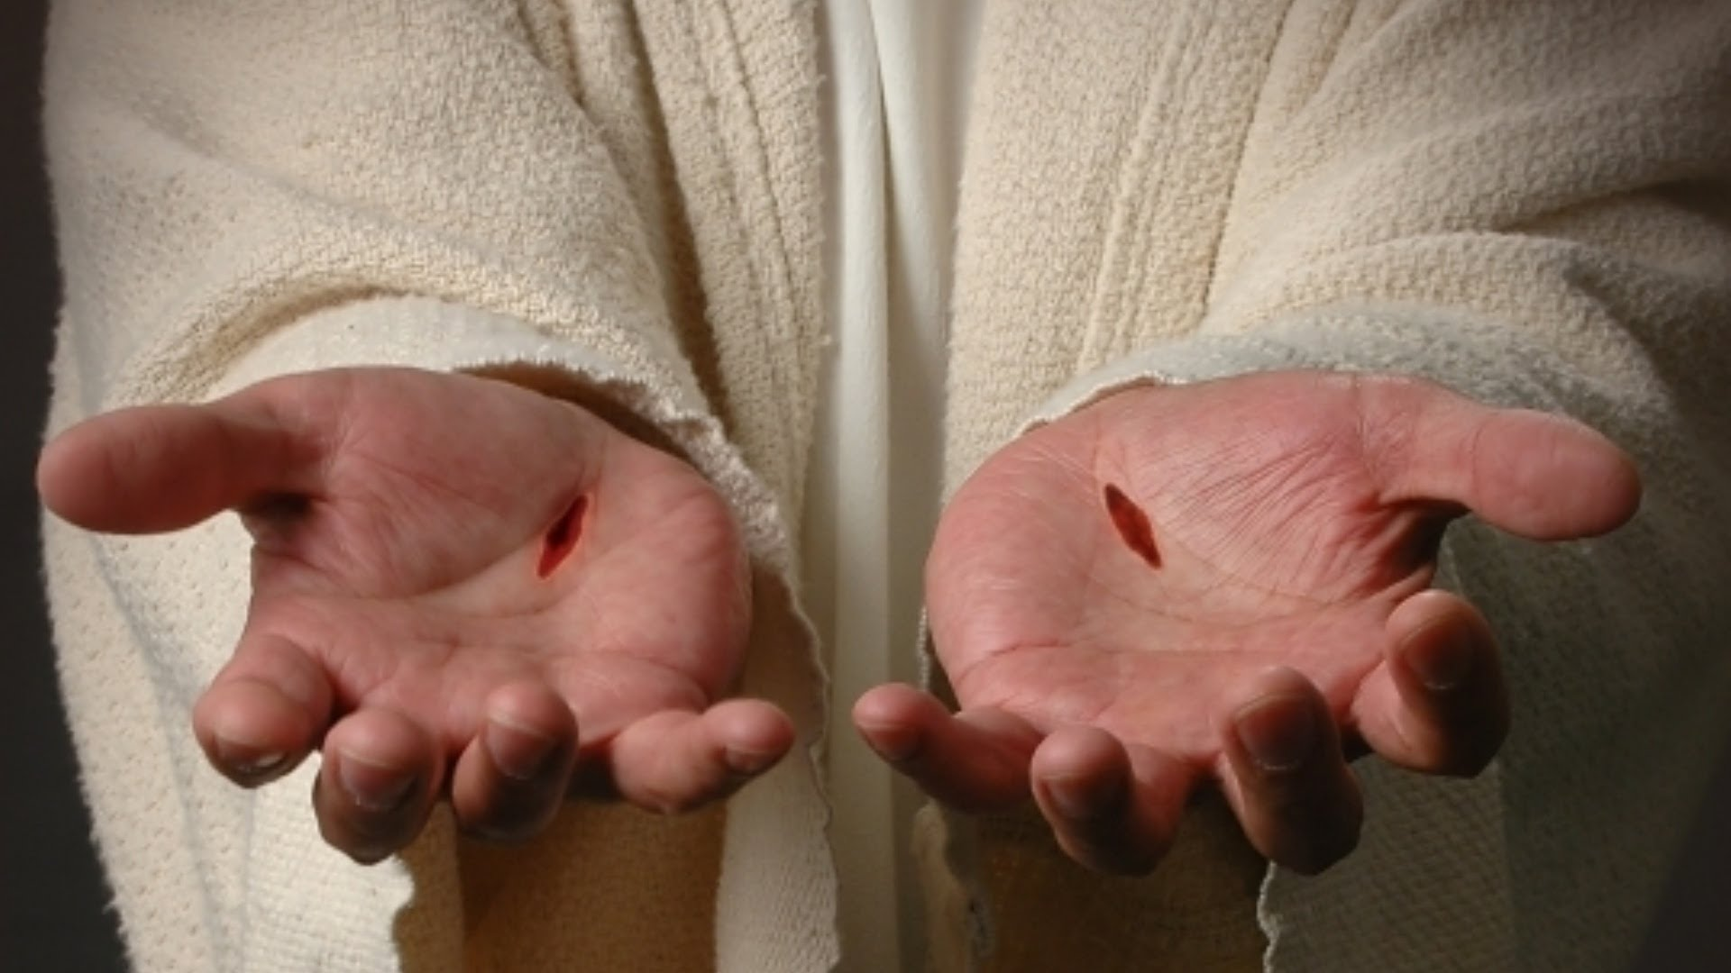

Slide 3
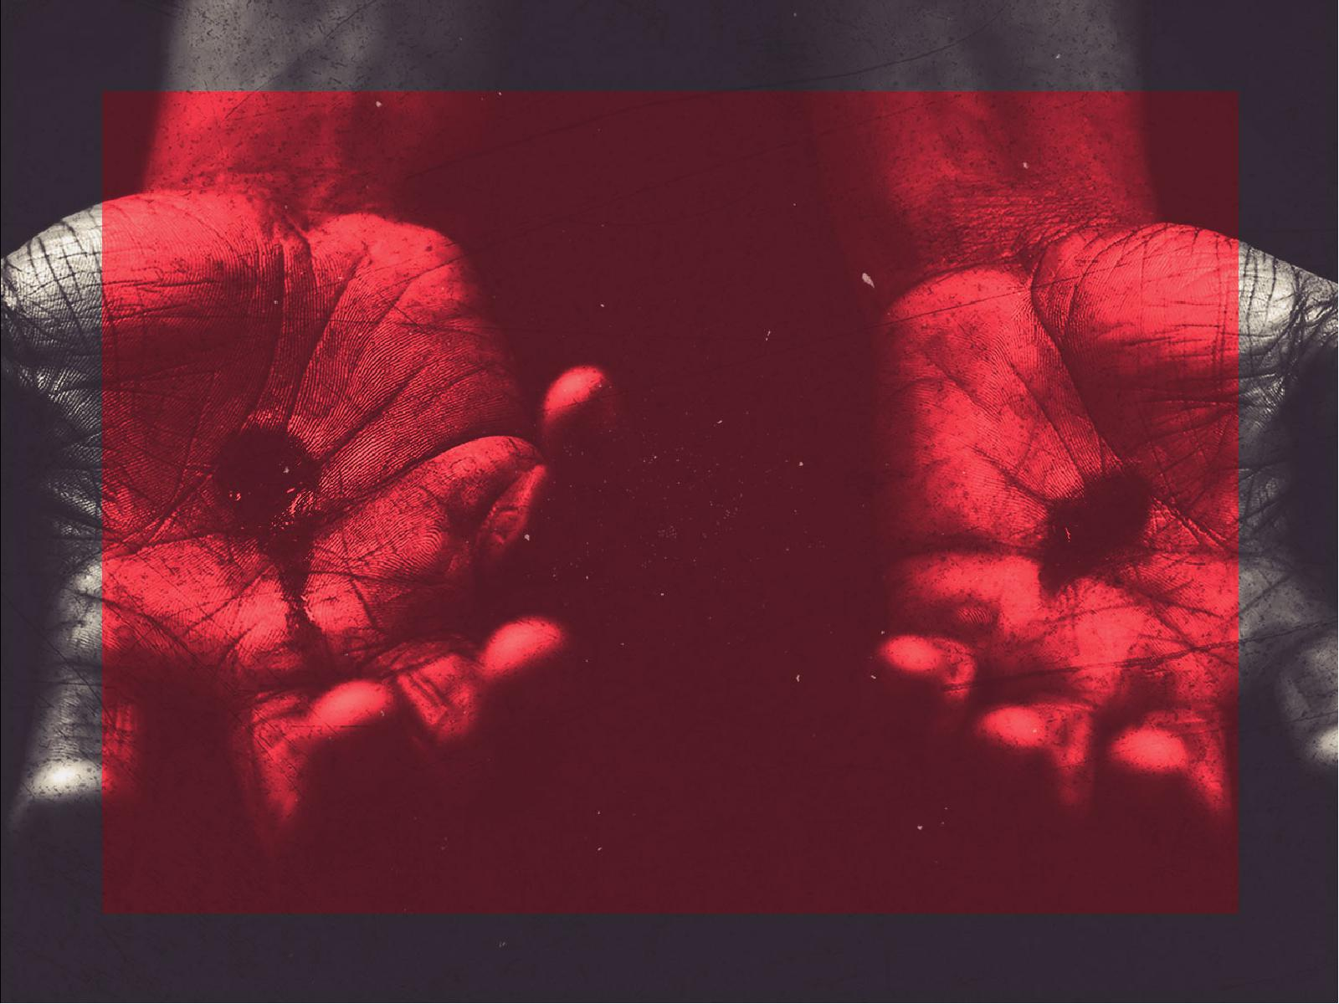
Scars can be
VISIBLE or
INVISIBLE.

Slide 4
Visible scars are
REMINDERS.

Slide 5
Invisible scars are not seen, but are
POWERFUL.

Slide 6
Psalm 51:7
Purge me with hyssop, and I shall be clean; wash me, and I shall be whiter than snow.

Slide 7
Psalm 51:8
Make me hear joy and gladness,
that the bones You have broken may rejoice.

Slide 8
Psalm 51:9
Hide Your face from my sins, and blot out all my iniquities.

Slide 9
Psalm 51:10
Create in me a clean heart, O God,
and renew a steadfast spirit
within me.

Slide 10
Psalm 51:11
Do not cast me away from Your presence, and do not take Your
Holy Spirit from me.

Slide 11
Psalm 51:12
Restore to me the joy of Your salvation, and uphold me by Your generous spirit.

Slide 12
Isaiah 9:6
For unto us a Child is born, unto us a
Son is given; and the government will be upon His shoulder. And His name
will be called Wonderful, Counselor, Mighty God, Everlasting Father,
Prince of Peace.

Slide 13
Isaiah 9:7
Of the increase of His government and peace there will be no end, upon the throne of David and over His kingdom,
to order it and establish it with judgment and justice from that time forward, even forever. The zeal of the Lord of hosts will perform this.

Slide 14
John 16:17
Then some of His disciples said among themselves, “What is this that He says
to us, ‘A little while, and you will not
see Me; and again a little while, and
you will see Me’; and ‘because I go to
the Father’?”

Slide 15
John 16:18
They said therefore, “What is this that He says, ‘A little while’? We do not
know what He is saying.”

Slide 16
John 16:19
Then, the same day at evening, being the first day of the week, when the doors were shut where the disciples were assembled, for fear of the Jews, Jesus came and stood in the midst, and said to them, “Peace be with you.”

Slide 17
John 16:20
When He had said this, He showed
them His hands and His side. Then
the disciples were glad when they
saw the Lord.

Slide 18
Scars are
TROPHIES of
GRACE.

Slide 19
Romans 8:38
For I am persuaded that neither death nor life, nor angels nor principalities nor powers, nor things present nor things to come,

Slide 20
Romans 8:39
nor height nor depth, nor any other created thing, shall be able to separate us from the love of God which is in Christ Jesus our Lord.

Slide 21
Scars tell us we
are HEALED.

Slide 22
Scars are part of
our STORY.

