Slide 1
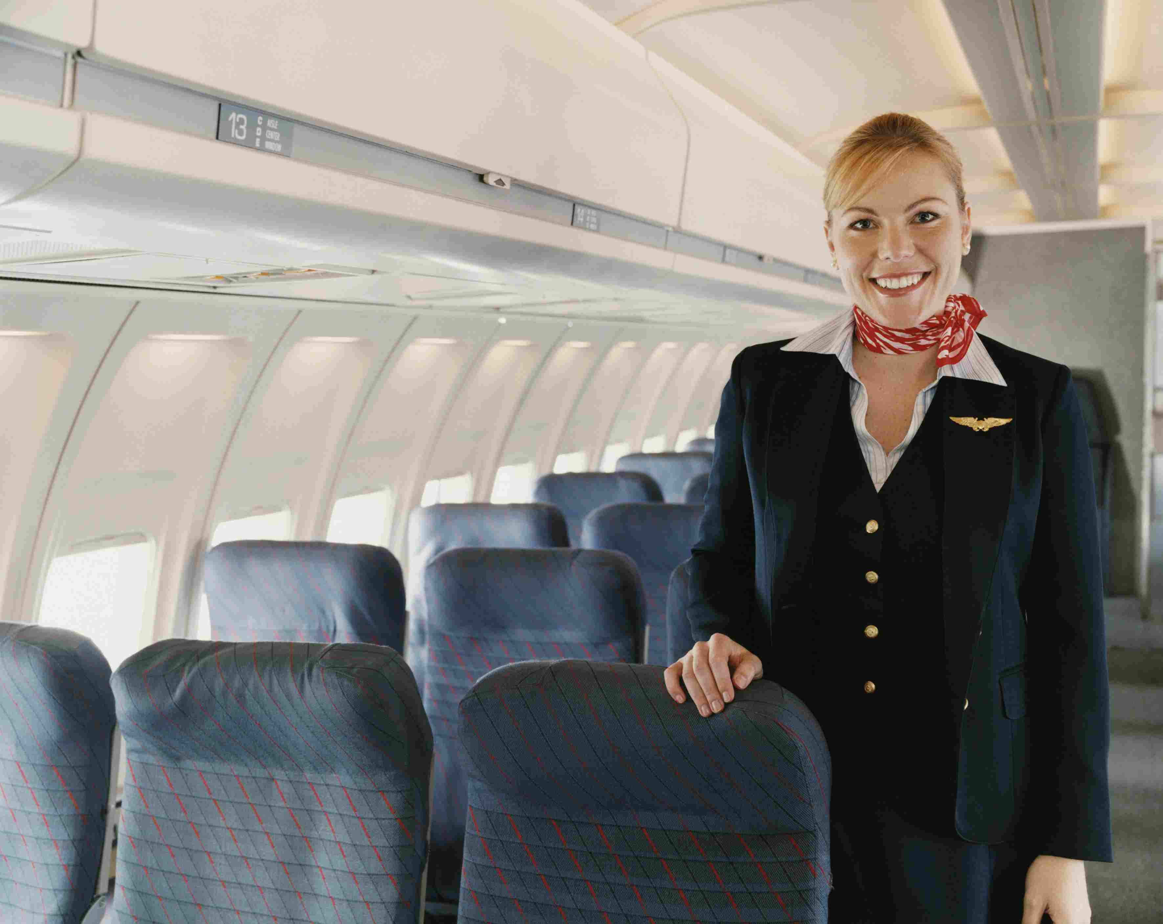
“Would You Like the Window or Aisle?”
Matthew 22 | Luke 14

Slide 2
Matthew 5:13
“You are the salt of the earth; but if the salt loses its flavor, how shall it be seasoned? It is then good for nothing but to be thrown out and trampled underfoot by men.

Slide 3
Matthew 5:14
“You are the light of the world. A city that is set on a hill cannot be hidden.

Slide 4
Matthew 5:15
Nor do they light a lamp and put it under a basket, but on a lampstand, and it gives light to all who are in the house.

Slide 5
Matthew 5:16
Let your light so shine before men, that they may see your good works and glorify your Father in heaven.

Slide 6


Slide 7

“Aisle seat” churches
only focus on INSIDE the four walls.

Slide 8
“Window seat” churches have EXTERNAL focus.

Slide 9
Attractional church says
“PLEASE COME”.

Slide 10
Missional church says, “GO OUT INTO”.

Slide 11
It is far easier to get the church into the COMMUNITY than to get the community into the CHURCH.

Slide 12
Church has become ABSENT in the conversations of social ills and needs.

Slide 13
Sometimes we stay in aisle seat because the window seat is HARD.

Slide 14
The church has become DISENGAGED from social needs.

Slide 15
The church has become IRRELEVANT to the community.

Slide 16
The best churches IN
the community have an
“aisle seat”.

Slide 17
The best church FOR
the community is a
“window seat” church.

Slide 18
“Would You Like the Window or Aisle?”
Matthew 22 | Luke 14

