Slide 1


Slide 2
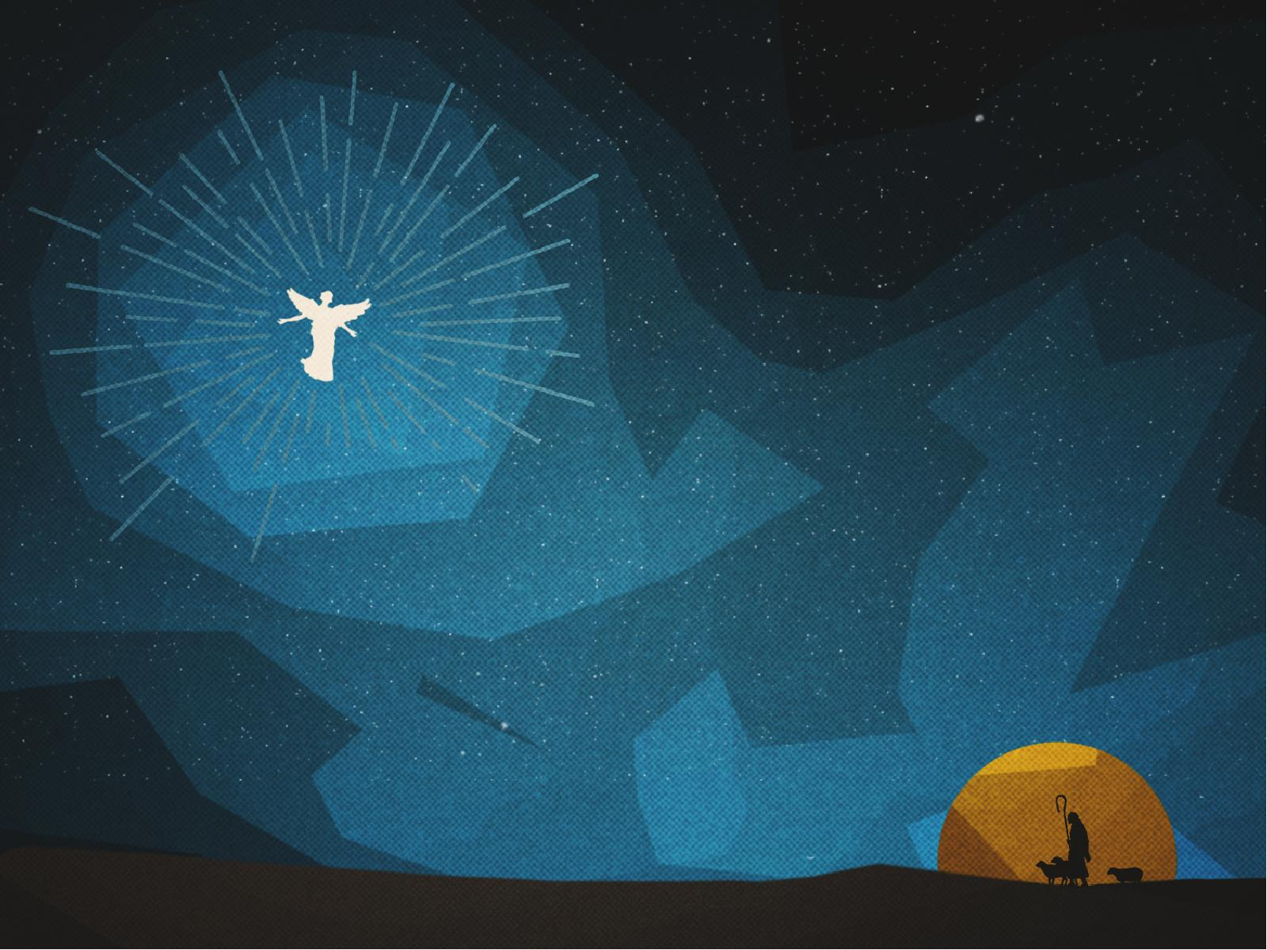
First, the Messiah would be born in BETHLEHEM.

Slide 3

Micah 5:2
“But you, Bethlehem Ephrathah, Though you are little among the thousands of Judah, yet out of you shall come forth to Me The One to be Ruler in Israel, Whose goings forth are from of old, From everlasting.”

Slide 4
Matthew 2:1a
Now after Jesus was born in Bethlehem of Judea…

Slide 5
Second, Messiah would come out of EGYPT.

Slide 6
Matthew 2:1
Now after Jesus was born in Bethlehem of Judea in the days of Herod the king, behold, wise men from the East came to Jerusalem,

Slide 7
Matthew 2:2
saying, “Where is He who has been born King of the Jews? For we have seen His star in the East and have come to worship Him.”

Slide 8
Matthew 2:3
When Herod the king heard this, he was troubled, and all Jerusalem with him.

Slide 9
Matthew 2:4
And when he had gathered all
the chief priests and scribes of the people together, he inquired of them where the Christ was to
be born.

Slide 10
Matthew 2:5
So they said to him, “In Bethlehem of Judea, for thus it is written by the prophet:

Slide 11
Matthew 2:6
‘But you, Bethlehem, in the land of Judah, Are not the least among the rulers of Judah; For out of you shall come a Ruler Who will shepherd
My people Israel.’ ”

Slide 12
Matthew 2:7
Then Herod, when he had secretly called the wise men, determined from them what time the star appeared.

Slide 13
Matthew 2:8
And he sent them to Bethlehem and said, “Go and search carefully for the young Child, and when you have found Him, bring back word to me, that I may come and worship Him also.”

Slide 14
Matthew 2:9
When they heard the king, they departed; and behold, the star which they had seen in the East went before them, till it came and stood over where the young
Child was.

Slide 15
Matthew 2:10
When they saw the star, they rejoiced with exceedingly great joy.

Slide 16
Matthew 2:11
And when they had come into the house, they saw the young Child with Mary His mother, and fell down and worshiped Him. And when they had opened their treasures, they presented gifts to Him: gold, frankincense, and myrrh.

Slide 17
Matthew 2:12
Then, being divinely warned in a dream that they should not return to Herod, they departed for their own country another way.

Slide 18
Matthew 2:13
Now when they had departed, behold, an angel of the Lord appeared to Joseph in a dream, saying, “Arise, take the young Child and His mother, flee to Egypt, and stay there until I bring you word; for Herod will seek the young Child to destroy Him.”

Slide 19
Matthew 2:14
When he arose, he took the young Child and His mother by night and departed for Egypt,

Slide 20
Matthew 2:15
and was there until the death of Herod, that it might be fulfilled which was spoken by the Lord through the prophet, saying, “Out of Egypt I called My Son.”

Slide 21
Third,
the slaughter of innocent babies in RAMAH.

Slide 22
Jeremiah 31:15
Thus says the Lord: “A voice was heard in Ramah, Lamentation and bitter weeping, Rachel weeping for her children, Refusing to be comforted for her children, Because they are no more.”

Slide 23
Matthew 2:16
Then Herod, when he saw that he was deceived by the wise men, was exceedingly angry; and he sent forth and put to death all the male children who were in Bethlehem and in all its districts, from two years old and under, according to the time which he had determined from the wise men.

Slide 24
Matthew 2:17
Then was fulfilled what was spoken by Jeremiah the prophet, saying:

Slide 25
Matthew 2:18
“A voice was heard in Ramah, Lamentation, weeping, and great mourning, Rachel weeping for her children, Refusing to be comforted, Because they are no more.”

Slide 26
Fourth, the Messiah would come from NAZARETH.

Slide 27
Isaiah 11:1
There shall come forth a rod from the stem of Jesse, and a branch shall grow out of his roots.

Slide 28
John 1:45
Philip found Nathanael and said to him, “We have found Him of whom Moses in the law, and also the prophets, wrote—Jesus of Nazareth, the son of Joseph.”

Slide 29
John 1:46
And Nathanael said to him, “Can anything good come out of Nazareth?” Philip said to him, “Come and see.”

Slide 30
Matthew 2:19
Now when Herod was dead, behold, an angel of the Lord appeared in a dream to Joseph in Egypt,

Slide 31
Matthew 2:20
saying, “Arise, take the young Child and His mother, and go to the land of Israel, for those who sought the young Child’s life are dead.”

Slide 32
Matthew 2:21
Then he arose, took the young Child and His mother, and came into the land of Israel.

Slide 33
Matthew 2:22
But when he heard that Archelaus was reigning over Judea instead of his father Herod, he was afraid to go there. And being warned by God in a dream, he turned aside into the region of Galilee.

Slide 34
Matthew 2:23
And he came and dwelt in a city called Nazareth, that it might be fulfilled which was spoken by the prophets, “He shall be called a Nazarene.”

Slide 35
What God has SAID He will DO.

