Slide 1


Slide 2

James 2:14
What does it profit, my brethren, if someone says he has faith but does not have works? Can faith save him?

Slide 3
James 2:15
If a brother or sister is naked and destitute of daily food,

Slide 4
James 2:16
and one of you says to them, “Depart in peace, be warmed and filled,” but you do not give them the things which are needed for the body, what does it profit?

Slide 5
James 2:17
Thus also faith by itself, if it does not have works, is dead.

Slide 6
James 2:18
But someone will say, “You have faith, and I have works.” Show me your faith without your works, and I will show you my faith by my works.

Slide 7
James 2:19
You believe that there is one God.
You do well. Even the demons believe—and tremble!

Slide 8
James 2:20
But do you want to know, O foolish man, that faith without works is dead?

Slide 9
James 2:21
Was not Abraham our father justified by works when he offered Isaac his son on the altar?

Slide 10
James 2:22
Do you see that faith was working together with his works, and by works faith was made perfect?

Slide 11
James 2:23
And the Scripture was fulfilled which says, “Abraham believed God, and it was accounted to him for righteousness.” And he was called the friend of God.

Slide 12
James 2:24
You see then that a man is justified by works, and not by faith only.

Slide 13
James 2:25
Likewise, was not Rahab the harlot also justified by works when she received the messengers and sent them out another way?

Slide 14
James 2:26
For as the body without the spirit
is dead, so faith without works is
dead also.

Slide 15
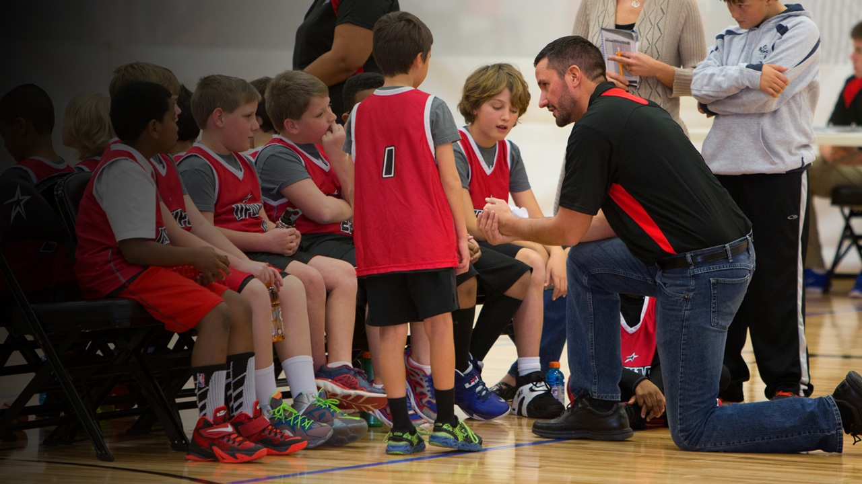

Slide 16


Slide 17

Playing in the game changes LIVES.

Slide 18
Too many are INSPIRED, but are not DOING anything.

Slide 19
Church needs an “EVERYONE PLAYS” policy.

Slide 20
Believers need
to have a LOVE for the game.

