Slide 3
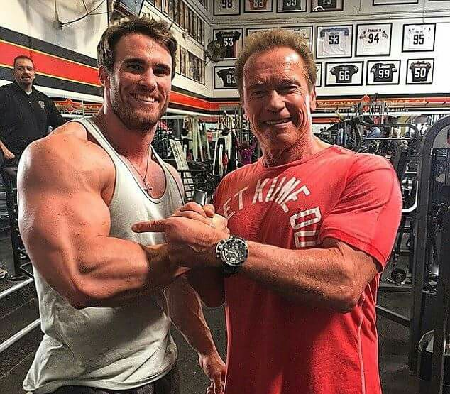

Slide 5
The local church needs to be INTERNALLY strong and EXTERNALLY focused.

Slide 6
Our calling is to EQUIP for ministry.

Slide 7
Our calling is to ENABLE people to use their gifts as salt and light.

Slide 8
EPHESIANS 2:8
For by grace you have been saved through faith, and that not of yourselves; it is the gift of God,

Slide 9
EPHESIANS 2:9
not of works, lest anyone should boast.

Slide 10
EPHESIANS 2:10
For we are His workmanship, created in Christ Jesus for good works, which God prepared beforehand that we should walk in them.

Slide 11
We all have God given PURPOSES in our lives.

Slide 12
We have to DISCOVER them not INVENT them.

Slide 13
We are to make a DIFFERENCE in the world.

Slide 14
EPHESIANS 4:11
And He Himself gave some to be apostles, some prophets, some evangelists, and some pastors and teachers,

Slide 15
EPHESIANS 4:12
for the equipping of the saints for the work of ministry, for the edifying of the body of Christ,

Slide 16
Preaching is to equip us for WORK.

Slide 17
2 TIMOTHY 1:17
but when he arrived in Rome, he sought me out very zealously and found me.

Slide 18
We are to be “ONE ANOTHER” people.

Slide 19
HEBREWS 10:24
And let us consider one another in order to stir up love and good works,

Slide 20
Spiritual gifts are to serve OTHERS not OURSELVES.

Slide 21
1 PETER 4:10
As each one has received a gift, minister it to one another, as good stewards of the manifold grace of God.

Slide 22
Wealth is given to us so we have the CAPACITY to do good.

Slide 23
1 TIMOTHY 6:17
Command those who are rich in this present age not to be haughty, nor to trust in uncertain riches but in the living God, who gives us richly all things to enjoy.

Slide 24
1 TIMOTHY 6:18
Let them do good, that they be rich in good works, ready to give, willing to share,

Slide 25
The Word is to EQUIP us.

Slide 26
The church body is to ENCOURAGE us.

Slide 27
Spiritual gifts are to ENABLE us.

