Slide 1


Slide 2

Luke 2:8
Now there were in the same country shepherds living out in the fields, keeping watch over their flock by night.

Slide 3
Luke 2:9
And behold, an angel of the Lord stood before them, and the glory of the Lord shone around them, and they were greatly afraid.

Slide 4
Luke 2:10
Then the angel said to them, “Do not be afraid, for behold, I bring you good tidings of great joy which will be to all people.

Slide 5
Luke 2:11
For there is born to you this day in the city of David a Savior, who is Christ the Lord.

Slide 6
Luke 2:12
And this will be the sign to you: You will find a Babe wrapped in swaddling cloths, lying in a manger.”

Slide 7
Luke 2:13
And suddenly there was with the angel a multitude of the heavenly host praising God and saying:

Slide 8
Luke 2:14
“Glory to God in the highest, And on earth peace, goodwill toward men!”

Slide 9
Luke 2:15
So it was, when the angels had gone away from them into heaven, that the shepherds said to one another, “Let us now go to Bethlehem and see this thing that has come to pass, which the Lord has made known to us.”

Slide 10
Luke 2:16
And they came with haste and found Mary and Joseph, and the Babe lying in a manger.

Slide 11
Luke 2:17
Now when they had seen Him, they made widely known the saying which was told them concerning this Child.

Slide 12
Luke 2:18
And all those who heard it marveled at those things which were told them by the shepherds.

Slide 13
Luke 2:19
But Mary kept all these things and pondered them in her heart.

Slide 14
Luke 2:20
Then the shepherds returned, glorifying and praising God for all the things that they had heard and seen, as it was told them.

Slide 15
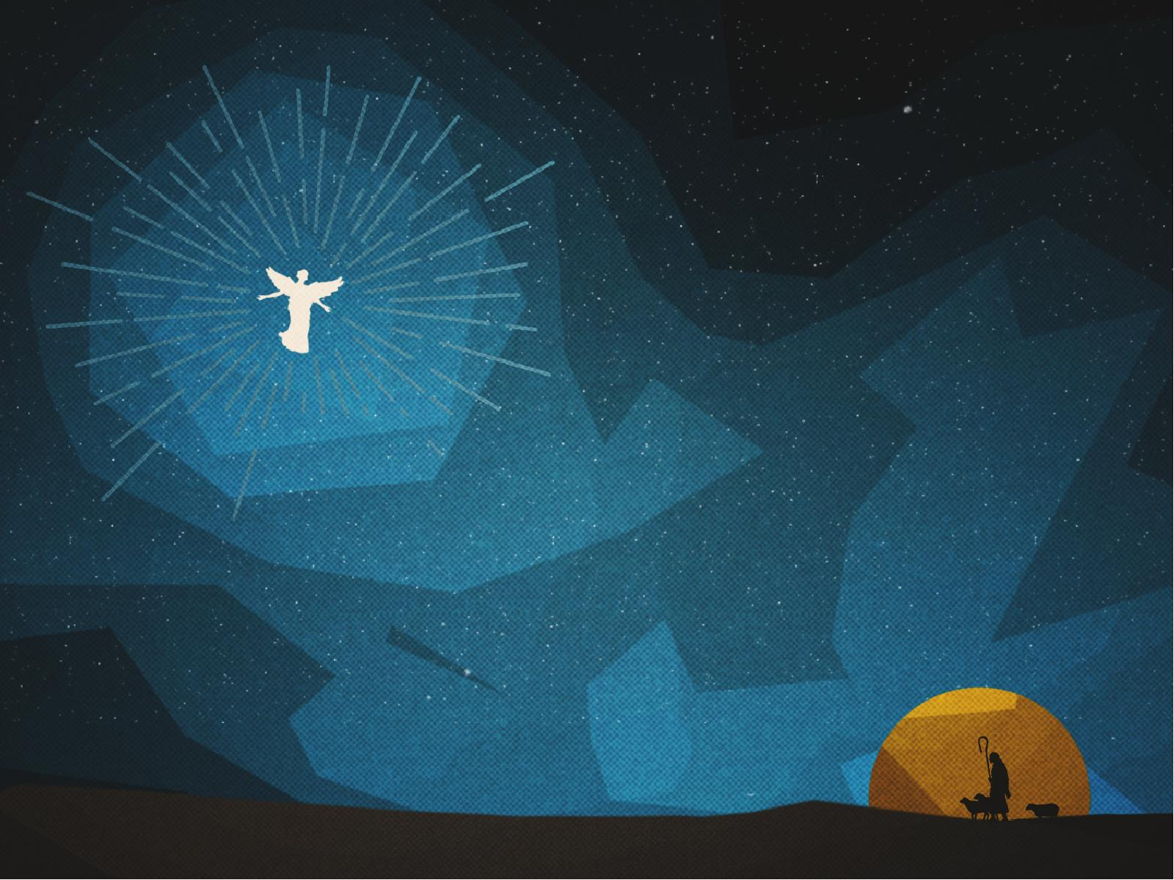
The shepherds were busy about their daily WORK.

Slide 16
God in
His perfect timing may INTERRUPT our lives.

Slide 17
When God speaks we must RESPOND
to Him.

Slide 18
God uses us to make the
Good News KNOWN.

Slide 19
As believers
we should be PRAISING
God as we go.

