Slide 4
Deuteronomy 29:29
“The secret things belong to
the Lord our God, but those things which are revealed
belong to us and to our
children forever, that we may
do all the words of this law.

Slide 5
Luke 2:1
And it came to pass in those days that a decree went out from Caesar Augustus that all the world should be registered.

Slide 6
Luke 2:2
This census first took
place while Quirinius was governing Syria.

Slide 7
Luke 2:3
So all went to be registered, everyone to his own city.

Slide 8
Luke 2:4
Joseph also went up from Galilee, out of the city of Nazareth, into Judea, to the city of David, which is called Bethlehem, because he was of the house and lineage of David,

Slide 9
Luke 2:5
to be registered with Mary, his betrothed wife, who was with child.

Slide 10
Luke 2:6
So it was, that while they were there, the days were completed for her to be delivered.

Slide 11
Luke 2:7
And she brought forth her firstborn Son, and wrapped Him in swaddling cloths, and laid Him in a manger, because there was no room for them in the inn.

Slide 12
Isaiah 55:8
“For My thoughts are not your thoughts, Nor are your ways My ways,” says the Lord.

Slide 13
Isaiah 55:9
“For as the heavens are higher than the earth, So are My ways higher than your ways, And My thoughts than your thoughts.

Slide 14
Isaiah 55:10
“For as the rain comes down, and the snow from heaven, And do not return there, But water the earth, And make it bring forth and bud, That it may give seed to the sower And bread to the eater,

Slide 15
Isaiah 55:11
So shall My word be that goes forth from My mouth; It shall not return to Me void, But it shall accomplish what I please, And it shall prosper in the thing for which I sent it.

Slide 16
External circumstances are SOMETHING but not EVERYTHING.

Slide 17
Internal growth is most important, but EXTERNAL things are necessary to GROW us.

Slide 18
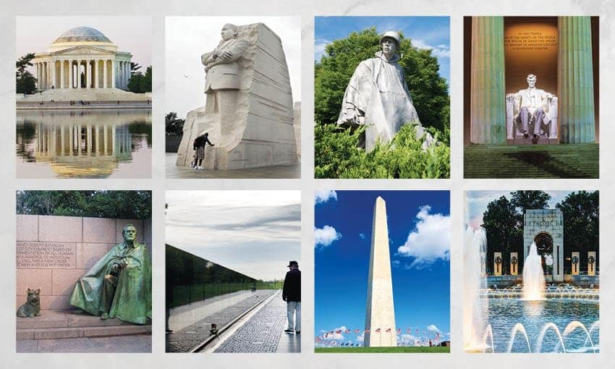

Slide 19
DIFFICULT circumstances cannot be the reason for
not OBEYING.

Slide 20
