Slide 1


Slide 2

Leviticus 27:30
And all the tithe of the land, whether of the seed of the land or of the fruit of the tree, is the Lord’s. It is holy to the Lord.

Slide 3
Leviticus 27:32
And concerning the tithe of the herd or the flock, of whatever passes under the rod, the tenth one shall be holy to the Lord.

Slide 4
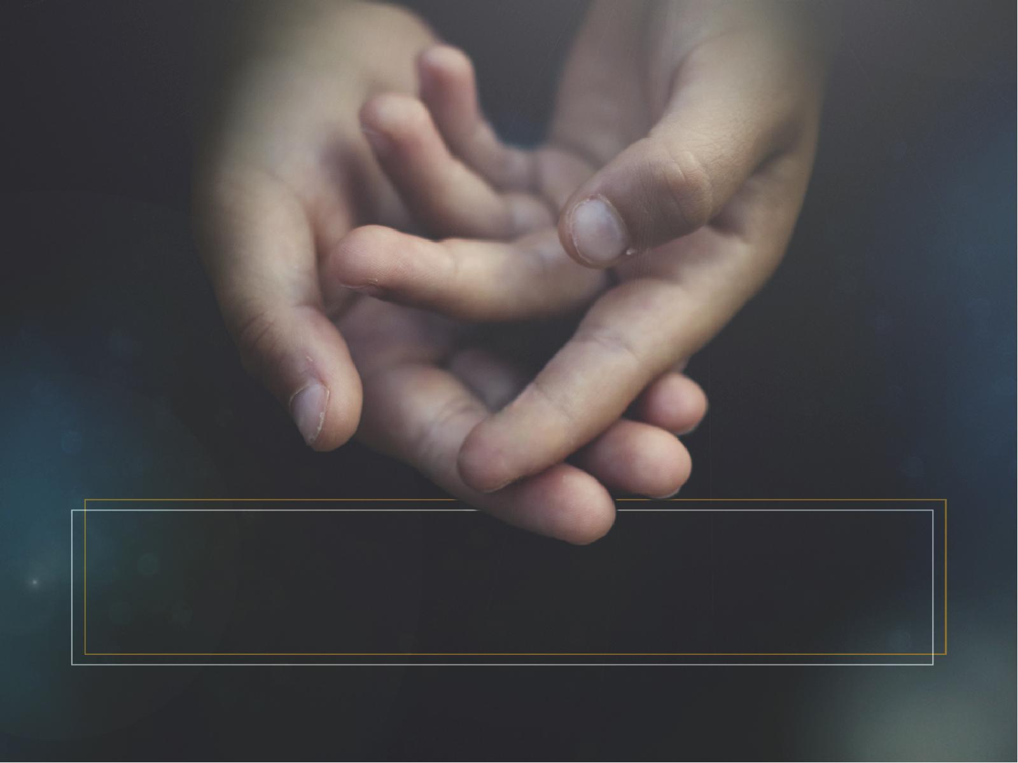
When we tithe, we are
putting God FIRST.

Slide 5
Malachi 1:8
And when you offer the blind as a sacrifice, Is it not evil? And when you offer the lame and sick, Is it not evil? Offer it then to your governor! Would he be pleased with you? Would he accept you favorably?” Says the Lord of hosts.

Slide 6
Malachi 1:14
“But cursed be the deceiver Who has in his flock a male, And takes a vow, But sacrifices to the Lord what is blemished— For I am a great King,” Says the Lord of hosts, “And My name is to be feared among the nations.

Slide 7
When we tithe, we prove God’s PROMISE.

Slide 8
Malachi 3:10
Bring all the tithes into the storehouse, That there may be food in My house, And try Me now in this,” Says the Lord of hosts, “If I will not open for you the windows of heaven And pour out for you such blessing That there will not be room enough to receive it.

Slide 9
When we tithe, God promises to PROVIDE.

Slide 10
Malachi 3:10
Bring all the tithes into the storehouse, That there may be food in My house, And try Me now in this,” Says the Lord of hosts, “If I will not open for you the windows of heaven And pour out for you such blessing That there will not be room enough to receive it.

Slide 11
Luke 19:17
And he said to him, ‘Well done, good servant; because you were faithful in a very little, have authority over ten cities.’

Slide 12
When we tithe,
we PRAISE God’s name.

Slide 13
Proverbs 3:9
Honor the Lord with your possessions, And with the firstfruits of all your increase.

Slide 14
When we tithe, we PERSONALIZE God’s Word.

Slide 15
When we tithe,
we practice GODLINESS.

Slide 16
When we tithe, we PARTICIPATE in God’s work.

Slide 17
We need to be PERCENTAGE givers.

Slide 18
We need to be
PRIORITY givers.

Slide 19
We need to be PROGRESSIVE givers.

