Slide 2
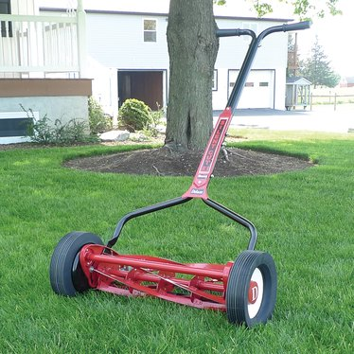

Slide 4
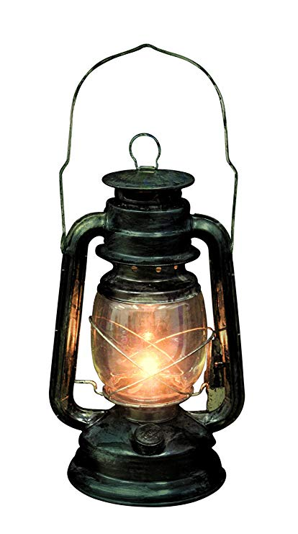

Slide 5
JOHN 5:1
After this there was a feast of the Jews, and Jesus went up to Jerusalem.

Slide 6
JOHN 5:2
Now there is in Jerusalem by the Sheep Gate a pool, which is called in Hebrew, Bethesda, having five porches.

Slide 7
JOHN 5:3
In these lay a great multitude of sick people, blind, lame, paralyzed, waiting for the moving of the water.

Slide 8
JOHN 5:4
For an angel went down at a certain time into the pool and stirred up the water; then whoever stepped in first, after the stirring of the water, was made well of whatever disease he had.

Slide 9
JOHN 5:5
Now a certain man was
there who had an infirmity thirty-eight years.

Slide 10
JOHN 5:6
When Jesus saw him lying there, and knew that he already had been in that condition a long time, He said to him, “Do you want to be made well?”

Slide 11
JOHN 5:7
The sick man answered Him, “Sir, I have no man to put me into the pool when the water is stirred up; but while I am coming, another steps down before me.”

Slide 12
JOHN 5:8
Jesus said to him, “Rise, take up your bed and walk.”

Slide 13
JOHN 5:9
And immediately the man was made well, took up his bed, and walked. And that day was the Sabbath.

Slide 14
Changes where we
spend our TIME.

Slide 15
Changes WHO we
spend our time with.

Slide 16
Changes what we
FOCUS on.

Slide 17
Changes HOW we
DO things.

