Slide 3
LUKE 15:1
Then all the tax collectors and the sinners drew near to Him to hear Him.

Slide 4
LUKE 15:2
And the Pharisees and scribes complained, saying, “This Man receives sinners and eats with them.”

Slide 5
LUKE 15:3
So He spoke this parable to them, saying:

Slide 6
LUKE 15:4
“What man of you, having a hundred sheep, if he loses one of them, does not leave the ninety-nine in the wilderness, and go after the one which is lost until he finds it?

Slide 7
LUKE 15:5
And when he has found it, he lays it on his shoulders, rejoicing.

Slide 8
LUKE 15:6
And when he comes home, he calls together his friends and neighbors, saying to them, ‘Rejoice with me, for I have found my sheep which was lost!’

Slide 9
LUKE 15:7
I say to you that likewise there will be more joy in heaven over one sinner who repents than over ninety-nine just persons who need no repentance.

Slide 11
LUKE 15:8
“Or what woman, having ten silver coins, if she loses one coin, does not light a lamp, sweep the house, and search carefully until she finds it?

Slide 12
LUKE 15:9
And when she has found it, she calls her friends and neighbors together, saying, ‘Rejoice with me, for I have found the piece which I lost!’

Slide 13
LUKE 15:10
Likewise, I say to you, there is joy in the presence of the angels of God over one sinner who repents.”

Slide 15
LUKE 15:11
Then He said: “A certain man had
two sons.

Slide 16
LUKE 15:12
And the younger of them said to his father, ‘Father, give me the portion of goods that falls to me.’ So he divided to them his livelihood.

Slide 17
LUKE 15:13
And not many days after, the younger son gathered all together, journeyed to a far country, and there wasted his possessions with prodigal living.

Slide 18
LUKE 15:14
But when he had spent all, there arose a severe famine in that land, and he began to be in want.

Slide 19
LUKE 15:15
Then he went and joined himself to a citizen of that country, and he sent him into his fields to feed swine.

Slide 20
LUKE 15:16
And he would gladly have filled his stomach with the pods that the swine ate, and no one gave him anything.

Slide 21
LUKE 15:17
“But when he came to himself, he said, ‘How many of my father’s hired servants have bread enough and to spare, and I perish with hunger!

Slide 22
LUKE 15:18
I will arise and go to my father, and will say to him, “Father, I have sinned against heaven and before you,

Slide 23
LUKE 15:19
and I am no longer worthy to be called your son. Make me like one of your hired servants.” ’

Slide 24
LUKE 15:20
“And he arose and came to his father. But when he was still a great way off, his father saw him and had compassion, and ran and fell on his neck and kissed him.

Slide 25
LUKE 15:21
And the son said to him, ‘Father, I have sinned against heaven and in your sight, and am no longer worthy to be called your son.’

Slide 26
LUKE 15:22
“But the father said to his servants, ‘Bring out the best robe and put it on him, and put a ring on his hand and sandals on his feet.

Slide 27
LUKE 15:23
And bring the fatted calf here and kill it, and let us eat and be merry;

Slide 28
LUKE 15:24
for this my son was dead and is alive again; he was lost and is found.’ And they began to be merry.

Slide 29
LUKE 15:25
“Now his older son was in the field. And as he came and drew near to the house, he heard music and dancing.

Slide 30
LUKE 15:26
So he called one of the servants and asked what these things meant.

Slide 31
LUKE 15:27
And he said to him, ‘Your brother has come, and because he has received him safe and sound, your father has killed the fatted calf.’

Slide 32
LUKE 15:28
“But he was angry and would not go in. Therefore his father came out and pleaded with him.

Slide 33
LUKE 15:29
So he answered and said to his father, ‘Lo, these many years I have been serving you; I never transgressed your commandment at any time; and yet you never gave me a young goat, that I might make merry with my friends.

Slide 34
LUKE 15:30
But as soon as this son of yours came, who has devoured your livelihood
with harlots, you killed the fatted
calf for him.’

Slide 35
LUKE 15:31
“And he said to him, ‘Son, you are always with me, and all that I have
is yours.

Slide 36
LUKE 15:32
It was right that we should make merry and be glad, for your brother was dead and is alive again, and was lost and is found.’ ”

Slide 38
EPHESIANS 3:4
by which, when you read, you may understand my knowledge in the mystery of Christ),

Slide 39
EPHESIANS 3:5
which in other ages was not made known to the sons of men, as it has now been revealed by the Spirit to His holy apostles and prophets:

Slide 40
EPHESIANS 3:6
that the Gentiles should be fellow heirs, of the same body, and partakers of His promise in Christ through
the gospel,

Slide 41
EPHESIANS 3:7
of which I became a minister according to the gift of the grace of God given to me by the effective working of His power.

Slide 42
EPHESIANS 3:8
To me, who am less than the least of all the saints, this grace was given, that I should preach among the Gentiles the unsearchable riches
of Christ,

Slide 43
EPHESIANS 3:9
and to make all see what is the fellowship of the mystery, which from the beginning of the ages has been hidden in God who created all things through Jesus Christ;

Slide 44
EPHESIANS 3:10
to the intent that now the manifold wisdom of God might be made known by the church to the principalities and powers in the heavenly places,

Slide 45
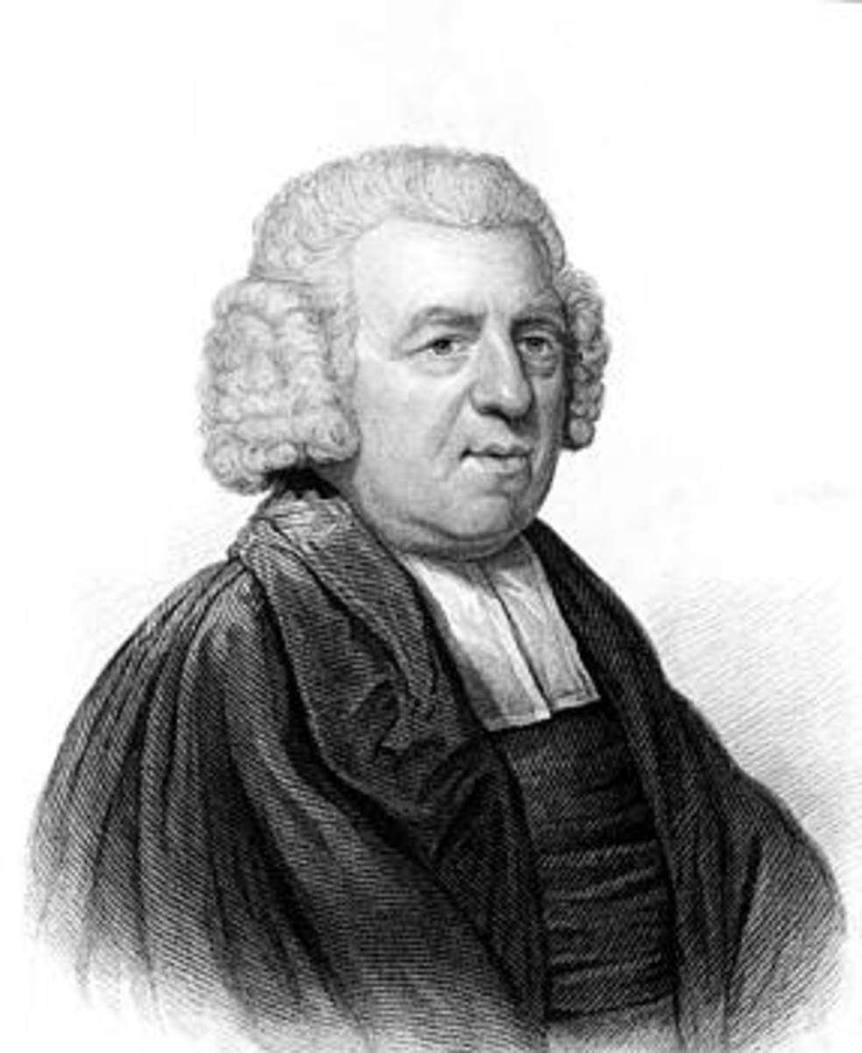

Slide 46
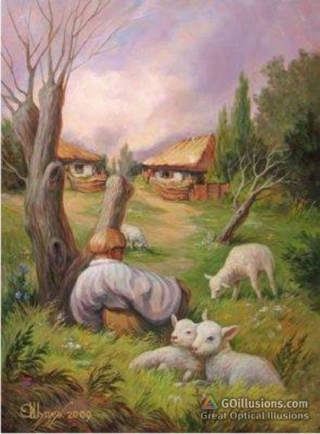

Slide 47
Church has to look OUT the window.

Slide 48
Church is not where we come to GET all our needs met.

Slide 49
Gospel is doctrines, etc., but it is also POURING our LIVES into others.

Slide 50
Need to be inwardly STRONG, but outwardly FOCUSED.

Slide 51
GET
_________
__________________________________________________________________________
Focused
________________________
__________________________________________________________________________________________________________________________________________________________________________________________________
PART 2
LUKE 15

