Slide 1
PART 1

Slide 2
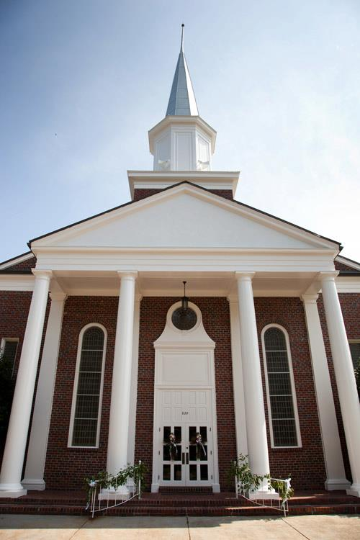
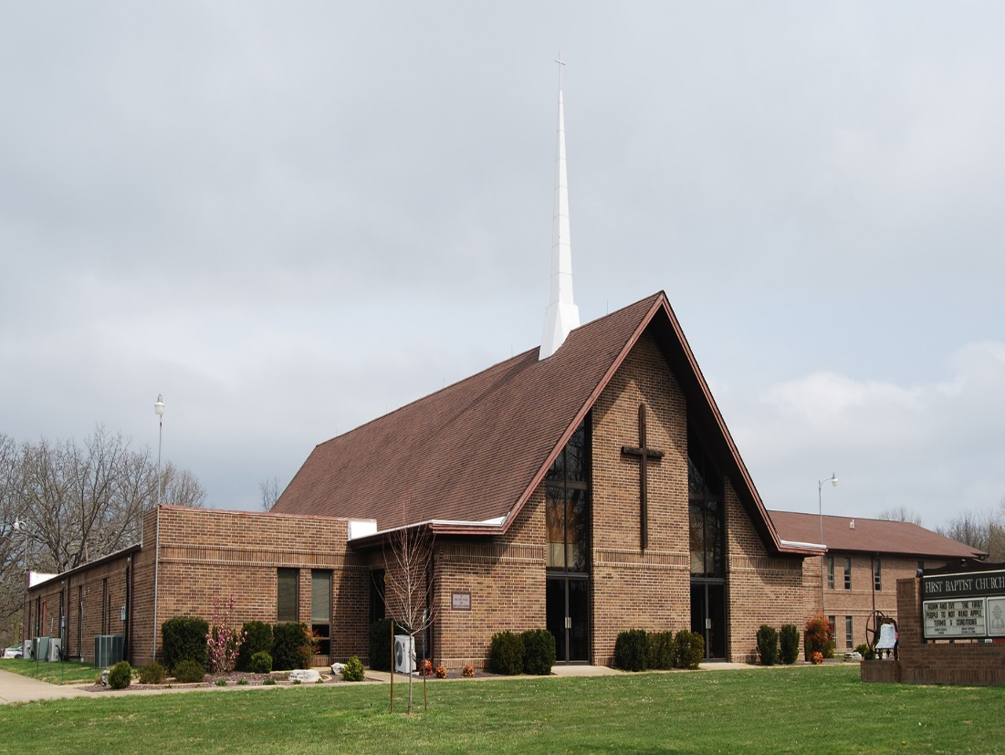

Slide 4
MATTHEW 4:23
And Jesus went about all Galilee, teaching in their synagogues, preaching the gospel of the kingdom, and healing all kinds of sickness and all kinds of disease among the people.

Slide 5
MATTHEW 9:35
Then Jesus went about all the cities and villages, teaching in their synagogues, preaching the gospel of the kingdom, and healing every sickness and every disease among
the people.

Slide 6
LUKE 6:36
Therefore be merciful, just as your Father also is merciful.

Slide 7
JOHN 13:34
A new commandment I give to you, that you love one another; as I have loved you, that you also love
one another.

Slide 8
JOHN 13:35
By this all will know that you are
My disciples, if you have love for
one another.”

Slide 9
LUKE 10:29
But he, wanting to justify himself, said to Jesus, “And who is my neighbor?”

Slide 10
LUKE 10:30
Then Jesus answered and said:
“A certain man went down from Jerusalem to Jericho, and fell among thieves, who stripped him of his clothing, wounded him, and departed, leaving him half dead.

Slide 11
LUKE 10:31
Now by chance a certain priest came down that road. And when he saw him, he passed by on the other side.

Slide 12
LUKE 10:32
Likewise a Levite, when he arrived at the place, came and looked, and passed by on the other side.

Slide 13
LUKE 10:33
But a certain Samaritan, as he journeyed, came where he was. And when he saw him, he had compassion.

Slide 14
LUKE 10:34
So he went to him and bandaged his wounds, pouring on oil and wine; and he set him on his own animal, brought him to an inn, and took care of him.

Slide 15
LUKE 10:35
On the next day, when he departed, he took out two denarii, gave them to the innkeeper, and said to him, ‘Take care of him; and whatever more you spend, when I come again, I will repay you.’

Slide 16
LUKE 10:36
So which of these three do you think was neighbor to him who fell among the thieves?”

Slide 17
LUKE 10:37
And he said, “He who showed mercy
on him.” Then Jesus said to him,
“Go and do likewise.”

Slide 18
Love was a NATURAL EXPRESSION of faith in Christ.

Slide 19
Ministered to PHYSICAL and SPIRITUAL needs.

Slide 20
Most think the primary purpose for church is WORSHIP and SUSTAINING the congregation.

Slide 21
LUKE 15:27
And he said to him, ‘Your brother has come, and because he has received him safe and sound, your father has killed the fatted calf.’

Slide 22
LUKE 15:28
“But he was angry and would not go in. Therefore his father came out and pleaded with him.

Slide 23
LUKE 15:29
So he answered and said to his father, ‘Lo, these many years I have been serving you; I never transgressed your commandment at any time; and yet you never gave me a young goat, that I might make merry with my friends.

Slide 24
LUKE 15:30
But as soon as this son of yours came, who has devoured your livelihood
with harlots, you killed the fatted
calf for him.’

Slide 25
LUKE 15:31
“And he said to him, ‘Son, you are always with me, and all that I have
is yours.

Slide 26
LUKE 15:32
It was right that we should make merry and be glad, for your brother was dead and is alive again, and was lost and is found.’ ”

Slide 27
LUKE 10:29
But he, wanting to justify himself, said to Jesus, “And who is my neighbor?”

Slide 28
LUKE 10:30
Then Jesus answered and said:
“A certain man went down from Jerusalem to Jericho, and fell among thieves, who stripped him of his clothing, wounded him, and departed, leaving him half dead.

Slide 29
LUKE 10:31
Now by chance a certain priest came down that road. And when he saw him, he passed by on the other side.

Slide 30
LUKE 10:32
Likewise a Levite, when he arrived at the place, came and looked, and passed by on the other side.

Slide 31
LUKE 10:33
But a certain Samaritan, as he journeyed, came where he was. And when he saw him, he had compassion.

Slide 32
LUKE 10:34
So he went to him and bandaged his wounds, pouring on oil and wine; and he set him on his own animal, brought him to an inn, and took care of him.

Slide 33
LUKE 10:35
On the next day, when he departed, he took out two denarii, gave them to the innkeeper, and said to him, ‘Take care of him; and whatever more you spend, when I come again, I will repay you.’

Slide 34
LUKE 10:36
So which of these three do you think was neighbor to him who fell among the thieves?”

Slide 35
LUKE 10:37
And he said, “He who showed mercy
on him.” Then Jesus said to him,
“Go and do likewise.”

Slide 36
We are called to extend GRACE to the UNWORTHY.

Slide 37
We are called to ACTION.

Slide 38
PART 1

