Slide 1


Slide 2
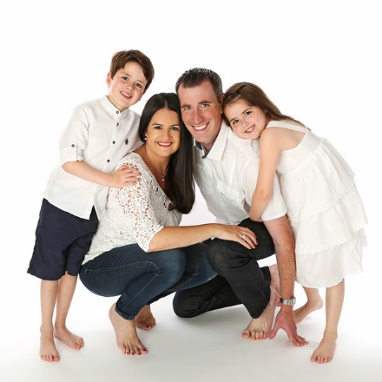

Slide 3
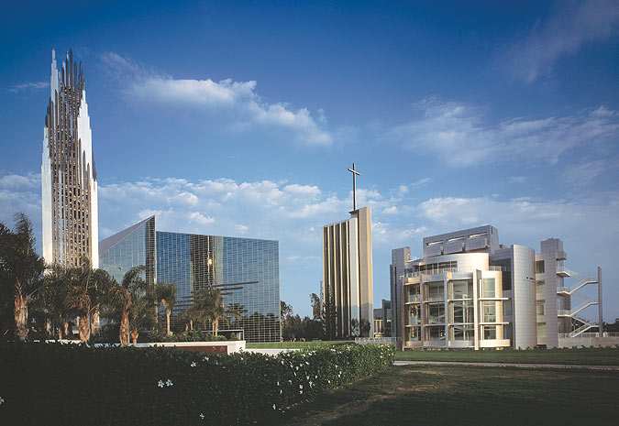

Slide 4

Matthew 9:35
Then Jesus went about all the cities and villages, teaching in their synagogues, preaching the gospel of the kingdom, and healing every sickness and every disease among the people.

Slide 5
Matthew 9:36
But when He saw the multitudes, He was moved with compassion for them, because they were weary and scattered, like sheep having no shepherd.

Slide 6
Jeremiah 23:1
“Woe to the shepherds who destroy and scatter the sheep of My pasture!” says the Lord.

Slide 7
Ezekiel 34:2
“Son of man, prophesy against the shepherds of Israel, prophesy and say to them, ‘Thus says the Lord God to the shepherds: “Woe to the shepherds of Israel who feed themselves! Should not the shepherds feed the flocks?

Slide 8
Matthew 9:37
Then He said to His disciples, “The harvest truly is plentiful, but the laborers are few.

Slide 9

Good news is
the harvest is READY
and PLENTIFUL.

Slide 10
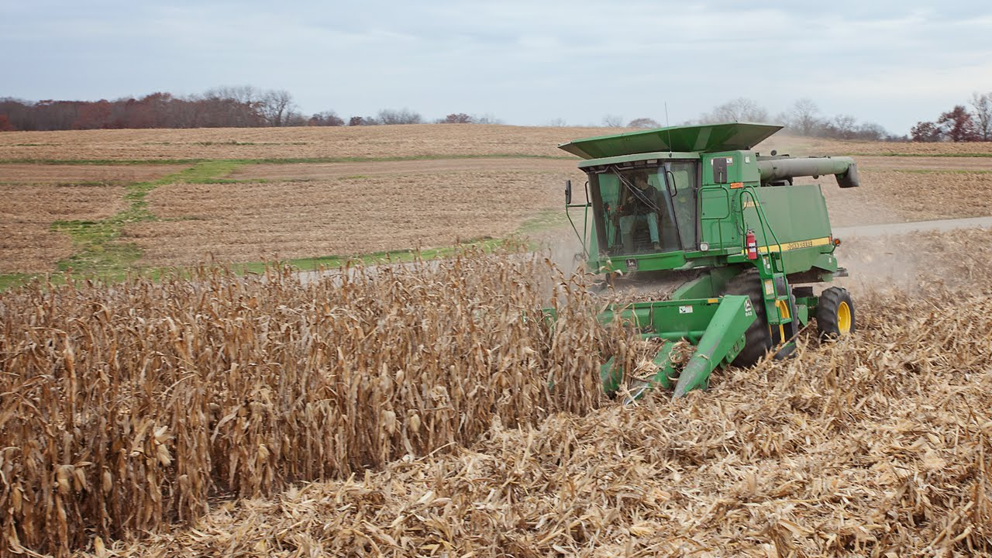

Slide 11
Matthew 9:38
Therefore pray the Lord of the harvest to send out laborers into His harvest.”

Slide 12
Prayer is the REMEDY.

Slide 13
Those we are BURDENED
for we should PRAY for.

Slide 14
Luke 6:12
Now it came to pass in those days that He went out to the mountain to pray, and continued all night in prayer
to God.

Slide 15
It’s God’s HARVEST and
for His GLORY.

Slide 16
Luke 6:8
Also I heard the voice of the Lord, saying: “Whom shall I send, And who will go for Us?” Then I said, “Here am I! Send me.”

