Slide 1
AMERICAN
GREED
Luke 12:13-21

Slide 2
Luke 11:39
Then the Lord said to him, “Now you Pharisees make the outside of the cup and dish clean, but your inward part is full of greed and wickedness.

Slide 3
Luke 12:13
Then one from the crowd said to Him, “Teacher, tell my brother to divide the inheritance with me.”

Slide 4
Luke 12:14
But He said to him, “Man, who made Me a judge or an arbitrator over you?”

Slide 5
Luke 12:15
And He said to them, “Take heed and beware of covetousness, for one’s life does not consist in the abundance of the things he possesses.”

Slide 6
Luke 12:16
Then He spoke a parable to them, saying: “The ground of a certain rich man yielded plentifully.

Slide 7
Luke 12:17
And he thought within himself, saying, ‘What shall I do, since I have no room to store my crops?’

Slide 8
Luke 12:18
So he said, ‘I will do this: I will pull down my barns and build greater, and there I will store all my crops and my goods.

Slide 9
Luke 12:19
And I will say to my soul, “Soul, you have many goods laid up for many years; take your ease; eat, drink, and be merry.”

Slide 10
Luke 12:20
But God said to him, ‘Fool! This night your soul will be required of you; then whose will those things be which you have provided?’

Slide 11
Luke 12:21
“So is he who lays up treasure for himself, and is not rich toward God.”

Slide 12
Greed is an
EXPRESSION of our
sinful human nature.

Slide 13
Greed leads to
OTHER serious sins.

Slide 14
Greed is a
“ME FIRST” attitude.

Slide 15
Greed is never
SATISFIED.

Slide 16
Greed is always willing
to do WRONG.

Slide 17
Greed doesn’t
CARE who it hurts.

Slide 18
Greed can have ETERNAL consequences.

Slide 19
Hebrews 13:5
Let your conduct be without covetousness; be content with such things as you have. For He Himself has said, “I will never leave you nor forsake you.”

Slide 20
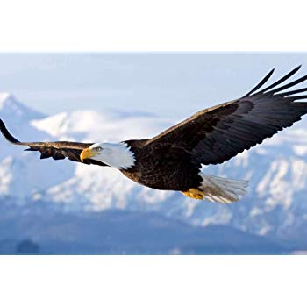

Slide 22
AMERICAN
GREED
Luke 12:13-21

